Slide 1
MECHANICAL PLAQUE CONTROL

Slide 2
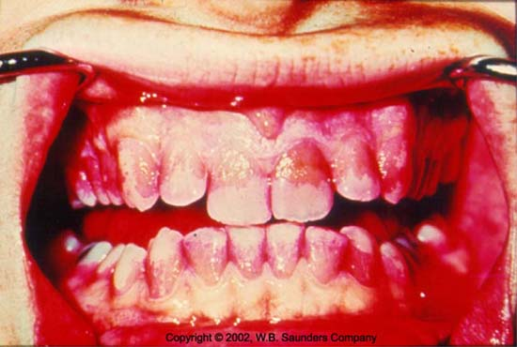
Dental plaque can be defined as the soft deposits that form the biofilm adhering to the the surface or other hard surfaces in the oral cavity, including removable and fixed restorations.

Slide 3
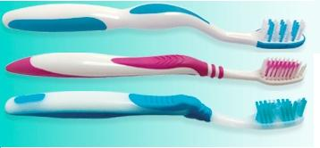
Plaque control is the regular removal of plaque and the prevention of its accumulation on the teeth and adjacent gingival areas. Besides it also deals with prevention of calculus formation.
Excellent long-term personal oral hygiene can modify both the quantity and composition of subgingival plaque, without further loss of attachment (Dahlen et al. 1992).

Slide 4
Advantages of plaque control
Prevention of gingivitis on buccal and lingual surfaces by daily toothbrushing has been confirmed in several studies ( Arno et al. 1958, Loe et al. 1965, Lindhe & Koch 1967, Ainamo 1971, Ainamo 1979).
Caries prevention by toothbrushing atleast on buccal and lingual surfaces

Slide 5
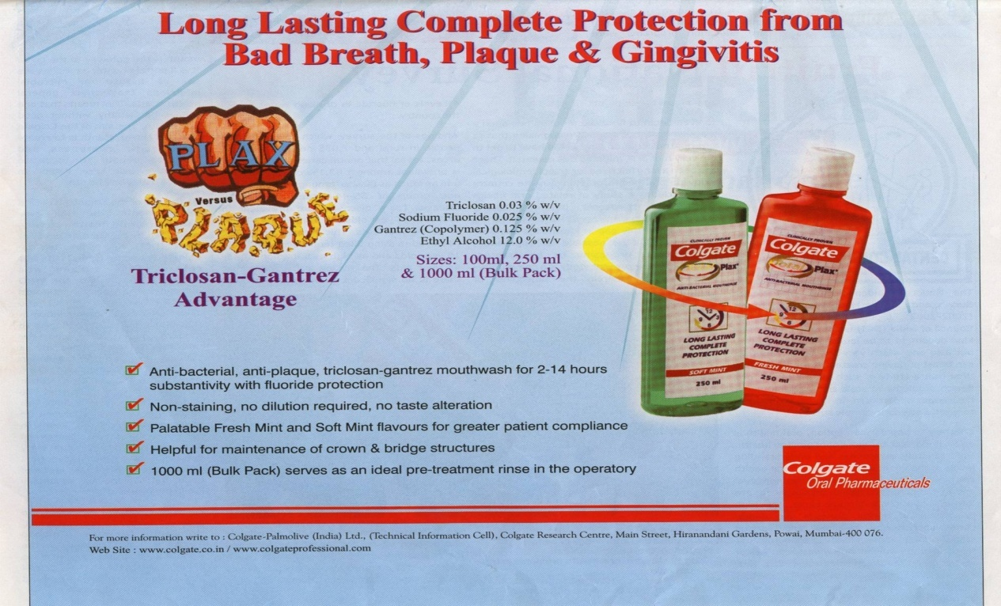
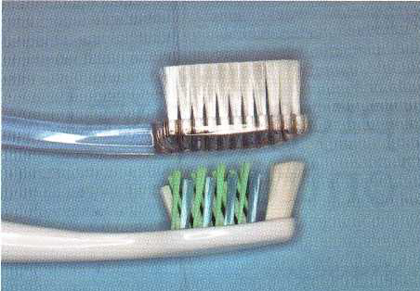
Methods of plaque control
Mechanical
Chemical

Slide 6
Advantages of mechanical plaque control
There was no appreciable effect of chlorhexidene on removal of plaque, from interproximal surfaces as compared to mechanical aids, probably because of the following reasons:-
Some amount of the solution (25-30%) which is bound with the rinse with distilled water (Loe and Schiott et al 1970) followed after topical application.
Probably 0.2% concentration will be diluted by the action of salivary glycoproteins and the required amount of the solution does not reach the proximal surfaces of the cationic chlorhexidene to act, or penetrate the plaque. (Comparative study of the efficacy of different interproximal aids -Mechanical & Chemical, Hemaet al,, ISP Bulletin, Vol.15, No.2, 1991)
Mechanical methods remove the organic pellicle, thus increasing the efficacy of chlorhexidene

Slide 7
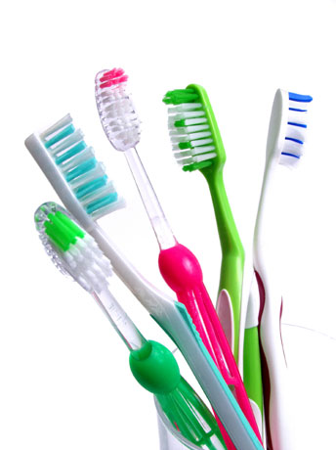
Mechanical plaque control
1) Toothbrushes
a) Manual toothbrush
b) Electrical toothbrush
2) Interdental Aids
a) Dental floss
b) Triangular tooth picks
- Hand held triangular toothpicks
- Proxapic
c) Interdental brushes
- Proxabrush system
- Bottle brushes
- Single tufted brushes
d) Yarn
e) Superfloss
f) Perio Aid

Slide 8
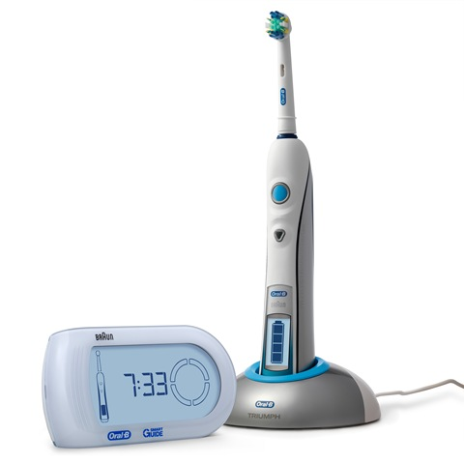
3) Aids for gingival stimulation
a) Rubber tip stimulator
b) Balsa wood edge
4) Others
a) Water irrigation devices
b) Gauze strips
5) Aids for edentulous or partially edentulous
patients
a) Denture & clasp brushes

Slide 9

Toothbrushes
Appeared first in China in 1600 B.C.
First patented in America in 1857
Bristles were earlier derived from hog
the natural bristles fray, break, soften and lose elasticity quickly
Nylon bristles first made their appearance during the second world war.
Nowadays nylon bristles are mostly used.
Round bristle ends cause fewer scratches than the flat cut bristles with sharp ends

Slide 10
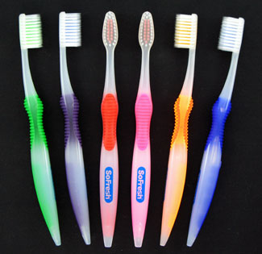
Diameter of the common bristles
- 0.007(0.2 mm) for soft brushes
-0.012(0.3 mm) for medium brushes
-0.014(0.4 mm) for hard brushes
According to ADA specifications the toothbrush bristles should be
-25.4 to 31.8 mm (1 to 1 ¼ inches) in length
- 7.9 to 9.5 mm (5/16 to 3/8 inch) in width
-5 – 12 tufts per Row

Slide 11
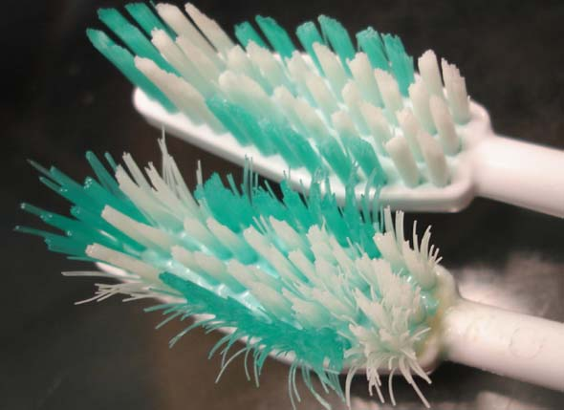
The efficacy of brushing with regard to plaque removal is dictated by three main factors:
(1) The design of the brush,
(2) The skill of the individual using the brush, and
(3) The frequency and duration of use (Frandsen 1986).
Toothbrushes need to be replaced every 3 months (ISP Bulletin, Vol. 15, No.1, 1991)

Slide 12
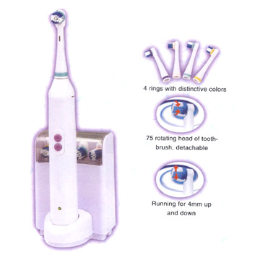
Electrically powered brushes
Introduced in 1939
Have oscillating and rotating motions
Use low frequency acoustic energy to enhance cleaning ability
Patient acceptance is good
The vibrations have also been shown to interfere with bacterial adherence to oral surfaces

Slide 13
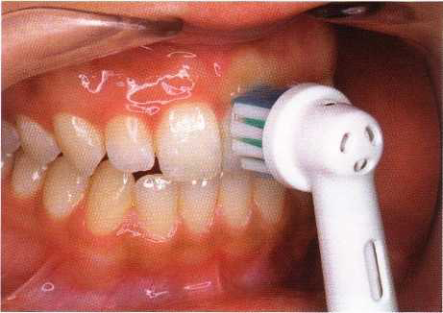
Rotary electric toothbrush is equally effective for plaque removal and control of gingival inflammation as conventional hygiene methods for patients in periodontal maintenance.( Source: Journal of Periodontology, 1989 Jul, R. L. Boyd, P. Murray and P. B. Robertson)

Slide 14
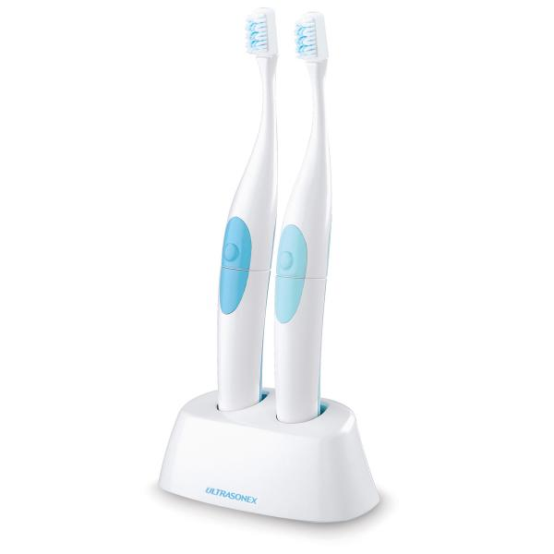
Sonic and ultrasonic toothbrushes
produce high frequency vibrations (1.6 MHz)
leads to the phenomenon of cavitation and acoustic micro streaming.
aids in stain removal as well as disruption of the bacterial cell wall (bactericidal).

Slide 15
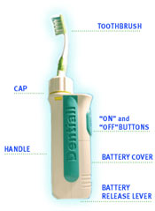
In a study subjects using the sonic toothbrush exhibited improved supragingival plaque removal compared to subjects using the manual brush; however,.( Source: Journal of Periodontology 1994 Jul : Bradley D. Johnson, Christopher Mclnnes)

Slide 16
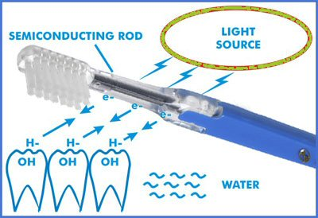
Ionic toothbrushes
Change the surface energy of a tooth by an influx of positively charged ions
Plaque with a similar charge is repelled from the tooth surface and is attracted by the negatively charged bristles of the toothbrush.

Slide 17
TOOTHBRUSHING METHODS
The toothbrushing methods have been categorized by Greene J.C. (1966) as:
Roll : Roll method, Modified Stillman technique
Vibratory : Stillman, Charters and Bass techniques
Circular : Fones technique
Vertical : Leonard Technique
Horizontal : Scrub technique
Physiological : Smiths method

Slide 18
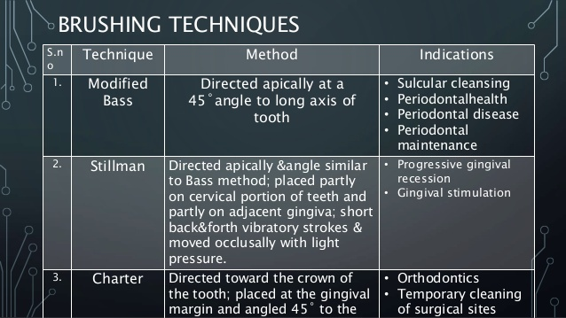

Slide 19
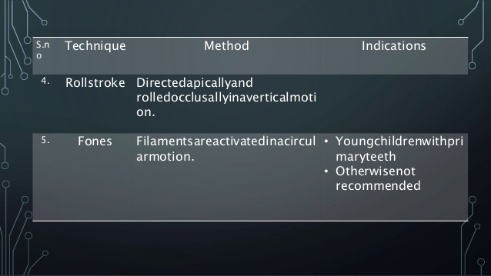

Slide 20
BASS TECHNIQUE/ SULCUS CLEANING METHOD
Indications
For all patients for dental biofilm removal adjacent to and directly beneath the gingival margin.
For open interproximal areas, cervical areas beneath the height of contour of the enamel, and exposed root surfaces.
For adaptation to abutment teeth, under the gingival border of a fixed partial denture and orthodontic appliances

Slide 21
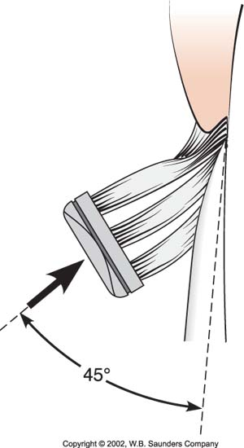
Procedure
Place the bristles at the gingival
margin, pointing at a 45 degree
angle to the long axis of the teeth.
Exert gentle vibratory pressure, using short, back and forth motions without dislodging the tips of the bristles
Complete several strokes in the same position.
Lift the brush, move it to the adjacent teeth, and repeat the process.

Slide 22
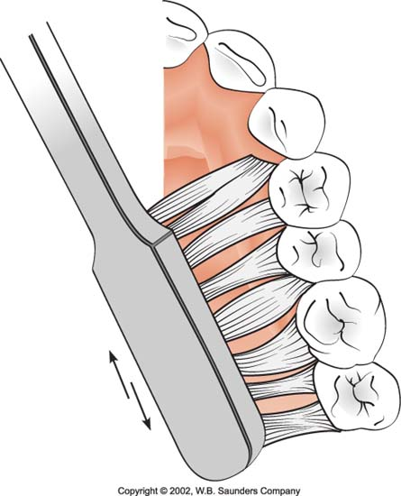
After completing the maxillary arch,
move the brush to the mandibular
arch, and brush in the same organized
way.
The brush should be turned vertically to press the end of the brush into the gingival sulcus area.
Brush the occlusal surfaces of three or four teeth at a time by pressing the bristles firmly into the pits and fissures and brushing with several short back and forth strokes

Slide 23
Problems
An overeager brusher may scrub vigorously causing injury to the gingival margin.
Dexterity requirements may be too high.
Rolling stroke may precede the sulcular brushing. The two methods should be performed separately.

Slide 24
STILLMAN METHOD
Designed for massage and stimulation, and cleaning the cervical areas.
The brush ends placed partly on the gingiva and partly on the cervical areas and directly slightly apically. Pressure is applied to effect a blanching.
The handle is given a slight rotary motion, and the brush ends are maintained in position on the tooth surface.
After several applications, the brush is moved to the adjacent tooth.

Slide 25
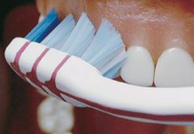
MODIFIED STILLMAN’S TECHNIQUE
Indications
General application for cleaning tooth surfaces and massage of gingiva.
Recommended for cleaning in areas with progressing gingival recession and root exposure to prevent abrasive tissue destruction.

Slide 26
Technique
A soft toothbrush is indicated for this technique
⇩
Bristles are pointed apically with an oblique angle to long axis of tooth.
⇩
Bristles are positioned partly on the cervical aspects of tooth and partly on adjacent gingiva.
⇩
Bristles are activated by short back and forth motions and simultaneously moved in a coronal direction. Following 20 strokes, the procedure is repeated systematically on adjacent teeth.

Slide 27
Problems
Tissue laceration can occur. Light pressure is needed
Patient may try to move the brush into the rolling stroke too quickly, and the vibratory aspect may be ineffective for biofilm removal at the gingival margin.

Slide 28
MODIFIED BASS TECHNIQUE
The brush is positioned similar to the BASS TECHNIQUE,after applying small movement in antero-posterior direction,the head of the brush is rotated applying a movement in occlusal direction.
Combination of the BASS & the MODIFIED STILL MAN TECHNIQUE.

Slide 29
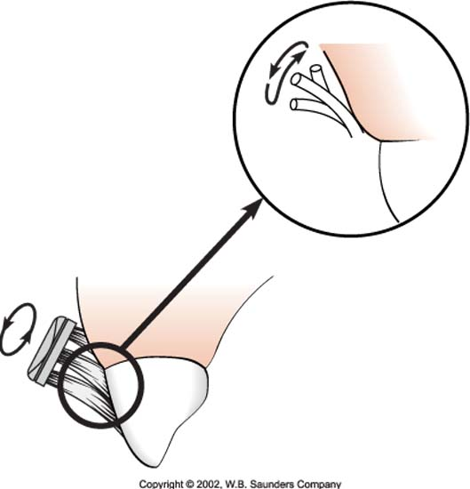
CHARTERS METHOD
Indications
Open interdental spaces with missing papilla and exposed root surfaces.
F.P.D. or orthodontic appliances.
For patients who have had periodontal surgery.
Patients with moderate gingival recession particularly interproximally.
Massage and stimulation for marginal and interdental gingiva.

Slide 30
Technique
A soft/medium multitufted toothbrush is indicated for this technique. Bristles are placed at an angle of 45 degrees to the gingiva with the bristles directed coronally. The bristles are activated by mild vibratory strokes with the bristle ends lying interproximally.

Slide 31
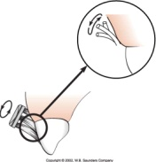
Problems
Brush ends do not engage the gingival
sulcus to remove subgingival bacterial accumulations
In some areas, the correct brush placement is limited or impossible; therefore, modifications become necessary, consequently adding to the complexity of the procedure.
Requirements in digital dexterity are high.

Slide 32
THE ROLL TECHNIQUE
Indication
Children and adult patients with limited dexterity.
Cleaning gingiva and removal of plaque, material alba and food debris from the teeth without emphasis on gingival sulcus.
For general cleaning in conjunction with the use of vibratory technique
Useful for preparatory instruction for modified Stillman’s technique.

Slide 33
Technique
The bristles are placed at a 45 degree and lightly rolled across the tooth surface towards the occlusal surfaces. It requires some flexibility around the wrist.
Problems
Laceration the alveolar mucosa.
Tendency to use quick, sweeping strokes resulting in no brushing for the cervical third of the tooth.
Filament tips directed into the gingiva may produce punctuate lesions.

Slide 34
FONES METHOD/CIRCULAR SCRUB METHOD
Indication
young children who want to do their own brushing
Technique
With the teeth closed, place the brush inside the cheek with the brush tips lightly contacting the gingiva over the last maxillary molar.
Use a fast, wide, circular motion that sweeps from maxillary gingiva to the mandibular gingiva with very little pressure

Slide 35
Problems
Possible trauma to gingiva.
Interdental areas are not cleaned properly
Detrimental for adults especially who use brush vigorously.

Slide 36
VERTICAL METHODS- LEONARDS METHOD
Leonard described a vertical stroke in which maxillary and mandibular teeth were brushed separately.
Technique
With the teeth edge to edge, place the brush with the filaments at right angles to the long axes of the teeth.
Brush vigorously, without great pressure, with a stroke that is mostly up and down on the tooth surfaces,
The upper and lower teeth are not brushed in the same series of strokes. The teeth are placed edge to edge to keep the brush from slipping over the occlusal or incisal surfaces.

Slide 37
HORIZONTAL METHOD
Horizontal or crosswise brushing is generally recognized as detrimental. An unlimited sweep with a horizontal scrubbing motion bears pressure on teeth that are most facially inclined or prominent. As the interdental areas are not touched by this method, dental biofilm can remain undisturbed on proximal surfaces.

Slide 38
PHYSIOLOGIC: SMITH’S METHOD
Technique
A soft brush with small tufts of fine bristles arranged in four parallel rows and trimmed to an even length was used in a brushing stroke.
Bristles are pointed incisally or occlusally and then along and over the tooth surfaces and gingiva.
The motion is gentle sweeping from incisal or occlusal surfaces over to the facial surfaces and progressing toward and over the gingiva. This method is an attempt to duplicate natures self cleansing

Slide 39
SCRUB BRUSH TECHNIQUE
This method of brushing requires vigorous horizontal, vertical and circular motions with some vibratory motions for certain areas.

Slide 40
Frequency and effectiveness of toothbrushing
Studies suggest that disease is more related to quality of cleaning than to its frequency (Bjertness 1991).
Brushing plus interdental cleaning once daily and also even every second day prevented the development of gingivitis (Lang et al. 1973).
The best estimate of actual mean tooth brushing time for adults seems to range between 30 and 60 seconds.
The duration of brushing should be 3 mins

Slide 41
INTERDENTAL AIDS
Interdental plaque removal is crucial because the majority of dental and periodontal disease originates in interproximal areas.
Dental floss and interdental cleaners like wooden or plastic tips and interdental brushes are the commonly recommended interdental aids

Slide 42
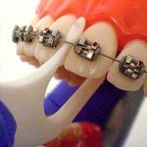
Factors influencing selection of an interdental cleaning aid
Type of gingival embrasure
Alignment of teeth
Contact areas
Open furcation areas
Fixed prosthesis/ orthodontic appliances

Slide 43
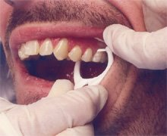
DENTAL FLOSS
Most widely recommended tool for removing plaque from proximal tooth surfaces
When properly used, flossing effectively removes up to 80% of proximal plaque.
Even subgingival plaque can be removed, since dental floss can be introduced 2-3.5 mm below the tip of the papilla (Waerhaug 1981).

Slide 44
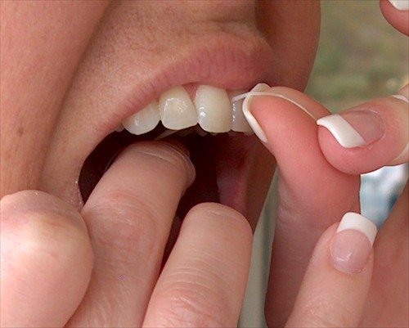
Dental floss is available as:
Multifilament- Twisted/Non twisted
Bonded/Non bonded
Thick/Thin
Waxed/Non waxed

Slide 45
Materials
1) Silk-Historically floss was made of silk fibers loosely twisted together to form a strand and waxed.
2) Nylon-Nylon multifilaments, waxed or unwaxed, have been widely used in circular (floss) or flat (tape) form.
3) Expanded PTFE- Plastic monofilament polytetrafluoroethylene with wax

Slide 46
Features of Waxed or Expanded PTFE
Smooth surface provided by the wax covering helps to prevent trauma.
Slides through contact area with ease.
Monofilament type resists breakage or shredding when passed over irregular tooth surface, restoration, or calculus deposit.
Wax gives strength and durability during application.

Slide 47
Features of unwaxed floss
Squeaking sound effect when floss moves over a clean tooth surface may provide a motivation for patient thoroughness.
Unwaxed floss, which frays when rubbed over an irregular tooth surface, rough surface of a restoration, or calculus deposit, might cause the patient to become aggravated and discouraged, thereby resulting in lost motivation to floss regularly.
Floss that is tightly wound around fingers tends to cut, hurt and cause discomfort. This problem is not usually as evident with wide dental tape or with waxed floss or tape.

Slide 48
Features of Unwaxed
Thinner floss may be helpful when contact areas are tight
Pressure against a tooth surface spreads the nylon fibres and gives a wider surface for biofilm removal.
Sharper thin edge requires special attention to prevent injury to the gingival tissue when guiding the floss through a tight contact area or when moving floss on the tooth surface in an apical direction.

Slide 49
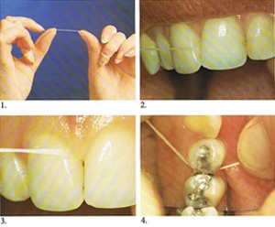
Methods of Using Dental Floss
Spool method used by and teenagers with mental maturity
45 cms (18 inches) long floss is taken and 10 cms (4 inches) from each end is wound around the middle finger of the each hand.
In both the hands the last three fingers are folded and closed and both the hands are moved apart.
In this way 5 cms (2 inches) long floss is held between the index fingers of both the hands.

Slide 50
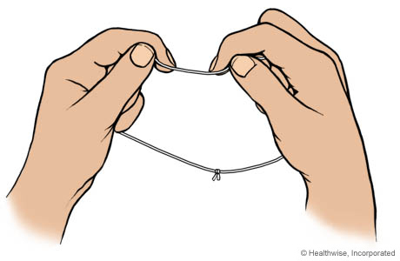
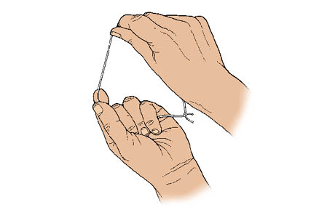
Methods of Using Dental Floss
Circle or loop method used by handicapped and mentally retarded patients
Loop or circle of the floss is made from 45 cms (18 inches) long pieces and both ends are tied securely with the three knots.
All the fingers except the thumbs of both the hands are placed within the loop and the floss is held by both the hands having about 2.5 cm (1 inch) floss between fingers of both the hands

Slide 51
TUFTED FLOSS
Tufted floss is also called a floss/yarn combination. Regular dental floss is alternated with a thickened tufted portion. It is available in two variations:
1)Single, precut lengths- Super Floss
2) Roll- NUFloss

Slide 52
Indications
Biofilm removal from tooth surfaces adjacent to wide embrasures where interdental papilla has been lost.
Biofilm removal from mesial and distal abutments and under pontic of a fixed partial denture or orthodontic appliance. The stiff end of “Superfloss” is inserted; “NUFloss” is threaded using a floss holder.

Slide 53
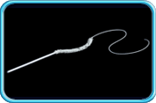
Super Floss
Available in a 2 foot length
Composed of a 5 inch tufted portion adjacent to a 3 inch stiffened end for inserting under a fixed appliance or orthodontic attachment

Slide 54
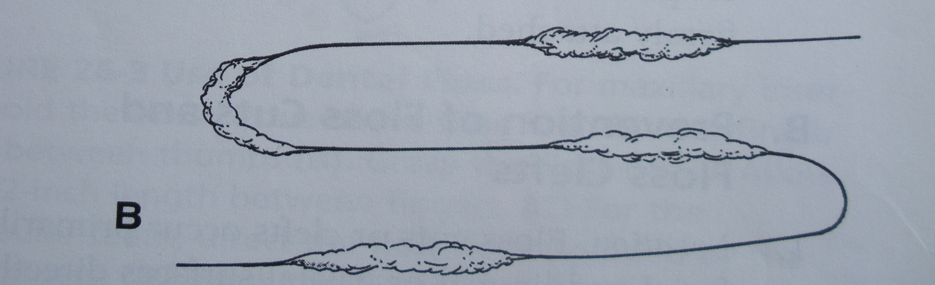
NUFloss
Available in a roll
Has a cutting device to allow selection of a preferred length
The tufted portions (about 1 inch long) alternate with the plain floss (about 1 ½ inches long).

Slide 55
WOODEN AND RUBBER TIPS
Ideal substitute for the dental floss in type 2 gingival embrasures
Manufactured from orange wood
Triangular in cross section.
Access is easier from buccal surfaces for those tips without handles, primarily in the anterior and bicuspid areas.
Other materials used are rubber tips and plastic tips. They can be rinsed and reused

Slide 56
Technique
Soft, triangular wooden picks or plastic alternatives are placed in the interdental spaces in such a way that the base of the triangle rests on the gingiva and the sides are in contact with the proximal tooth surfaces. The pick is then repeatedly moved in and out of the embrasure.
Rubber tips should be placed into the embrasure space and used in a circular motion. They can be applied to the interproximal spaces and other defects throughout the mouth and are easily adaptable to lingual surfaces.

Slide 57
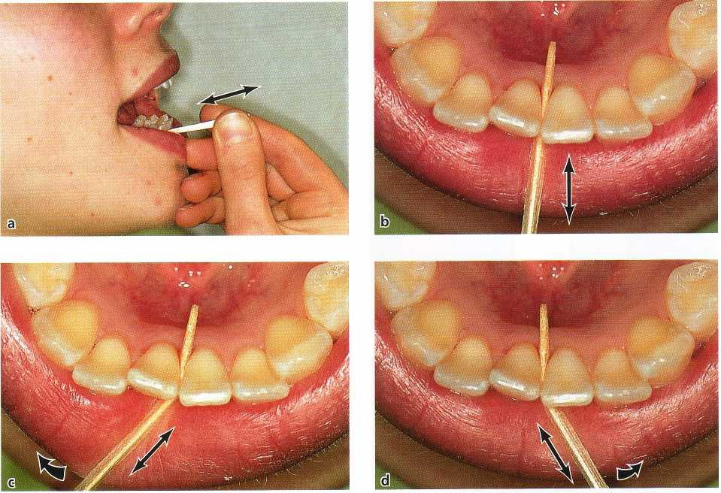

Slide 58
INTERDENTAL BRUSHES
In case of type 2 gingival embrasures interdental brushes have proven to be the best choice. Their design is similar to that of a bottle brush, which may be mounted on to specifically designed handles, to make its use in the posterior areas of the mouth more comfortable. They may also be used to clean furcation area and root concavities.

Slide 59
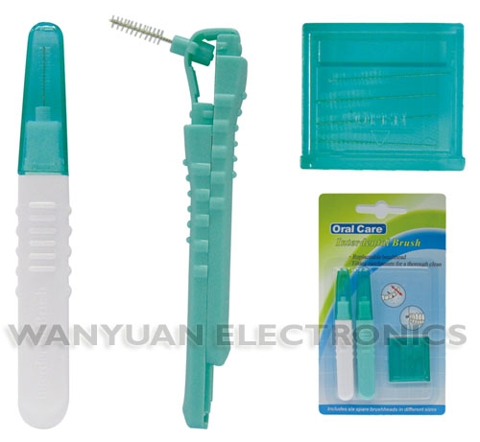
Types of interdental brushes
1) Small insert brushes with reusable handle
Soft nylon filaments twisted into a fine stainless steel wire for insertion into a handle with an angulated shank.
The small tapered or cylinderic brush heads of varying sizes approximately 12 to 15 mm in length, with a diameter of 3 to 5 mm.

Slide 60
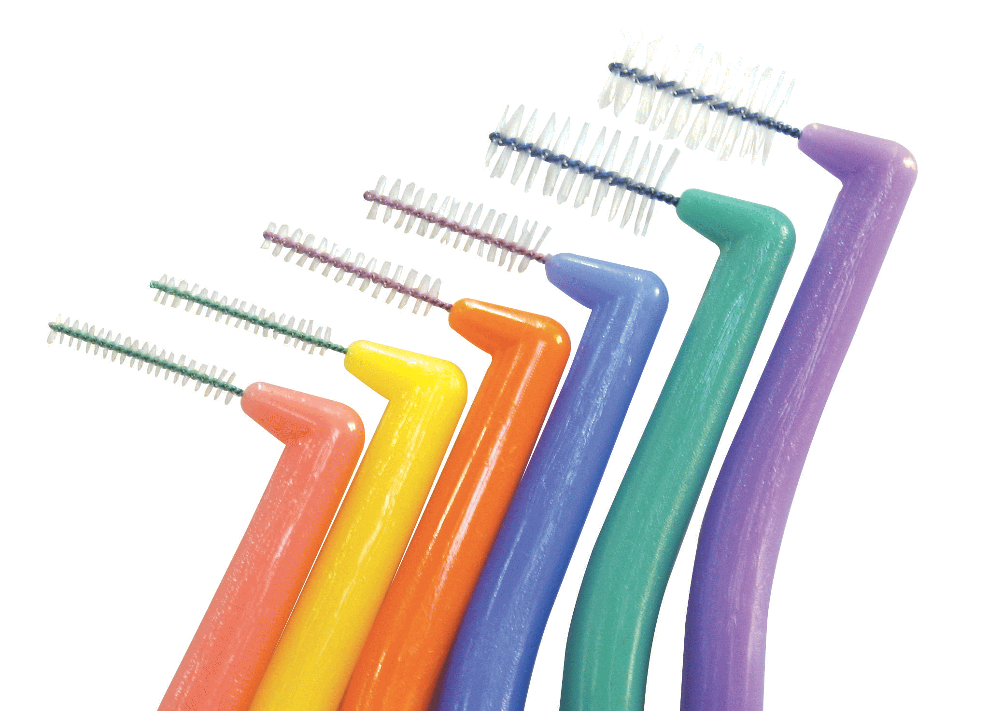
Types of interdental brushes
2) Brush with a wire handle
  Soft nylon filaments twisted into a fine stainless steel wire. The wire is continuous with the handle, which is approximately 35 to 45 mm (1 ½ to 1 ¾ inches) in length.
  The filaments form a narrow brush approximately 30 to 35 mm (1 ¼ to 1 ½ inches) in length and 5 to 8 mm (1/4 to 5/16 inches) in diameter.

Slide 61
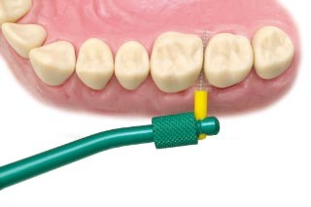
Indications
When sufficient space is available for the insertion of an interdental brush without excess force, the following applications are indicated:
A) For the removal of Dental Biofilm and debris
Proximal tooth surfaces adjacent to open embrasures, orthodontic appliances, fixed prostheses, dental implants, periodontal splints and space maintainers, and other areas that are hard to reach with a regular toothbrush.
Concave proximal surfaces where dental floss and other interdental aids cannot reach and cleans.
Exposed Class IV furcations

Slide 62
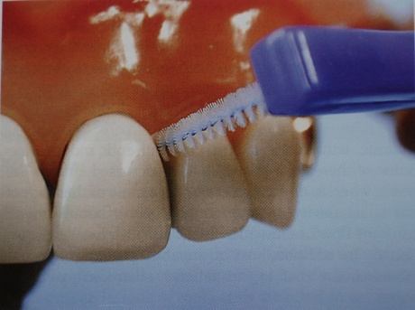
B) For application of chemotherapeutic agents
Fluoride dentrifice, gel and/or mouthrinse for prevention of dental caries, particularly root surface caries, and for surface adjacent to any prosthesis.
Antibacterial agents for control of dental biofilm and the prevention of gingivitis.
Desensitizing agents.
Procedure
Select brush of appropriate diameter.
Moisten the brush and insert at an angle in keeping with gingival form; brush in and out

Slide 63
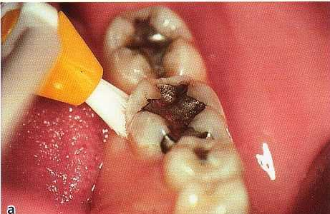
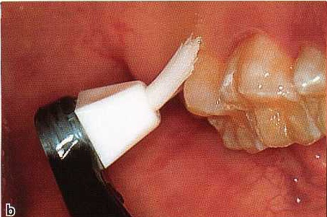
Single tufted brushes
The single tuft, or group of small tufts, may be 3 to 6 mm in diameter and may be flat or tapered. The handle may be straight or contra-angled
Indications
For open interproximal areas
For fixed dental prostheses
For difficult to reach areas
Procedure
Direct the end of the tuft into the
interproximal area and along the
gingival margin.
Combine a rotating motion with
intermittent pressure.
Use a sulcular brushing stroke.

Slide 64
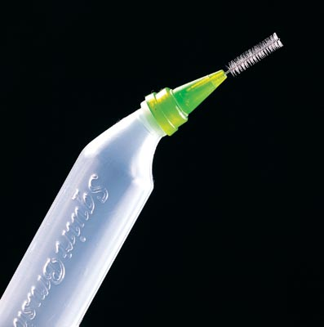
New advancements in interdental brushes
1) Squirt Brush - the new Interdental brushes that provide added cleaning efficiency by using the interproximal brush with the attached refillable bottle to delivery a variety of mouth rinses for irrigation and disinfection
Combines oral irrigation and interproximal cleaning into one.
Helps you access hard to reach area such as in between teeth and around bridges and implants.
Surpasses traditional interdental cleansing techniques (dry brushing) with the addition of bubricant and disinfectant.
Cleans between ortho brackets and wires.

Slide 65
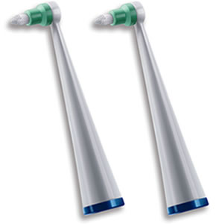
New advancements in interdental brushes
2) Powered interdental brushes

Slide 66
KNITTING YARN
Indications
For tooth surfaces adjacent to wide proximal spaces, dental floss is too narrow and does not remove biofilm efficiently.
For mesial and distal abutments of fixed partial dentures and under pontics, use a floss threader.
For isolated teeth, teeth separated by a diastema, and distal surfaces of most posterior teeth.

Slide 67
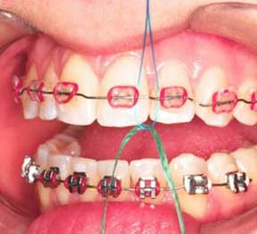
Procedure
Fold yarn double. Use about 8 inches of 3 or 4 ply smooth synthetic yarn. Loop through about 8 inches of dental floss; tie floss with one over-hand knot.
Insert floss through the contact area. Draw the yarn into the embrasure.
Clean adjacent teeth separately with a facial-lingual, back-and-forth stroke. Hold the ends of the yarn distally and then around mesially.
For specific areas where a papilla
may be high or access is not
otherwise sufficient for the
wide yarn, use the dental
floss end of the combination.
Apply dentifrice.
For closed contacts, use a floss
threader

Slide 68
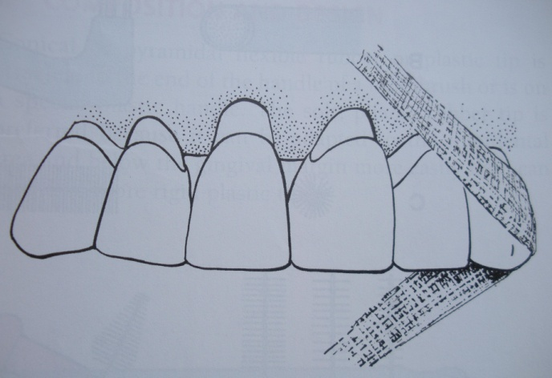
GAUZE STRIPS
Indications
For proximal surfaces of widely spaced teeth.
For surfaces of teeth next to edentulous areas.
For distal and mesial surfaces of abutment teeth.
For areas under posterior cantilevered section of a fixed appliance, such as the distal portion of a denture supported by implants.

Slide 69
Procedure
Cut 1 inch gauze bandage into a 6 to 8 inch length, and fold in thirds or down the center.
Position the fold of the gauze on the cervical area next to the gingival crest and work back and forth several times; hold ends in a distal direction to clean a mesial surface, and in a mesial direction to clean a distal surface.

Slide 70
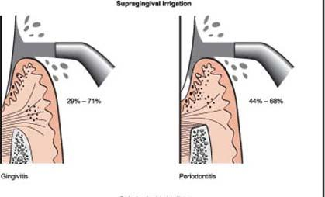
ORAL IRRIGATION DEVICES
Supragingival irrigation
Oral irrigators clean nonadherent bacteria and oral debris from the oral cavity more effectively than the toothbrushes and mouthrinses. They are particularly helpful for removing debris from inaccessible areas around orthodontic appliances and fixed prostheses. Oral irrigation can be useful in delivering antimicrobial agents into periodontal pockets.

Slide 71
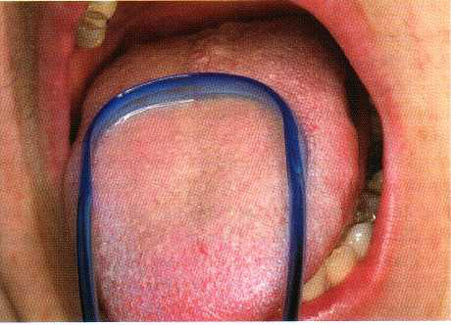
TONGUE SCRAPERS
Tongue brushing has been advocated as part of daily home oral hygiene together with toothbrushing and flossing, since this might reduce a potential reservoir of microorganisms contributing to plaque formation (Christen & Swanson 1978)

Slide 72
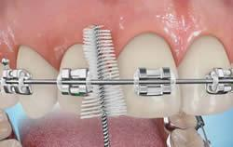
Plaque Removal In Patients Undergoing Orthodontic Treatment
The patient should be motivated to maintain a good oral hygiene.
Perform brushing before a mirror so that brush application is accurate and brushing is thorough.
Use a disclosing solution rinse to assist in self-evaluation.

Slide 73
Conventional Toothbrushes
1. Brushes should have soft bristles with rounded ends to minimize gingival and tooth abrasion.
2. Orthodontic designs (with the middle row of bris­tles shorter than the outer rows) may be more effective. A shorter middle row that can be applied directly over the appliance. It is used with a short horizontal stroke.
3.Power brush. Used with soft filaments, a light stroke, and at a low speed, power brushes have been shown to be very effective for maintaining gingival health and cleaning around appliances
Recommend an approved fluoride dentifrice to aid in dental caries control

Slide 74
Brushing Procedure
1. Sulcular brushing. A sulcular method is needed by most patients for cleaning the appliances and maintaining the gingiva.
2. Adapt for appliance. Special adaptation is required for facial surfaces. Place the brush with filament ends directed toward the occlusal sur­face to clean over the wire and bracket (or under for mandibular arch); place in Stillman position for the opposite side.
3. Clean all surfaces. To ensure cleanliness, one should brush the appliances in any way that the filaments can be manipulated. Insert the brush from below, over, and above the arch wire; rotate and vibrate to remove biofilm and debris.
4. Lingual and palatal. Approach to brushing is similar to the basic strokes used on the facial surfaces. .

Slide 75
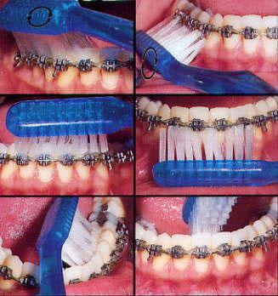

Slide 76
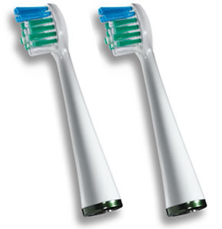
Electric Toothbrushes
Previous studies have demonstrated that 20%
to 40% of orthodontic patients with fixed
appliances will show less than ideal plaque
removal with conventional toothbrushes
even with repeated instructions.
The Rotadent electric toothbrush with the
pointed bristles is most effective for patients.
Its advantages following:
a.Most effective toothbrush for interproximal plaque removal
b.Least abrasion because of smaller diameter bristles (especially important for implant & exposed root surfaces
c.Lower cost for replacement brush heads (only every 6 to 8 weeks)
Oral B-Braun and Interplak are more effective than the conventional toothbrush but have higher cost for replacement, which is usually every 2 to 3 weeks for Braun and 6 weeks for Interplak.
In addition to the toothbrushes, patients can use a number of agents to help improve gingival health. These agents include stannous fluoride, Listerine rinse, triclosan, chlorhexidine & other antiplaque agents.

Slide 77
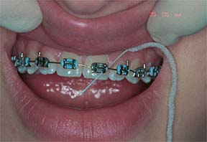
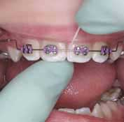
Interdental care
Regular flossing should be done with the help of floss threaders
superfloss

Slide 78
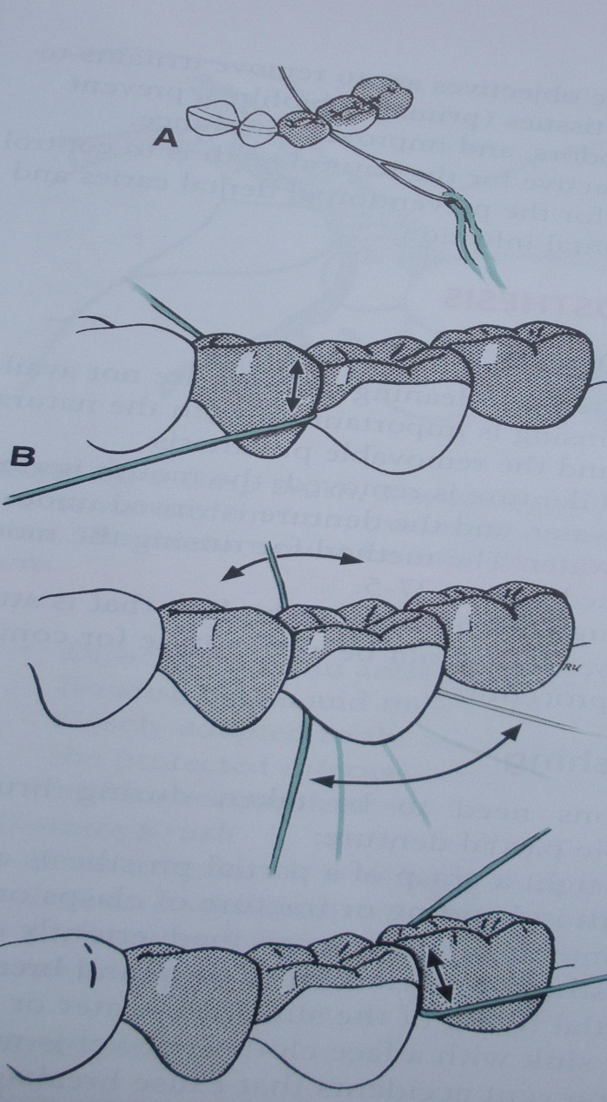
Care procedures for the fixed prosthesis
When suggesting a procedure for the patient to follow for cleaning the oral cavity when a fixed partial denture is present, debris removal with an oral irrigator may be recommended as the first step.
The proximal surface of an abutment tooth and the gingival adjacent to a pontic require special attention.
Sulcular method of brushing is generally indicated. A nonabrasive dentifrice is indicated to prevent the possibility of abrasion when pontic or crown facings are made of acrylic.

Slide 79
The method of interdental care is selected on the basis of individual patient and the prosthesis.
Margins of the restorations may provide slight irregular areas for retaining biofilm. A toothbrush in Charter’s position may be helpful for cleaning the gingival surface of the pontic from the facial aspect.
Tufted dental floss is most efficient for cleaning a fixed partial denture. A floss threader is used alongwith.

Slide 80
Thank you

