Slide 1
CHEMICAL PLAQUE CONTROL A SEMINAR
ITS DENTAL COLLEGE , HOSPITAL & RESEARCH CENTRE GREATER NOIDA
PRESENTED BY
JOHNN KAZIMM
Date – 4/09/2014
Moderator – Dr. SHIVJOT CHHINA

Slide 2
INDEX
Dental Plaque and formation
Classification
Categories of chemical plaque control agents
Description
Mechanism of Action
Vehicles
Disclosing Agent
Mouthwashes
Oral Irrigators
Dental Spray
Plaque control and Implants

Slide 3
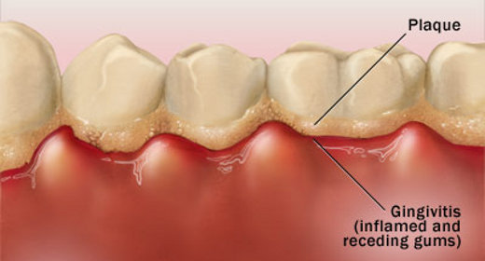
DENTAL PLAQUE
Dental Plaque is defined as a specific but highly variable structural entity resulting from sequential colonization and growth of micro organisms on the surfaces of teeth and restoration consisting of micro organisms of various strains and species are embedded in the extra cellular matrix, composed of bacterial metabolic products and substance from serum, saliva and blood.⁽¹⁾

Slide 4
COMPOSITION OF DENTAL PLAQUE
Bacterial cells, plaque contains a small number of epithelial cells, leukocytes, and macrophages.
The cells are contained within an extracellular matrix, which is formed from bacterial products and saliva.
The extracellular matrix contains protein, polysaccharide, lipids and glycoproteins.⁽²⁾
Inorganic components are also found in dental plaque; largely calcium and phosphorus which are primarily derived from saliva.

Slide 5
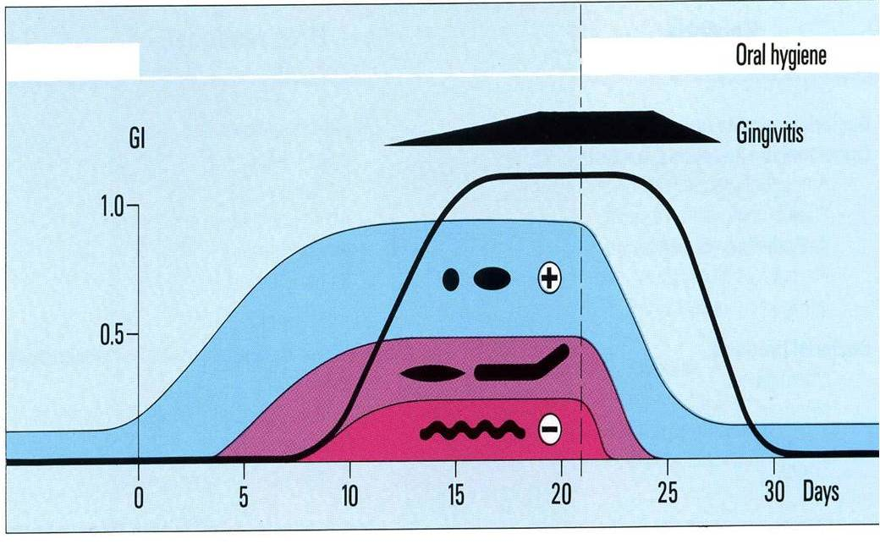
ETIOLOGY OF PERIODONTAL DISEASES & RELATED STUDIES
⁽³⁾
Page & Schroeder have demonstrated that an initial gingival lesion develops within approximately four days from a condition of healthy gingiva if plaque is allowed to accumulate freely.⁽⁴⁾

Slide 6
CHEMICAL PLAQUE CONTROL
DEFINTION
Chemical plaque control can be defined as use of various chemical agents for the purpose of removal of plaque and maintaining of oral health.

Slide 7
CHEMICAL PLAQUE CONTROL
IDEAL REQUISITE OF AN ANTI PLAQUE AGENTS:-
Should significantly reduce plaque & gingivitis.
Should prevent growth of pathogenic bacteria.
Should Prevent development of resistant bacteria.
Should be compatible with the oral tissues.
Should not stain teeth/ alter taste.
Should be inexpensive & easy to use.⁽⁶⁾

Slide 8
FIVE CATEGARIES OF CHEMICAL PLAQUE CONTROL AGENTS.
Broad spectrum antiseptics.
Antibiotics aimed at specific bacteria's.
Single or combinations of enzymes that could modify plaque structure or activity.
Non – enzymatic dispersing or modifying agents.
Agents that could affect bacterial attachment.

Slide 9
DIFFERNCE BETWEEN ANTISEPTIC AND ANTIMICROBIAL
Antibiotics are effective only against bacteria while antiseptic acts against a wide range of microorganisms.
Antibiotics are chemical substances that kill and stop the growth of bacteria.
They act by interfering with the cell wall synthesis and nucleic acid metabolism, and by inhibiting protein synthesis.⁽⁷⁾
They are broadly classified as bacteriostatic, which acts primarily by inhibiting bacterial multiplication, and bactericidal, which acts primarily by killing the bacteria.
ANTISEPTIC
Antiseptic prevents the growth and development of the microorganisms without necessarily killing them. They can be topical agents that are used to apply the skin, mucus membranes and intimate objects or can be internally used agents such as urinary tract antiseptics.⁽⁸⁾

Slide 10
CLASSIFICATION BY GENERATIONS
1st generation: reduce plaque 20-50%. Efficacy is limited by their poor retention E.g: phenols, sanguinarine
2nd generation: retains longer in oral cavity. 70 to90% plaque control. E.g.: chlorhexidine.⁽⁹⁾
3rd generation: it should be effective against specific periodontal organism. Yet to be developed.

Slide 11
ADDY’S CLASSIFICATION
a) ANTIBIOTIC
PENICILLIN
VANCOMYCIN
ERYTHROMYCIN
b) ENZYMES
MUCINASE
LIPASE
AMYLASE
LACTOPEROXIDASE
c) QUATERNARY AMMONIUM COMPOUND
BENZETHONIUM CHLORIDE
d) BISBIGUANIDES
CHLORHEXIDINE
ALEXIDINE

Slide 12
E) METALLIC SALTS
COPPER
TIN
ZINC
F) PHENOLIC COMPOUNDS
THYMOL
MENTHOL
EUCALYPTOL
G) FLUORIDE
STRO
H) OTHER ANTISEPTICS
IODINE
TRICLOSAN⁽⁹⁾

Slide 13
METALLIC IONS
Salts of zinc & copper are most commonly used. They have plaque inhibitory capacity.
MECHANISM OF ACTION
They reduce glycolytic activity in microorganisms & delay bacterial growth.
Zinc inhibits the production of VSC in the oral cavity by interacting with sulphur in the amino acids or their metabolism. ⁽¹⁰⁾
Zinc can be retained in the oral cavity for approximately 2-3 hours after tooth brushing by binding to acidic substances on the oral mucosa, in the saliva or on bacterial surfaces

Slide 14
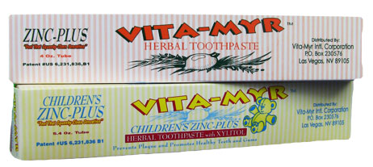
ZINC CONTAING TOOTHPASTE
ADAPTED FROM: www.healthydentallife.com/
Last accessed on 27thAugust,2014

Slide 15
QUATERNARY AMMONIUM COMPOUNDS
They are more active against gram positive than gram negative organisms.
Cetylpyridinium chloride is used in a wide variety of antiseptic mouth rinse products, usually at a concentration of 0.05%.
At oral pH these antiseptics are monocationic and adsorb readily and quantitatively, to a greater extent, than chlorhexidine to oral surfaces.⁽¹⁰⁾
MECHANISM OF ACTION
Positively charged molecule reacts with negatively charged cell membrane phosphates & thereby disrupts the cell wall structure.⁽¹¹⁾
e.g.; Benzathonium chloride.

Slide 16
SANGUINARINE
It is a benzophenathridine alkaloid, which is derived from the plant SANGUINARIA CANDENSISS .
They are effective against a wide variety of gram negative organisms.
SANGUINARINE exhibits good retentive properties with dental plaque when used as a mouth rinse.⁽¹²⁾
SANGUINARINE can be disclosed under long wave ultraviolet light because of its fluorescent properties.

Slide 17
ANTIBIOTICS
Vancomycin, erythromycin, kinnamycin & Niddamycin are used.
But because of potential problem of BACTERIAL RESISTANCE and HYPERSENSTIVITY REACTIONS the use of these agents have been reduced considerably.
Mode of action is by interfering with peptidoglycan of the cell wall of gram positive bacteria or with phospholipids of gram negative bacteria .It limits the bacterial colonization.⁽¹³⁾

Slide 18
Vancomycin is an antibiotic useful for the treatment of a number of bacterial infections.
It is of the glycopeptide antibiotic class and is effective mostly against Gram-positive bacteria
Vancomycin acts by inhibiting proper cell wall synthesis in Gram-positive bacteria
Erythromycin is an antibiotic useful for the treatment of a number of bacterial infections. It is in the macrolide class and has an antimicrobial spectrum similar to or slightly wider than that of penicillin
MECHANISM OF ACTION
By binding to the 50s subunit of the bacterial 70s rRNA complex, protein synthesis and subsequent structure are inhibited.

Slide 19
RELATED STUDIES
Eur J Oral Sc. 2011 Apr;119(2):151⁽¹⁴⁾
To compare antibiotic toothpastes and mouthrinse
Biofilms from freshly collected human saliva were grown in 96-well microtitre plates.
Microtitre plates were exposed to a dilution series of mouthrinses .
All formulations showed acute action at the highest concentrations . Further dilution yielded loss of efficacy, or even stimulation of biofilm growth.
It demonstrated for three selected antimicrobial products, indicating that antimicrobials remain bio-available for substantive action on new biofilm

Slide 20
BISBIGUANIDES
Bisbiguanides are a class of chemically related compounds known for their bactericidal properties.
1.Alexidine
2.Chlorohexidine

Slide 21
ALEXIDINE
Alexidine is an alkyl bis(biguanide) antiseptic which has been used in mouthwashes to eliminate plaque forming microorganisms.
It binds to lipopolysaccharide and lipoteichoic acid and inhibits fungal phospholipase B
Alexidine also inhibits the mitochondrial phosphatase PTPMT1 (IC₅₀ = 1.08 μM, in vitro) and induces apoptosis in cancer cell lines

Slide 22
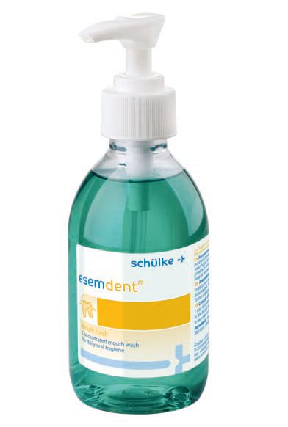
ESMEDENT MOUTHWASH
Application
1 stroke per mouth rinse cup filled with water.
For this purpose, hold the mouth rinse cup under the dosing.
Pump on the bottle and press the pump once.
ADAPTED FROM www.schuelke.com Last Accesed ON 27TH AUGUST.⁽¹⁵⁾

Slide 23
CHLOROHEXIDINE
HISTORY
It was developed in 1940s by imperial chemical industries, England.
Plaque inhibition by Chlorhexidine was first investigated in 1969 (Shroeder 1969) but definitive study was performed by Loe & Schiott(1970).⁽¹⁶⁾
The study showed that rinsing for 60 secs twice/day with 10 ml 0.2% (20 mg dose) inhibited the re-growth & development of gingivitis.

Slide 24
The digluconate of chlorhexidine (1:6-Di 4 –chlorophenyl-diguanidohexane) is a synthectic antimicrobial drug which is effective in-vitro against both gram-positive and gram-negative bacteria .
Its mechanism of action is due mainly to rupture of the bacterial cell wall and precipitation of the cytoplasm contents

Slide 25
SUBSTANTIVITY
At physiological PH, Chlorhexidine is large dicationic molecule and has ability to adsorb onto negatively charged surface .
As it is adsorbed to oral surfaces and slowly released in active form it is substantive.
Molecules bound to salivary proteins will be released within 8-12 hours in active form.
Weak concentrations can be recovered after 24 hours.

Slide 26
HIGH CONCENTRATION. – Bactericidal
LOW CONCENTRATION – Bacteriostatic⁽¹⁷⁾
PIN CUSHION EFFECT
1 charge end interact with tooth and other remains available to initiate the interaction with bacterial membrane as microorganism approaches the tooth surface.⁽¹⁸⁾

Slide 27
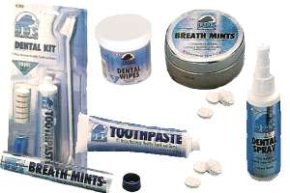
CHLORHEXIDINE PRODUCTS
MOUTHRINSES
As aqueous solution of 0.2 %
SPRAYS
0.1 % & 0.2% Chlorhexidine in sprays
TOOTHPASTE
1% Chlorhexidine toothpaste for the prevention of plaque & gingivitis.⁽¹⁹⁾

Slide 28
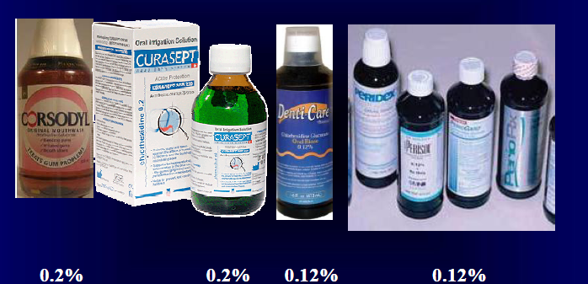
CHLOROHEXDINE PRODUCTS

Slide 29
ADVERSE EFFECT OF CHLOREXIDINE
The common adverse effect associated with Chlorhexidine are.
Brownish staining of teeth on restoration.
Hypersensitivity to Chlorhexidine has reported.
Stenosis of the Parotid duct .⁽¹⁹⁾

Slide 30
ENZYMES
Enzymes have been used as active agent in antiplaque preparations, due to basic fact that they would be able to breakdown already formed matrix of plaque and calculus.⁽²⁰⁾
Example-MUCINASE
LIPASE
AMYLASE
LACTOPEROXIDASE

Slide 31
AMYLOGLUCOSIDASE AND GLUCOSE OXIDASE
These are enzymes that are claimed to reduce plaque, gingivitis and dental caries.
Their mechanism of action is by activating the antibacterial lactoperoxidase-thiocyanate system in saliva Amyloxglucosidase and glucoseoxidase can degrade starch and glucose to H² O².
The released peroxides will react with thiocyanate-ion present in saliva, converting it to hypothiocyanate, which can inhibit bacterial growth.⁽²¹⁾

Slide 32
TRICLOSAN
It is Phenol derivation which has been included in mouth rinses and also available in tooth paste form.
It is synthetic, non-ionic & is used as a topical antimicrobial agent. And more effective in combination with zinc citrate.⁽²²⁾
It has a broad spectrum of activity against gram positive & negative bacteria.

Slide 33
MECHANISM OF ACTION
1.Act on microbial cytoplasmic membrane
2.Leakage of cellular constituents
3.Bacteriolysis
It was observed that triclosan can delay plaque maturation & also inhibits formation of prostaglandin’s & leuko trienes
At high concentrations, triclosan acts as a biocide with multiple cytoplasmic and membrane targets.⁽²³⁾
At the lower concentrations triclosan appears bacteriostatic, and it is seen to target bacteria primarily by inhibiting fatty acid synthesis

Slide 34
EFFICACY OF CHEMICAL PLAQUE AGENTS
RELATED STUDIES
Adapted from LG DePaola et al. Chemotherapeutic inhibition of supragingival dental plaque and gingivitis development.
J Clin Periodontol ;1989:16: 311-315⁽²⁴⁾.

Slide 35
DENTIFRICES:-
According to the American Dental Association Council on Dental therapeutics “ A dentifrice is a substance used with a toothbrush for the purpose of cleaning the accessible surface of the teeth”.⁽²⁵⁾
Webster described the term dentifrice as derived as derived from dens [tooth] and fricare [to rub].

Slide 36
CONSTITUENT | PURPOSE
Abrasive | Cleaning/stain removal
Water | Solvent
Humectants | Provide creamy texture
Detergent/Surfactant | Foam builder
Thickening agent | Controls viscosity
Flavoring agent | Improves taste
Sweetening agent | Enhances flavor
Therapeutic agent | Active ingredient
Color or preservative | Color or preservative
Binder | Ingredients together

Slide 37
INGREDIENTS
Detergents create the foaming action ,aiding in the retention of toothpaste within the mouth. Sodium lauryl sulfate is a detergent used in nearly all toothpastes to clean the surface of the teeth by acting as such a foaming agent. Detergents loosen food particles and other debris and aid in the movement of the abrasive across the gums and teeth surface.
An abrasive typically consists of hard, very fine insoluble particles that act as scrubbing agents to remove stains and plaque as well as polish teeth. Example.Calcium carbonate
Humectants
Humectants provide toothpaste texture as well as moisture retention properties. Glycerin, sorbitol, and water are common humectants.
Thickening Agents
Thickeners also help create the texture of toothpaste and include agents such as carrageenan, cellulose gum, and xanthan gum.
Taste Enhancers
Flavoring agents and sweeteners (e.g., sodium saccharin) improve the taste of toothpaste, while coloring agents (e.g., titanium dioxide, white color) .

Slide 38
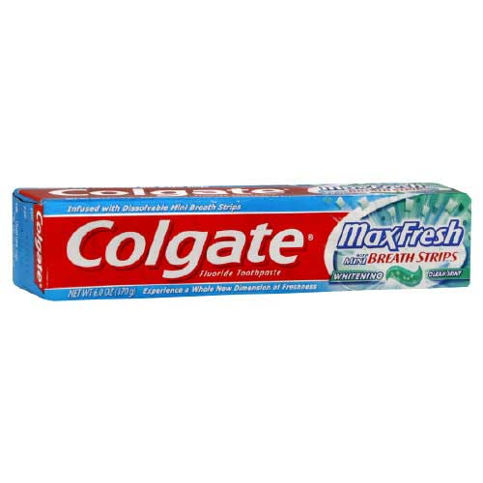
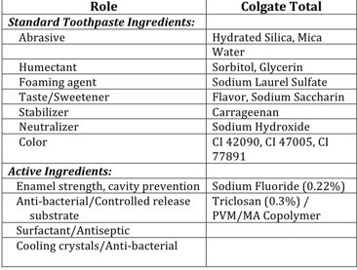

Slide 39
RELATED STUDIES
AIM- To assess the efficacy of dentifrice containing
A.(0.3% triclosan/ 2.0% PVM/MA copolymer/ 0.243% sodium fluoride)
for controlling established gingivitis and supragingival plaque to that of a dentifrice containing
B.(0.454% stannous fluoride, sodium hexametaphosphate
Instructions were given to Brush their teeth twice daily (morning and evening) for one minute
CONCLUSION
The overall results showed that that a dentifrice containing 0.3% triclosan/2.0% PVM/MA copolymer/0.243% sodium fluoride is efficacious for the control of established gingivitis and supragingival plaque as compared to a regular fluoride dentifrice.⁽²⁶⁾

Slide 40
MOUTHWASH
A mouthwash may be recommended to treat infection, reduce inflammation, relieve pain, reduce halitosis or to deliver fluoride locally for caries prevention.
Recommending particular mouthwashes should take into consideration the patient's ability to perform good oral hygiene practices ⁽²⁷⁾
The condition of their teeth, gingiva and oral mucosa.
The proven efficacy of the mouthwash and its potential adverse effects

Slide 41
AGENTS USED FOR MOUTHWASH/MOUTHRINSE
Chlorhexidine
Povidone-iodine containing mouthwashes
Cetylpyridinium chloride, sodium benzoate and Triclosan
Oxygenating agents
Sodium bicarbonate
Fluoride-containing mouthwashes

Slide 42
MOUTHRINSES/MOUTHWASHES
IDEAL PROPERTIES OF MOUTH RINSES
Antimicrobial spectrum appropriate for site of application.
Exhibit selective activity for some essential microbial biochemical reactions that is not a reaction of the host.
Rapidly effective.
Bactericidal instead of bacteriostatic
Be stable & not inactivated by body fluids or infectious exudates
Should not induce hypersensitivity with repeated applications
Have residual effect after each use
Reasonable cost .⁽²⁸⁾

Slide 43
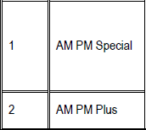
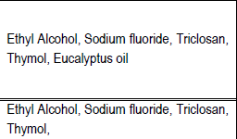
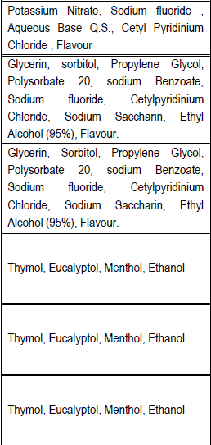
AVAILABLE MOUTHWASHES AVALIABLE IN INDIA
ADAPTED FROM- Kesavarao Teki et al Composition Analysis of the Oral Care products available in Indian market Part II:: Mouthwashes IJARPB, 2012; 2 (3): 338-347.⁽²⁹⁾

Slide 44
ORAL IRRIGATION
Purpose of an oral irrigator
Reduction of gingivitis & bleeding
Reduction or alteration of subgingival dental biofilm
Subgingival delivery of antimicrobial agents
CLASSFICATION
Power driven- WATER JET
Non-power driven
Non-powered driven irrigators attach to household water supply:
Faucet
Shower

Slide 45
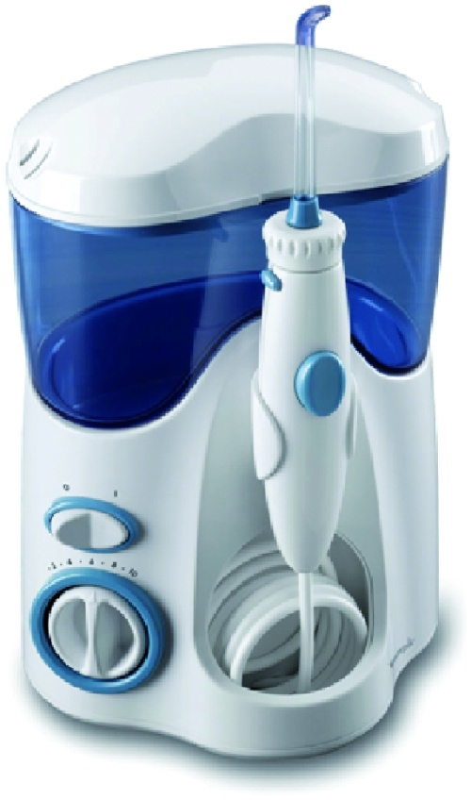
ORAL IRRIGATORS
Oral irrigators deliver a pulsating stream of water or chemical agent through a nozzle to the teeth and gingiva.
Oral irrigation can be applied at home by the patient or in the dental office.
.

Slide 46
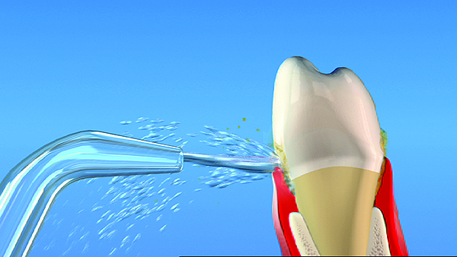
SUPRAGINGIVAL IRRIGATION
Supragingival is usually performed once or twice daily by the patient as an adjunct to toothbrushing and flossing.
The irrigator's nozzle should be positioned at some distance from the gingival margin and the jet stream lined perpendicular to the long axis of the teeth to achieve optimal subgingival penetration of an irrigant.
Irrigation pressures of 540 kPa to 620 kPa (80 psi to 90 psi) can be tolerated without adverse effects.⁽³⁰⁾

Slide 47
SUBGINGIVAL IRRIGATION
To penetrate the periodontal pocket near its base by rubber tip nozzles are positioned at the gingival margin or blunted cannulas with an end or side port are inserted into the periodontal pocket.
Ejection site pressures at the opening of various tip designs have been
demonstrated to range from 0.7 kPa to 35 kPa (0.1 psi to 5 psi) and were lowest in side port systems .
Care should be taken not to block the opening of the canula to prevent excessive pressure buildup.
To bring the irrigant into contact with all root surfaces, scaling and root planing should precede subgingival irrigation, and irrigation should be
performed circumferentially

Slide 48
RELATED STUDIES
J Clin Periodontol.1985 Sep;12(8):630-8. Braatz L et al.⁽³¹⁾
106 sites probing pocket depths 7 mm .
14 patients were treated with plaque control .
Sites in each patient were either irrigated with 2% chlorhexidine or left as non-irrigated controls.
Irrigation immediately followed root planing was done.
Results at 24 weeks demonstrated that bleeding scores decreased from 91% to 9%.
Probing pocket depths decreased from 7.5 to 4.5 mm
Probing attachment levels gained 1.1 to 1.4 mm.

Slide 49
DIFFERENT BRANDS OF ORAL
IRRIGATIONS
Waterpik Ultra Dental Water Jet.
Panasonic EW1270AC Portable Oral Irrigator.
Oral Breeze—(non-power).
Hydro Floss Oral Irrigator.
Glacier Floss Dental Magnetic Oral Irrigator.

Slide 50
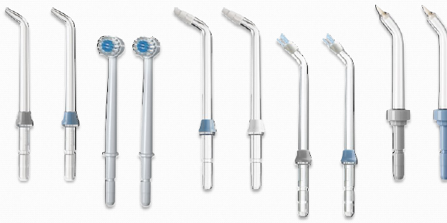
DIFFERENT TYPES OF TIPS USED FOR IRRIGATION
ADAPTED FROM :Bashkar S, Cutright DE, Gross A, et al. Water jet devices in dental practice. J Periodontol. 1971;42(10):658-664.⁽³²⁾

Slide 51
CHEMICAL PLAQUE CONTROL AND IMPLANTS
Felo A et al
To evaluate the effect of irrigation in Patients with peri implant maintenance
1.0.06% chlorhexidine (PerioGard) (CHX) using a powered oral irrigator (Water Pik)
2.special subgingival irrigating tip (Pik Pocket Subgingival Tip) compared to rinsing with 0.12% chlorhexidine gluconate once daily.
Modified Gingival Index (MGI), Plaque Index (PI), Bleeding Index (BI), and Calculus Index (CI). Also, a Stain Index (SI) was measured at 3 months.
The rinse group showed a non significant (P > 0.05) increase from baseline in CI and a non significant decrease in PI. Intergroup comparisons showed that CHX irrigation produced statistically significantly greater reductions than CHX rinsing in the PI, MGI, and SI.
The results of this study suggest that use of diluted 0.06% CHX when used in a powered irrigator may be a valuable adjunct to oral health in patients with implants.⁽³³⁾

Slide 52
CONCLUSION
Mechanical plaque control methods remain to be a primary preventive method to control dental diseases and it should not be replaced by chemical control.
Chemical agents are especially useful in :
1. Mentally/ Physically handicapped individuals.
2. Patients who have undergone surgical procedures it is used post – operatively.
3.Individuals with defective host defence mechanism

Slide 53
REFRENCES
1.Who Refrence 1978
2. Michael G. Newman, Henry Takei, Perry R. Klokkevold, Fermin A. Carranza, Carranza's Clinical Period ontology. Elsevier( Saunders )10th edition.Page no 98.
3. MAN.LOE H, THEILADE E, JENSEN SB EXPERIMENTAL GINGIVITIS IN J Periodontol 1965 May-Jun;36:177-87.
4. RC, Schroeder HE. Pathogenesis of inflammatory periodontal disease. A summary of current work.. Lab Invest1976 Mar;34(3):235-49.
5. P Kolenbrander et al .Oral multispecies biofilm development and the key role of cell–cell distance.Nature Reviews Microbiology 8:471-480 2010

Slide 54
REFRENCES
6. Beiswanger BB, Doyle PM, Jackson RD, Mallatt ME, Mau M, Bollmer BW, et al. The clinical effect of dentifrices containing stabilized stannous fluoride on plaque formation and gingivitis—a six-month study with ad libitum brushing. Journal of Clinical Dentistry Dent 1995;6:46–53.
7. Christopher T Walsh.Prospects for new antibiotics: a molecule-centered perspective.The Journal of Antibiotics (2014) 67, 7–22; 2013
8. P. Gilbert and L.E. Moore.Cationic antiseptics: diversity of action under a common epithet.Journal of Applied Microbiology Volume 99, Issue 4, pages 703–715.
9. Addy et al Chlorhexidine digluconate–an agent for chemical plaque control and prevention of gingival inflammation:
J Periodont res 1986; 21:16 74-8

Slide 55
REFRENCES
10. Pharmacology ReCap 2.0 for×Bachelor of Dentistry Students. Dr. J. G. Buch.4TH EDITION.PAGE NO 78
11.Joyston-Bechals. Chemical agents in control of dental plaque in dentistry. J Clin periodontol. 1993;20:49-53.
12. NAYAK Textbook Of Periodontology And Oral Implantology 2010 page 96
13. WHO Model List of EssentialMedicines". World Health Organization. October 2013. Retrieved 22 April 2014.

Slide 56
REFRENCES
14. Otten MP, Busscher HJ, van der Mei HC, van HoogmAcute and substantive action of antimicrobial toothpastes and mouthrinses on oral biofilm in vitro.
Eur J Oral Sci. 2011 Apr;119(2):151-5.
15. Available at www.schuelke.com.last accesed on 27 th august.2014.
16. SCHROEDER H E: Formation and Inhibition of Dental Calculus. Hans Huber, Berlin, pp 145–172 (1969).5th EDITION
17. Mary Ellen Davey,George A. Chlorohexidine O'toole Microbiol Mol Biol Rev. Dec 2000; 64(4): 847–867.

Slide 57
REFRENCES
18. Jenkins S, Addy M, Newcombe R. The effects of a chlorhexidine toothpaste on the development of plaque, gingivitis and tooth staining. J Clin Periodontol. 1993 Jan;20(1):59-62.
19. R Aly,H I Maibach.Comparative study on the antimicrobial effect of 0.5% chlorhexidine gluconate and 70% isopropyl alcohol on the normal flora of hands.Mar 1979; 37(3): 610–613.
20. Addy M,Moran JM, Clinical indications for the use of chemical adjuncts to plaque control, Periodontol 2000, 1997 Oct;15:52-54.

Slide 58
REFRENCES
21. E L Thomas et alAntibacterial activity of hydrogen peroxide and the lactoperoxidase-hydrogen peroxide-thiocyanate system against oral streptococci. Infect Immun. Feb 1994; 62(2): 529–535.
22.Grossman E, Meckel A, Isaacs R, Ferretti G, Sturzenberger O, Bollmer B, et al. A clinical comparison of antibacterial mouthrinses: effects of chlorhexidine, phenolics, and sanguinarine on dental plaque and gingivitis. Journal of periodontology. 1989;60(8):435-40.
23. Russell AD (May 2004). "Whither triclosan ? . J. Antimicrob. Chemother. 53 (5): 693–5.

Slide 59
REFRENCES
24. Adapted from LG DePaola et al. Chemotherapeutic inhibition of supragingival dental plaque and gingivitis development.
J Clin Periodontol ;1989:16: 311-315
25.Vinay Kumar Srivastav. Modern Peiadtric dentistry.5th edition.JP.Page no 67
26. Singh S, Chaknis P, DeVizio W.A clinical investigation of the efficacy of three commercially available dentifrices for controlling established gingivitis and supragingival plaque J Clin Dent. 2010;21(4):105-10.
27.S.Robensen.All Mouthwash. Australian prescriber.2012:32(6).23-39

Slide 60
REFRENCES
28. Aneja KR, Joshi R, Sharma C. The antimicrobial potential of ten often used mouthwashes against four dentalcaries pathogens. Jundishapur J Microbiol. 2010; 3(1): 15-27.
29. Kesavarao Teki et al Composition Analysis of the Oral Care products available in Indian market Part II:: Mouthwashes IJARPB, 2012; 2 (3): 338-347
30. Braun RE, Ciancio SG: Subgingival delivery by an oral irrigation device. J Periodontol 1992; 63:469.
31. Braatz L, Garrett S, Claffey N, Egelberg J. Antimicrobial irrigation of deep pockets to supplement non-surgical periodontal therapy. II. Daily irrigation J Clin Periodontol. 1985 Sep;12(8):630-8.

Slide 61
REFRENCES
32. Bashkar S, Cutright DE, Gross A, et al. Water jet devices in dental practice. J Periodontol. 1971;42(10):658-664.
33. Felo A, Shibly O, Ciancio SG, Lauciello FR, Ho A.Effects of subgingival chlorhexidine irrigation on peri-implant maintenance. Am J Dent.1997 Apr;10(2):107-10

