Slide 1
HOST MODULATION THERAPY

Slide 2
Contents
Introduction
Host Response
Potential targets for host modulation
Host modulation factors
Host modulation agents
Advantages
Disadvantages
Emerging Host Modulating agents
Conclusion
References

Slide 3
Introduction
Host:- defined as the “the organism from which a parasite obtains its nourishment” or in the transplantation of the tissue,’ the individual who receives graft.¹
Modulation is defined as “ alteration of function or status of something in response to a stimulus or an altered chemical or physical environment.¹
Concept of host modulation was 1st introduced by Williams (1990) and Golub et al (1992).²

Slide 4
Periodontists previously believed that periodontal disease was an consequence of aging and uniformly distributed.
Thought that severity was directly correlated with plaque.
Disease progression occurred in a continuous, linear manner throughout life.²

Slide 5
The Host Response & Potential target
This host response to the bacterial challenge presented by subgingival plaque is the important determinant of disease severity.³
Although plaque bacteria are capable of causing direct damage to the periodontal tissues(antigens, lipopolysaccharide (LPS), and other virulence factors stimulates like H2S, butyric acid, other enzymes ).

Slide 6
Schematic illustration of Pathogenesis of periodontitis
Modified from Kornman KS: Clin Infect Dis 28:520,1999

Slide 7
Perpetuation of the host response due to a persistent bacterial challenge disrupts homeostatic mechanisms.
This results in release of mediators including proinflammatory cytokines (e.g., IL-1, 1L-6, tumor necrosis factor-a [TNF-a]), proteases (e.g., matrix metalloproteinases), and prostanoids (e.g., prostaglandin E2 [PGE2]) which can promote extracellular matrix destruction in the gingiva and stimulate bone resorption.⁴

Slide 8
Protective aspects of the host response include recruitment of neutrophils, production of protective antibodies, and possibly the release of anti-inflammatory cytokines including transforming growth factor- ß (TGF-ß), interleukin-4 (IL-4), IL-10, and IL-12.⁴

Slide 9
The periodontal balance
Page RC. The role of inflammatory mediators in the pathogenesis of periodontal disease, J Periodont Res 1991: 26: 230-242.

Slide 10
Host Modulation Therapy
HMTs offer the opportunity for modulating or reducing this destruction by treating aspects of the chronic inflammatory response.
HMTs do not “switch off” normal defense mechanism or inflammation; instead, they ameliorate excessive of pathologically elevated inflammatory processes to enhance opportunities for wound healing.

Slide 11
Specific aspects of disease pathogenesis for modulation
a) Regulation of immune and inflammatory responses.
b) Regulation of excessive production of matrixmetalloproteinase’s
c) Regulation of arachidonic acid metabolites
d) Regulation of bone metabolism.

Slide 12
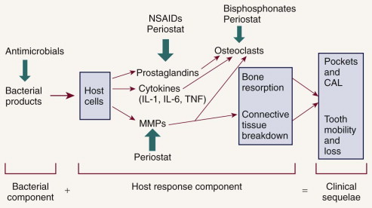
Potential adjunctive treatment approaches
Source : Carranza’s Clinical Periodontology 1oth Edition, Chapter 16 ⁵
Notes:
Possible adjunctive therapies & point of intervention in t/t of periodontitis are presented related to pathologic cascade of evevnts.

Slide 13
Host modulatory therapy (HMT) is a treatment concept that aims to reduce tissue destruction and stabilize or even regenerate the periodontium by modifying or downregulating destructive aspects of the host response and upregulating protective or regenerative responses.⁵
HMTs are systemically or locally delivered pharmaceuticals that are prescribed as part of periodontal therapy and are used as adjuncts to conventional periodontal treatments, such as scaling and root planing (SRP) and surgery.

Slide 14
The purpose of host modulatory therapy is to restore the balance of proinflammatory destructive mediators and antiinflammatory or protect mediators to that seen in healthy individuals.
Intervention in periodontal disease can now include host modulatory therapy (HMT) as one of the available adjunctive treatment options.

Slide 15
The term adjunctive is meant to imply "in addition to conventional therapies" or in addition to other established therapies."
For the management of periodontal diseases, conventional approaches were initially mechanical in nature, that is, surgery as well as scaling and root planing.

Slide 16
.
Host modulating agents
Systemically Administered Agents :-
NSAIDs
Bisphosphonates
Subantimicrobial-
Dose Doxycycline
Locally administered Agents :-
Topical NSAIDs
Enamel matrix proteins
Growth factors
Bone morphogenetic proteins

Slide 17
Nonsteroidal antiinflammatory drugs
NSAIDs inhibit the formation of prostaglandins, including prostaglandin E2 (PGE2) .
Produced by neutrophils, macrophages, fibroblasts, and gingival epithelial cells in response to lipopolysaccaride(LPS).
Upregulates bone resorption by osteoclasts.⁶
It also inhibits fibroblasts function and has inhibitory effects on the immune response.⁶

Slide 18
Mechanism of Action of NSAID’s
Source – www.medscape.org (Last accessed on 15th Dec 2014)

Slide 19
Action
Inhibits prostaglandins
Reduce inflammation
Used to treat pain, acute inflammation, and chronic inflammatory conditions.
Inhibits osteoclastic activity in periodontitis (Howell TH in oral bio med 1993).⁶
NSAIDs such as indomethacin, flurbiprofen , and naproxen(Howell TH 1993) administered daily for up to 3 years, significantly slowed the rate of alveolar bone loss compared with placebo.

Slide 20
Disadvantages when used as a HMT for periodontitis
Administration for extended periods is necessary for periodontal benefits to become apparent, and are associated with significant side effects:
gastrointestinal problems,
hemorrhage (from decreased platelet aggregation),
and renal and hepatic impairment.

Slide 21
Research shows that the periodontal benefits of taking long-term NSAIDs are lost when patients stop taking the drugs, with a return to or even an acceleration of the rate of bone loss seen before NSAID therapy, often referred to as a “rebound effect.” (William RC)⁷

Slide 22
Selective cyclooxygenase-2 (COX-2) inhibitors offers as adjunctive treatments in the management of periodontitis.
Cyclooxygenase, which converts arachidonic acid to prostaglandins, exists in two functionally distinct isoforms, COX-1 and COX-2.
COX-1 has antithrombogenic and cytoprotective functions.
Inhibition of COX-1 by nonselective NSAIDs causes side effects
gastrointestinal ulceration
and impaired hemostasis.
.

Slide 23
Use of selective COX-2 inhibitors reduce periodontal inflammation without the side effects typically observed after long-term (nonselective) NSAID therapy.
Selective COX-2 inhibitors slowed alveolar bone loss in animal models and modified prostaglandin production in human periodontal tissues.⁸
However, the selective COX-2 inhibitors were later identified to be associated with significant and life-threatening adverse effects, resulting in some drugs being withdrawn from the market.⁸

Slide 24
Role of arachidonic acid metabolites | Mode of interception | Significant Contributors | Agents employed | Results
Prostaglandins and other arachidonic acid metabolites within the periodontal tissues play a role in the pathogenesis. | Inhibition of arachidonic acid metabolite by blocking of the cyclooxygenase pathway | Goldhaber et al (1973) Nyman et al (1979) Weaks- Dybvig et al (1982) Offenbacher et al (1987) Jeffcoat et al (1991) | Indomethacin, Flurbiprofen, S-Ketoprofen, | Systemic daily administration for periods up to three years ,showed significant reduction in rate of bone loss, major disadvantage of rebound effect

Slide 25
Author | Purpose | Host M Agent | Parameters | Subjects | Results
Ishihara Y, Nishihara T et al (1991) | demonstrate the lipopolysaccharide isolated from a.a comitans strain induced bone resorption | Indomethacin | PGE2 and IL-1 levels | Mouse | PGE2 and IL-1 participate in LPS induced bone resorption in vitro.
Howell TH Fiorellini I, Weber HP et al (1991) | To study the effects of piroxicam in preventing gingival inflammation and plaque formation | Piroxicam | Gingival inflammation plaque index | Beagle dogs | Significantly inhibit the development of gingival inflammation
Roy S, Feldman, Szeto B et al (1983) | To evaluate the effect on bone resorption: A retrospective study | Aspirin (asp) or aspirin plus indomethcin | Radiographs | Humans | Percentage bone loss for the entire dentition was lower in asa group
Offenbacher S, Odle BM et al (1989) | metabolites of cyclooxygenase (co) during the progression of periodontitis | Flurbiprofen | Crevicular fluid levels of PGE2 and TXB2 | Rhesus monkey | prevented rise in TXB2, but did not affect increase in PGE2.
Heasman PA, et al (1993) | efficacy of flurbiprofen (50mg) on both developing and established gingivitis | Flurbiprofen | GCF concentration of PGE2, TXB2 and LTB4, Bleeding index | Human | control gingival inflammation with both preventive and therapeutic properties

Slide 26
Bisphosphonates
The bisphosphonates are bone-seeking agents . inhibit bone resorption by disrupting osteoclast activity.
Interfere with osteoclastic metabolism and secretion of lysosomal enzymes possess anticollagenase properties .
Treatment with the bisphosphonate significantly increased bone density compared with placebo.⁹
In human studies, these agents resulted in enhanced alveolar bone status and density .¹⁰
The ability of bisphosphonates to modulate osteoclast activity clearly may be useful in the treatment of periodontitis.

Slide 27
Action of Bisphosphonates
Source – www.ijdr.org ( last accessed on 16/12/14)

Slide 28
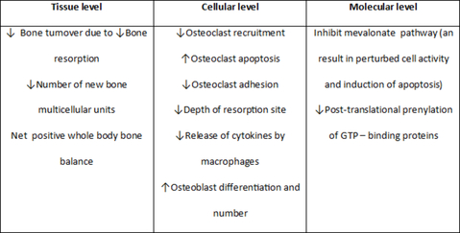
Source – www.dentalpress.org (last accessed on 15/12/14)

Slide 29
Author | Purpose | Host modulating agent | Parameters | Subjects | Results
Shoji K,Horiuchi H (1995) | Efficacy of risendronate to prevent alveolar bone resorption | Risendronate | Bone mineral density | Rats. | In preventing bone resorption in periodontitis
M young H , P ark JY et al (2 001 ) | evaluate the clinic al availability of bisphosphonate in auto genous free bone grafts | Bisphosphonates | Clinical measurements, histomorphological review | Rats | Clinical application of bisphosphonates for decreasing resorption of grafted bone
Durate P M , Gurgel B C e t a l (2 0 0 5 | To evaluate whether alendronate (ald) influence Bone healing around titan ium implants | Alendronate | Estrogen levels | rats . | Alendronate may prevent negative influence of estrogen deficiency on bone healing around titanium implants
Howell 1991,, Holzhausen 2005, Gurkan 2005, Durate 2005. | Inhibition of osteoclast/MMP activity through chelation of cations. | Bisphosphonates (Alendronate), Hormone replacement therapy.(HRT), OPG- Fc therapeutic agents | Osteoporosis and osteopenia may be indicators for periodontal diseases. | humans | improves the clinical outcome of nonsurgical periodontal therapy and may be an appropriate adjunctive treatment to preserve periodontal bone mass.

Slide 30
Some bisphosphonates have the unwanted effects
inhibiting bone calcification
inducing changes in white blood cell counts.
avascular necrosis of the jaws following bisphosphonate therapy, with the resultant risk of bone necrosis following dental extractions (Carter G, Goss AN).¹¹
As with NSAIDs, at present there are no bisphosphonate drugs that are approved and indicated for treatment of periodontal diseases

Slide 31
Sub-antimicrobial-dose doxycycline (SDD)
Sub-antimicrobial-dose doxycycline (SDD) is a 20-mg dose of doxycycline (Periostat) that is approved and indicated as an adjunct to SRP in the treatment of chronic periodontitis.
It is taken twice daily for 3 months, up to a maximum of 9 months of continuous dosing.
Therapeutic effect by enzyme, cytokine, and osteoclast inhibition rather than by any antibiotic effect.

Slide 32
At present SDD (Periostat) is the only systemically administered HMT specifically indicated for the treatment of chronic periodontitis that is approved by the US Food and Drug Administration (FDA) and accepted by the American Dental Association (ADA).

Slide 33
Mechanism of Action
Carranza’s clinical Periodontology, 10th edition, Chapter 53

Slide 34
Sequencing Prescription with Periodontal Treatment
SDD is indicated as an adjunct to mechanical periodontal therapy and should not be used as a stand­alone therapy.
SDD should be prescribed to coincide with the first episode of SRP and is prescribed for 3 months, up to a maximum of 9 months of continuous dosing.
Modification of any risk factors, such as smoking, nutrition, stress, contributing medications, faulty restorations, poor oral hygiene, and poor diabetic control, can also be addressed at this time.

Slide 35
Combining with Periodontal Surgery or Local Delivery Systems
Most clinical research to date has focused on using SDD as an adjunct to nonsurgical periodontal treatment.
However, emerging data in which SDD was used as an adjunct to access flap surgery in 24 patients revealed better probing depth reductions in surgically treated sites greater than 6 mm compared with surgically treated sites in patients given placebo (Gapski et al 2004).¹²
SDD treatment can also be combined with the local delivery of antibiotics into the periodontal pocket through sustained-delivery systems.

Slide 36
Author | Purpose | Host modulating agent | Parameters | Subjects | Results
Crout RJ, Lee HM, et al (1996) | check for potency of low dose doxycycline | Low dose doxycycline | CAL, PD and GCF Collagenase activity and Periodontal ligament degradation | Human | LDD inhibits tissue destruction in the absence of antimicrobial property. Long term LDD could be a useful adjunct to instrumentation
Golub LM, Lee HM et al (1997) | inhibitor of matrix metalloproteinases(MMP’s) administered to human , can reduce bone type collagen degradation in inflammatory exudates | Doxycycline | Collagenase activity | Human | Reduction of excessive MMP activity with concomitant reduction in collagen degradation products
Golub LM , Mc Namara T F et al (2 001 ) | clinically effective dose regimens using subantimicroal dose doxycycline (SDD) as an adjunctive therapy in patients with adult periodontitis | Doxycycline | Clinical attachment level | Human s | significant potential as an oral adjunctive therapy in the long term management of adult periodontitis
Novak M J , Dawson D R , e t a l 2 0 0 8 | combination of systemically administered host-modulating therapy & locally administered topical antimicrobialtherapy , as adjuncts to scaling and root planing(SRP),would provide significantly improved clinical benefits in the treatment of untreated moderate to severe chronic periodontitis(CP) compared to SRP alone . | Low dose(20mg) doxycycline hyclate , doxycycline Hyclate gel | (CAL) ,(BOP), and the gingival index(GI) | Humans | critical role in disrupting the progression of periodontal breakdown

Slide 37
Adverse Effects
Doxycycline at antibiotic doses (≥100 mg) is associated with adverse effects, including
photosensitivity, hypersensitivity reactions, nausea, vomiting, and esophageal irritation.
SDD (20-mg dose), it was reported that the drug was well tolerated, and the profile of unwanted effects was virtually identical in the SDD and placebo groups.¹³

Slide 38
Locally Administered Agents
Nonsteroidal Antiinflammatory Drugs
Topical NSAIDs have shown benefit in the treatment of periodontitis.
Chronic periodontitis who received topical ketorolac mouthrinse reported that gingival crevicular fluid (GCF) levels of PGE2 were reduced by approximately half over 6 months and that bone loss was halted. ( Jeffcoat MK et al.)¹⁴
Topically administered NSAIDs have not been approved as local HMTs for the management of periodontitis.

Slide 39
Enamel Matrix Proteins, Growth Factors, and Bone
Morphogenetic Proteins:-
Local HMTs used as adjuncts to surgical procedures, not only to improve wound healing but also to stimulate regeneration of lost bone, periodontal ligament, and cementum, restoring the complete periodontal attachment apparatus.
These have included
enamel matrix proteins
bone morphogenetic proteins (BMP-2, BMP-7),
growth factors (platelet-derived growth factor,
Insulin like growth factor.
and tetracyclines.

Slide 40
The locally applied HMTs currently approved by the FDA for adjunctive use during surgery are :
Enamel matrix proteins (Emdogain),
Recombinant human platelet-derived growth factor-BB (GEM 21S),
BMP-2 (INFUSE).

Slide 41
Newer Agents for Host Modulation
In the future a variety of HMTs will likely be developed as adjunctive treatments for periodontitis. One of the most promising groups of potential HMTs is the chemically modified tetracydines (CMTs).
These nonantibiotic tetracycline analogs are tetracycline molecules that have been modified to remove all antibiotic properties, but which retain host modulatory, anticollagenolytic effects.
The CMTs are also designed to be more potent inhibitors of proinflammatory mediators and can increase levels of antiinflammatory mediators such as interleukin-10 (IL-10).

Slide 42
CMTs such as CMT-3 and CMT-8 (both of which lack antibiotic activity but retain anti-MMP activity) have been shown to:
inhibit osteoclastic bone resorption and promote bone formation,
enhance wound healing, and
inhibit proteinases produced by periodontal pathogens.¹⁵
CMTs also are being studied for other effects, such as inhibition of tumor cell invasion and attenuation of intimal thickening after arterial injury.

Slide 43
NO synthase inhibitors:-
Lietao et al (2005)¹⁶ reported that nitric oxide synthase (NOS) inhibitors have protective effects against bone resorption and inflammatory process in periodontitis in rats.
Lappin et al. in (2000)¹⁷ reported that inducible NOS (iNOS) is responsible for nitric oxide (NO) production by epithelial and inflammatory cells in response to proinflammatory cytokines in some inflammatory diseases such as rheumatoid arthritis and periodontal disease.

Slide 44
Although NO has an antimicrobial protective activity, its elevated concentration in the tissues has a cytotoxic effect toward the host cells.
Leitao et al. in 2005¹⁶ found a reduction of alveolar bone loss and gingival inflammation after the use of a selective iNOS inhibitor – mercaptoethylguanidine – confirming that NO has a deleterious role in the pathophysiology of periodontitis and that its modulation may prevent tissue destruction.

Slide 45
Recombinant human interleukin-11
According to Trepicchion et al¹⁸ 1995, IL-11 was shown to have anti-inflammatory effects by inhibition of TNF-α and other proinflammatory cytokines.
Leng et al.¹⁹ in 1995 observed that it indirectly minimizes tissue injury through stimulation of tissue inhibitor of metalloproteinase-1 (TIMP-1).
Martuscelli et al.²⁰ in 2000 investigated the ability of recombinant human IL-11 (rhIL-11) to reduce periodontal disease progression.
Significant reduction in the rate of clinical attachment and radiographic bone loss were observed after an 8-week period of rhIL-11 administration twice a week.

Slide 46
Omega-3 fatty acid
Vardar et al. ²¹ in 2005 evaluated the use of omega-3 fatty acids for blocking arachidonic acid cascade in induced periodontal disease in rats.
Results in the inhibition of production of not only prostaglandins derived from the COX pathway but also leukotrienes derived from the lipooxygenase pathway. The combined use of omega-3 fatty acid with celecoxib, acts as synergism for anti-inflammatory effect.
Therapy resulted in significant superior reductions on periodontal tissue levels of prostaglandins, leukotriene B4, and platelet-activating factor.

Slide 47
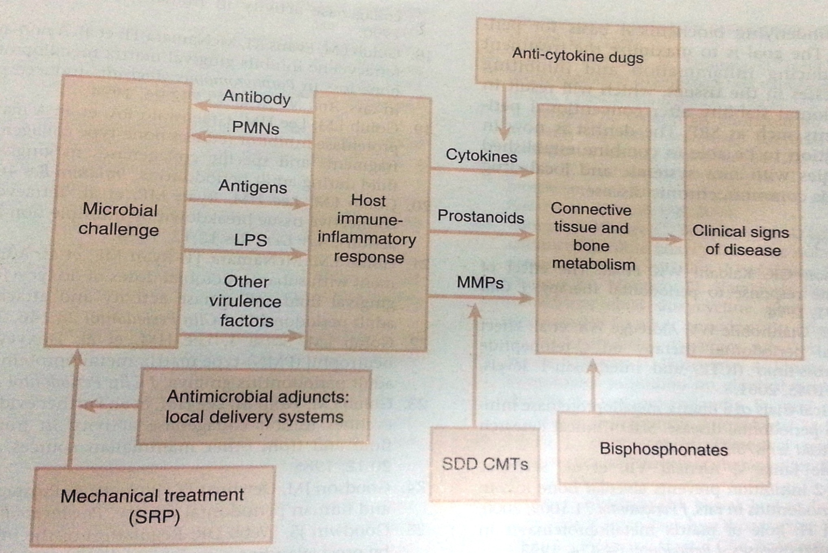
Schematic illustration of the pathogenesis of periodontitis, including targets & potential targets for adjunctive therapies
Carranza’s clinical periodontology 10th Edition , Chapter - 53

Slide 48
Conclusion
In the future a range of HMTs targeting different aspects of the destructive cascade of breakdown events in the periodontal tissues are likely to be developed as adjunctive treatments for periodontitis.
The further development of these agents will permit dentists to treat specific aspects of the underlying biochemical basis for periodontal disease.

Slide 49
References
Taber's Medical Dictionary, 2004
Golub LM, Sorsa T.Host modulation with tetracyclines and their chemically modified analogues.Curr Opin Dent 2:80, 1992.
Grossi SG et al. Assessment of risk for periodontal disease. II. Risk indicators for alveolar bone loss. J Periodontol 65:260;1994.
Genco RJ. Host responses in periodontal diseases:Current concepts.J Periodontol63:338, 1992.
Carranza’s Clinical Periodontology 1oth Edition.Chapter 16 ,Page No. 275-281.
Howell TH, Williams RC . Nonsteroidal antiinflammatory drugs as inhibitors of periodontal disease progression. Crit Rev Oral Biol Med.1993;4(2):177-96.
Williams RC, Jeffcoat MK, Howell TH, et al. Three-year trial of flurbiprofen treatment in humans: post-treatment period . J Dent Res. 1991;70(Spec Iss):1617.

Slide 50
Bezerra MM, de Lima V, Alencar VB, Vieira IB, Brito GA, Ribeiro RA, Rocha FA. Selective cyclooxygenase-2 inhibition prevents alveolar bone loss in experimental periodontitis in rats. J Periodontol. 2000 Jun;71(6):1009-14.
Reddy MS, Smith CA. Alendronate treatment of naturally occuring periodontitisin beagle dogs. J Periodontol 66:211,1995.
Ryan ME, Ramamurthy NS, Golub LM. Matrix Metalloproteinases & their inhibition in periodontal treatment. Cuu opin Periodontol 3:85, 1996.
Carter G, Goss AN, Doecke C. Bisphosphonates & avascular necrosis of the jaw: a possible association. Med J Aust 182:8, 413.
Gapski R, Barr JL, Sarment DP, et al. Effect of systemic matrix metalloproteinases inhibition on periodontal wound repair. J Periodontol 75:441,2004.
Caton JG, Ciancio SG, Bliden TM. Treatment with subantimicrobial dose doxycycline improves the efficacy of scaling & root planing in patients with adult periodontitis. J Periodontol 71:521,2000.

Slide 51
Jeffcoat MK, Reddy MS, Haigh S. A comparison of topical Ketorolac, systemic flurbiprofen, & placebo for the inhibition of bone loss in adult periodontitis. J Periodontol 66:329;1995.
Grenier D, Sorsa T. Inhibition of proteolytic, serpinolytic and pro-gelatinase b activation activities of periontopathogens by docycycline & non-antimicrobial chemically modified tetracyclines derivatives. J Periodontol 73:79,2002.
Leitão RF, Ribeiro RA, Chaves HV, Rocha FA, Lima V, Brito GA. Nitric oxide synthase inhibition prevents alveolar bone resorption in experimental periodontitis in rats. J Periodontol. 2005 Jun;76(6):956-63.
Lappin, D.; Kjeldsen, M.; Sander.et al.Copenhagen : Munksgaard International Publishers. Inducible nitric oxide synthase expression in periodontitis . Journal of periodontal research 35 (2000).
Trepicchio WL, Bozza M, Pedneault G, Dorner AJ. Recombinant human IL-11 attenuates the inflammatory response through down-regulation of pro-inflammatory cytokine release and nitric oxide production. J Immunol. 1996;157:3627–34.

Slide 52
Leng SX, Elias JA. Interleukin-11 inhibits macrophage interleukin-12 production. J Immunol.1997;159:2161–8.
Vardar S, Buduneli E, Baylas H, Berdeli AH, Buduneli N, Atilla G. Individual and combined effects of selective cyclooxygenase- 2 inhibitor and omega-3 fatty acid on endotoxin-induced periodontitis in rats. J Periodontol. 2005;76:99–106.

