Slide 1

INCISIONS AND FLAP DESIGN
DEPARTMENT OF PERIODONTICS
at
ITS Dental College , Hospital And Research Centre, Greater Noida

Slide 2
VARIOUS INCISIONS USED IN PERIODONTAL SURGERY
Horizontal Incisions
Internal bevel incision
Crevicular incision
Interdental incision

Slide 3
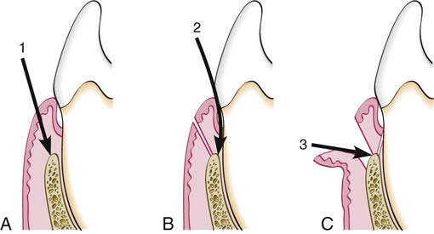

Slide 4
Internal bevel incision—First/ basic incision
It starts from a designated area on the gingiva and is directed to an area at or near the crest of the alveolar bone.
Given with the help of 11 or 15 no. surgical blade .
Morris in 1965 introduced internal bevel incision .
It separates the pocket wall from the rest of the mucoperiosteal flap and produced a healthy thin and flexible margin.
Also known as REVERSE BEVEL INCISION

Slide 5
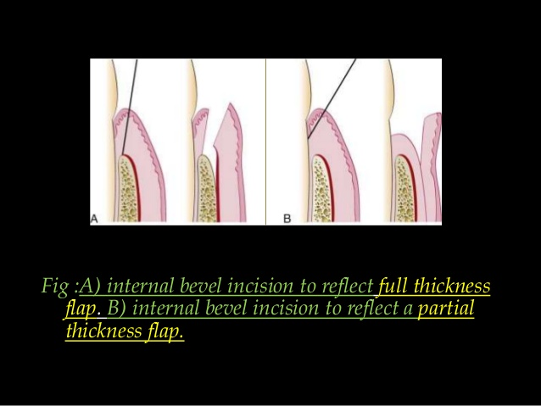
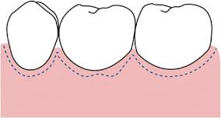

A: INTERNAL BEVEL INCISION to reflect Partial Thickness Flap
B : INTERNAL BEVEL INCISION to reflect Full Thickness Flap

Slide 6
OBJECTIVES
1. It removes the pocket lining.
2. It conserves the relatively uninvolved outer surface of the gingiva.
3. It produces a sharp, thin flap margin for adaptation to the bone–tooth junction

Slide 7
INDICATIONS
If :
1. There is a sufficient band of attached gingiva.
2. Thick gingiva (such as palatal gingiva).
3. Deep periodontal pockets and bone defect.
4. Desire to lengthen clinical crown.

Slide 8
Crevicular/Sulcular incision—Second incision.
It is made from the base of the sulcus to the crest of the alveolar bone.
This incision is carried around the entire tooth with the help of 12 no. surgical blade.

Slide 9
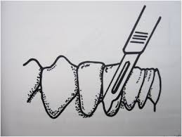
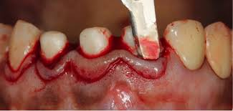
CREVICULAR INCISION from base of the pocket to crest of alveolar bone.

Slide 10
INDICATIONS
If there is :
1. Narrow band of attached gingiva.
2. Thin gingiva and alveolar process.
3. Shallow periodontal pocket.
4. Desire to lessen postoperative gingival recession for esthetic reasons in the maxillary anterior region.
5. As a secondary incision of usual flap surgery.
6. Bone graft or GTR procedure: Desire to preserve as much periodontal tissue (especially interdental papilla) as possible to completely cover grafted bone and membrane by flap.

Slide 11
Interdental incision: Third incision.
This incision is made in a horizontal direction and close to the surface of the bone crest, thereby separating the soft tissue collar from the root surfaces and alveolar bone.
Given by Orban’s knife.
The third incision facilitates secondary flap removal as a single piece.

Slide 12
Vertical Incisions
Vertical incision must extend beyond the mucogingival line.
It should be made at the line angles of a tooth either to include the papilla in the flap or to avoid it completely.
Thus, vertical incision should be placed on the tooth surface rather than on interdental gingiva .
Vertical incision in lingual and palatal areas are avoided.

Slide 13
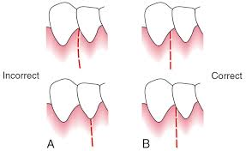
These should be designed so as to avoid short flap mesiodistally with long apically directed horizontal incision because this could jeopardize the blood supply to the flap.
Given with the help of 11 or 15 no. surgical blade.

Slide 14
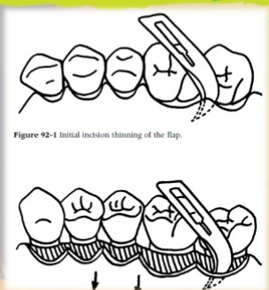
Thinning Incisions
Extends from gingiva towards the base of the flap in palatal flap and distal wedge procedures.
Given with the help of 11 or 15 no. surgical blade.

Slide 15
Cut Back Incision
Made at apical aspect of releasing incision and directed towards base of the flap in laterally positioned flap.
Given with the help of 11 or 15 no. surgical blade.

Slide 16
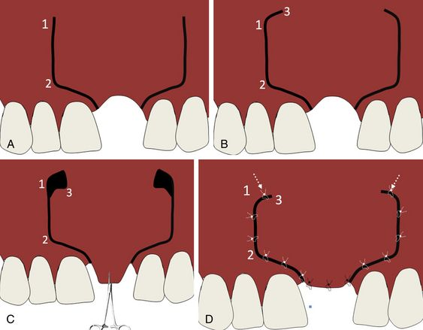

Slide 17
Periosteal Releasing Incision
Made at the base of flap severing the underlying periosteum.
Given with the help of 15 or 15C no. surgical blade.

Slide 18
OBJECTIVES OF PERIODONTAL FLAP
i)Provide access for root surface detoxification.
ii) Reducing probing depth including those that extend to or beyond the mucogingival junction.
iii) Preserve/create an adequate zone of attached gingiva.
iv) Permits access to underlying bone for treatment of osseous defects.
v) Facilitate regenerative procedures.

Slide 19
PRINCIPLES OF FLAP DESIGN
According to Hupp (1993), the following principles should be followed for flap design.
Prevention of flap necrosis:
• The apex of the flap should never be wider than the base.
• The flap sides should either run parallel to each other or preferably converge moving from the base of the flap to the apex of the flap.
• Length of the flap should be no more than twice the width of the base

Slide 20
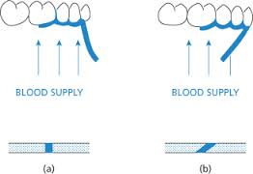

Slide 21
PRINCIPLES OF FLAP DESIGN
Prevention of flap tearing:
Vertical releasing incisions should be placed one full tooth anterior to the sites of any anticipated bone removal.
Vertical incision should be started at the line angle of the tooth or in the adjacent interdental papilla and carried obliquely apically into the unattached gingiva.

Slide 22
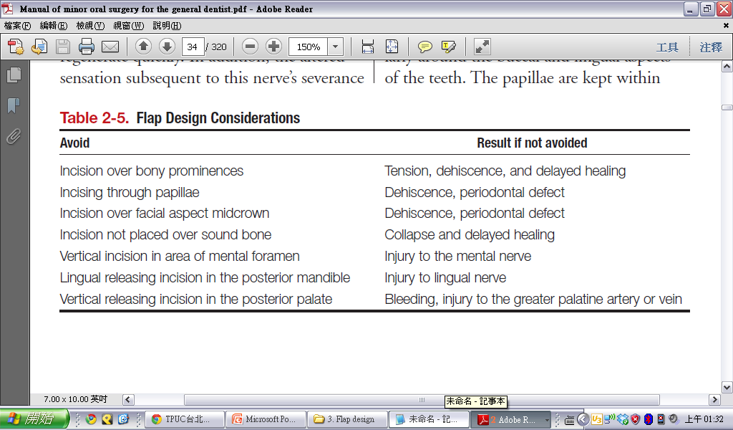

Slide 23
CLASSIFICATION OF PERIODONTAL FLAPS
According to flap reflection or tissue content:
Full thickness flap
Split-thickness flap

Slide 24
CLASSIFICATION OF PERIODONTAL FLAPS
According to management of papilla
Conventional flap
Papilla preservation flap

Slide 25
CLASSIFICATION OF PERIODONTAL FLAPS
According to flap placement after surgery:
Undisplaced flap
Displaced flap
Apical displaced flap
Coronal displaced flap
Lateral displaced flap

Slide 26
MUCOPERIOSTEAL
FLAP
A full-thickness flap is used to expose the bone surface in osseous surgery
1. Area where treatment for osseous defect with mucogingival problem is not required.
2. Thin periodontal tissue with probable osseous dehiscence and osseous fenestration.
3. Area where alveolar bone is thin.
INDICATIONS
CONTAINDICATIONS

Slide 27
Types of Mucoperiosteal Flaps
Envelope/ Sulcular incision
Envelope with one releasing incision (three-corner flap)
Envelope with two releasing incisions (four-corner flap)
Semilunar incision
Y-incision
Pedicle flap
Full-thickness mucoperiosteal flap

Slide 28
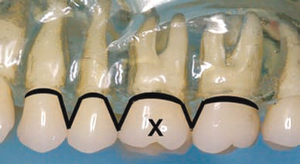
Types of Mucoperiosteal Flaps
1. Envelope/ Sulcular flap
2 teeth anterior
1 tooth posterior

Slide 29
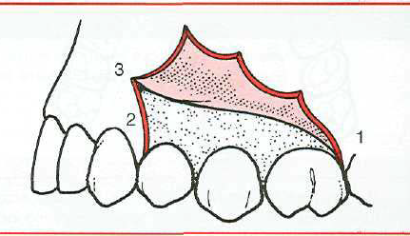
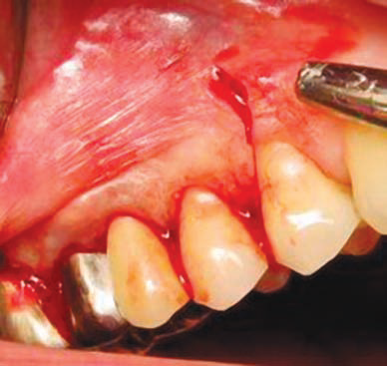
Types of Mucoperiosteal Flaps
2. Three-corner flap
1 tooth anterior
1 tooth posterior

Slide 30
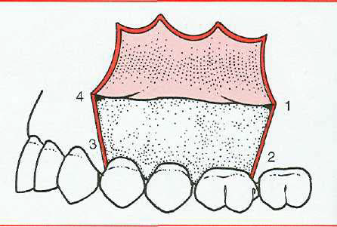
Types of Mucoperiosteal Flaps
3. Four-corner flap
1 tooth anterior
1 tooth posterior
rarely indicated

Slide 31
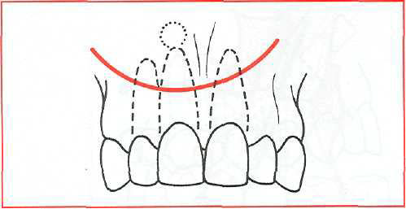
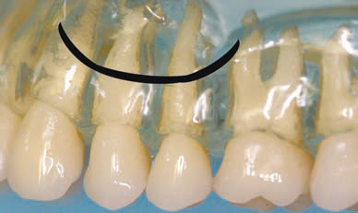
Types of Mucoperiosteal Flaps
4. Semilunar incision
to approach the root apex
avoids trauma to the papillae and gingival margin
useful for periapical surgery of a limited extent.
should not cross major prominences, ex: canine eminence

Slide 32
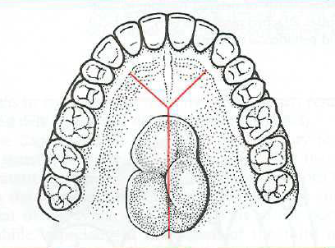
Types of Mucoperiosteal Flaps
5. Y-incision
removal of a maxillary palatal torus

Slide 33
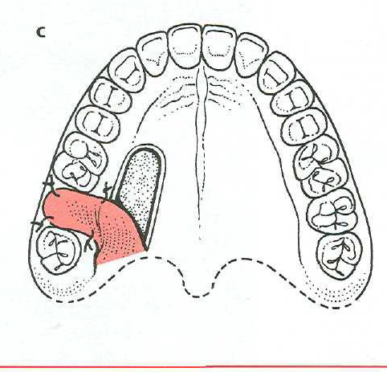
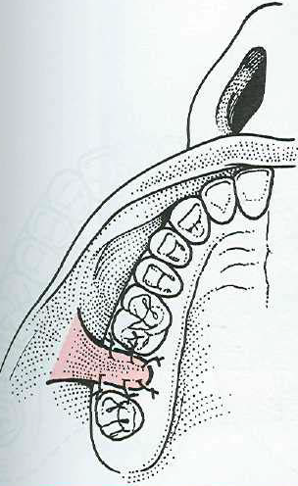
Types of Mucoperiosteal Flaps
6. Pedicle flap
mobilizes from one area and then rotates to fill a soft tissue defect in another area.
closure of oroantral communications

Slide 34
SPLIT THICKNESS FLAP
Gingiva is dissected from the underlying periosteum which is left on the bone and consists of epithelium and thin layer of connective tissue.
Sharp dissection is used to produce a partial thickness flap.

Slide 35
Partial-thickness flap is prepared while holding and pulling the flap edge with tissue pliers, turning the blade toward the gingival margin.
The flap is dissected slowly from an apico-occlusal direction.
To prevent flap penetration, use the side of the blade and hold it parallel to the periosteum to make the incision

Slide 36
Split Thickness Flap
INDICATIONS
For augmentation of the attached gingiva.
When exposure of bone is to be avoided as in the case of fenestration/dehiscence.
ADVANTAGES
The flap can be attached firmly to the desired position with a periosteal suture if the reflected flap is displaced apically and the thin marginal bone can be protected by the periosteum-connective tissue bed.
DISADVANTAGES
If the thickness of the remaining periosteum-connective tissue bed on the bone is less than 0.5 mm, the remaining periosteum-connective tissue may become necrotic, with decreased protective effect for the alveolar bone.
Difficult technique

Slide 37
MODIFIED WIDMAN FLAP
OBJECTIVES
ADVANTAGES
Minimum trauma to alveolar bone and
Access to adequate instrumentation of the root surface.
Close adaptation of soft tissue to root surface.
To remove the pocket lining.
Residual deposits of subgingival calculus left in deep pockets are thus removed.
To facilitate instrumentation on root surfaces by exposing them

Slide 38
UNDISPLACED FLAP PROCEDURE
It is also called as Internal bevel gingivectomy because the soft tissue pocket wall is removed with the initial incision.
OBJECTIVES:
i. To reduce or eliminate pocket by removing pocket wall.
ii. To improve accessibility for instrumentation.

Slide 39
LATERALLY DISPLACED FLAP
A LPPG cannot be performed unless there is significant gingiva lateral to the site of recession.
A shallow vestibule also may jeopardize outcomes.
Although the use of the LPPG provides an ideal color match, it often is inadequate for the treatment of multiple recessions

Slide 40
APICALLY DISPLACED FLAP
OBJECTIVES
i. To eliminate pocket by apically positioning the soft tissue wall of the pocket.
ii. To preserve/increase the width of attached gingiva.
iii. To improve accessibility.

Slide 41
APICALLY DISPLACED FLAP
The position of the flap displacement varies depending on the:
1.Thickness of alveolar margin in operating area.
2. Width of attached gingiva.
3. Clinical crown length necessary for an abutment.

Slide 42
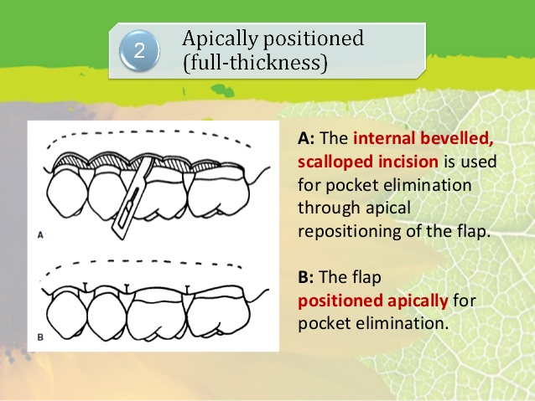

Slide 43
APICALLY DISPLACED FLAP
ADVANTAGES
DISADVANTAGES
1. Apically repositioned flap results in pocket elimination and the formation of a normal/physiological length of junctional epithelium whereas the replaced flap results in the formation of a long junctional epithelium which may adhere to the root surface.
2. Preserves attached gingiva and increases its width.
3. Establishes gingival morphology facilitating good hygiene.
4. Ensures healthy root surface necessary for the biologic width on alveolar margin and lengthen clinical crown.
1. May cause esthetic problems due to root exposure.
2. May cause attachment loss due to surgery.
3. May cause hypersensitivity.
4. May increase the risk of root caries.
5. Possibility of exposure of furcations and roots, which complicates postoperative supragingival plaque control.

Slide 44
PAPILLA PRESERVATION FLAP
Indications:
i. Diastema region.
ii. Bone grafting areas.
Contraindication:
i. Narrow embrasures.
Advantages:
i. Esthetically pleasing.
ii. Primary coverage of implant.
iii. Prevents postoperative tissue craters.
Disadvantages:
i. Technically difficult.
ii. Time consuming.

Slide 45
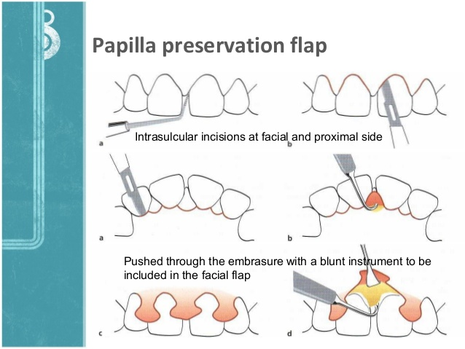

Slide 46
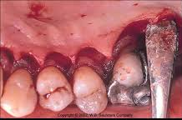
PALATAL FLAP
Indications:
i. Areas that require osseous surgery.
ii. Pocket elimination.
iii. Reduction of enlarged and bulbous tissue.

Slide 47
PALATAL FLAP
Contraindication:
It is contraindicated when the palate is broad and shallow.
Special care must be taken performing a palatal flap due to several anatomic structures:
• Greater palatine artery and nerve may be damaged if flap reflection is extensive in molar region.
• Palatal exostoses present in molar region in 1/3rd of the patient. It creates thin tissue in the region and make proper flap margin placement difficult.
• Incisive papilla present in anterior palate.
• Presence of palatal rugae at or near the flap margin create poor gingival margin contours postsurgically.

Slide 48
SUTURING TECHNIQUES
FLAP PROCEDURE | SUTURING TECHNIQUE
MODIFIED WIDMAN FLAP PROCEDURE | Interdental suturing
UNDISPLACED FLAP PROCEDURE | Continuous sling suture
APICALLY DISPLACED FLAP PROCEDURE | Interrupted sutures at the mesial and distal vertical incisions. Full thickness flap by sling suture. Partial thickness flap is secured with direct loop suture or a combination of loop and anchor suture.
PAPILLA PRESERVATION FLAP | Cross mattress suture Alternatively, a direct suture of the semilunar incisions can be done as the only means of flap closure

Slide 49
CORONALLY ADVANCED FLAP | Interrupted sutures.
LATERALLY DISPLACED FLAP | Interrupted sutures.

Slide 50
