Slide 1
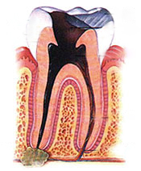
The periodontic-endodontic
LESIONS
DEPARTMENT OF PERIODONTICS
AT
I.T.S DENTAL COLLEGE, HOSPITAL & RESEARCH
CENTRE, GREATER NOIDA

Slide 2
Contents
Introduction
Pathways of communication
Classifications
Effects of periodontitis on dental pulp
Effects of pulpal disease on periodontium
Differentiation between periodontal and pulpal lesions
Differentiation between pulpal and periodontal abscess
Microbiological aspects of endo-periodontal lesions
Management of endo-periodontal lesions

Slide 3
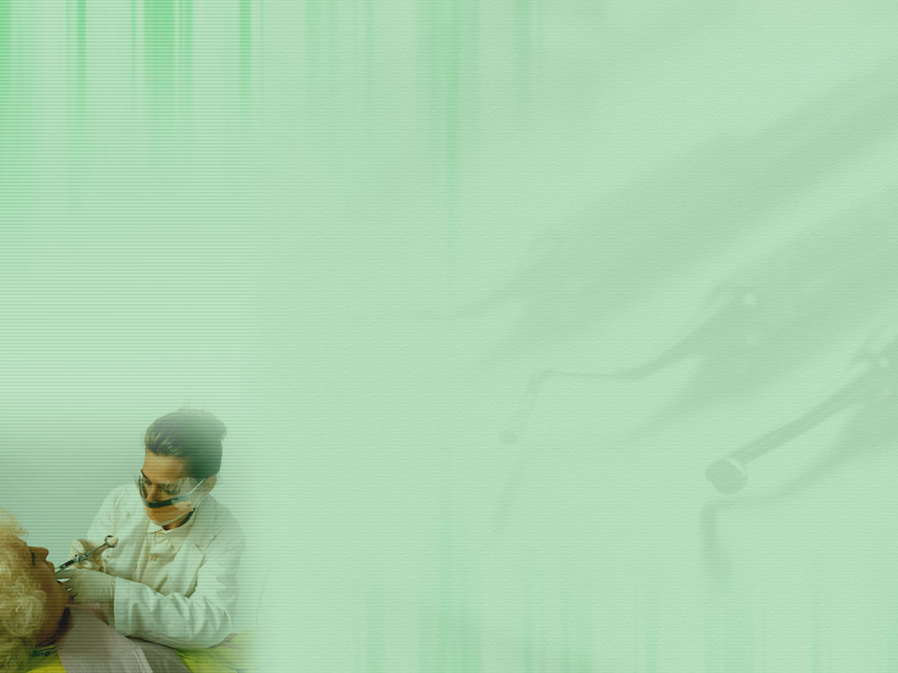
introduction
Pulpal and Periodontal tissues have close embryonic, anatomic and functional inter relationships.
Tissues of dental pulp and periodontium are inter linked from the embryonic stage. The dental papilla and the dental sac are of a common mesodermal origin.

Slide 4
The term “pulpodontic-periodontic” syndrome has been used to define a syndrome involving inflammation or degeneration of the pulp with a periodontal pocket adjacent to the same tooth¹.
This syndrome can be initiated by either pulpal or periodontal disease and may manifest pulpal and periodontal symptoms

Slide 5
Pathways of communication
Pathways of communications between pulp and periodontium can be classified into 3 main categories².
Physiological
Developmental
Non physiological
Pathologic
Iatrogenic

Slide 6
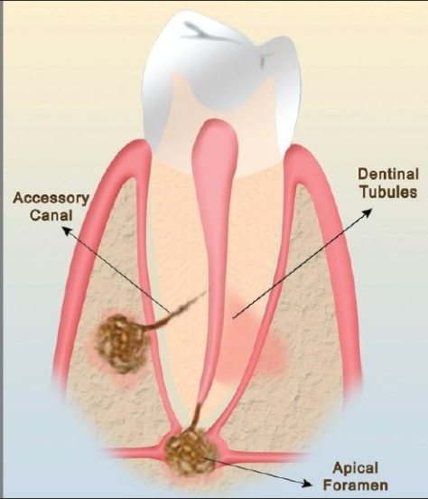
PATHWAYS OF COMMUNICATION
Ref- The periodontal – endodontic continuum: A review-J Conserv Dent. 2008 Apr-Jun; 11(2): 54–62

Slide 7
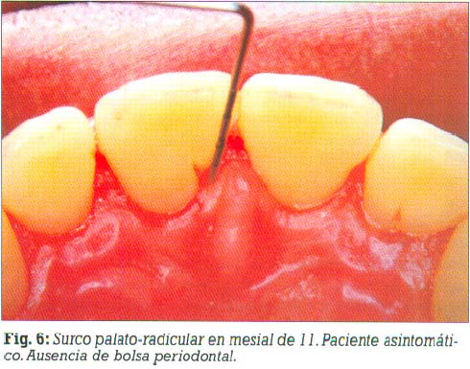
Pathways of Developmental Origin²:
Apical foramen,
Accessory canals/lateral canals
Congenital absence of cementum exposing dentinal tubules.
Permeability of cementum,
Developmental grooves
Common on maxillary lateral incisors. (Withers et al 1981)
Developmental anomalies such as enamel projections and enamel pearls.

Slide 8
Pathways of Pathological Origin²:
Empty spaces on root created by Sharpey’s fibers
Root following trauma
Idiopathic resorption- Internal and external
Loss of cementum due to external irritants.

Slide 9
Pathways of Iatrogenic Origin²:
Exposure of dentinal tubules following root planing
Accidental lateral perforation - endodontic procedures
Root fractures - endodontic procedures

Slide 10
apical foramen²:
Major connections between periodontal and pulpal tissues and direct route of communication.
The apex is also a portal of entry of inflammatory by products from deep periodontal pockets to the pulp.
Pulpal inflammation or pulp necrosis extends into the periapical tissues causing a local inflammatory response accompanied by bone and root resorption

Slide 11
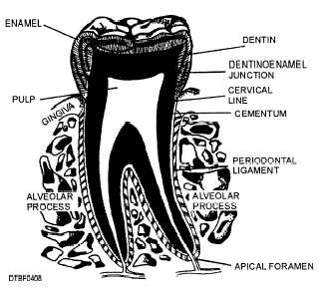
Image showing apical foramen
Ref- The periodontal – endodontic continuum: A review-J Conserv Dent. 2008 Apr-Jun; 11(2): 54–62

Slide 12
lateral and accessory canals²
Cohen(1984) made the distinction that lateral canals are those that run perpendicular to the main canal where as accessory canals branch off and run parallel to the main canal.
DeDeus (1975) found 17% of the teeth have lateral and accessory canals in apical third, 9% in middle third, and <2% in the coronal third.
More common in posteriors

Slide 13
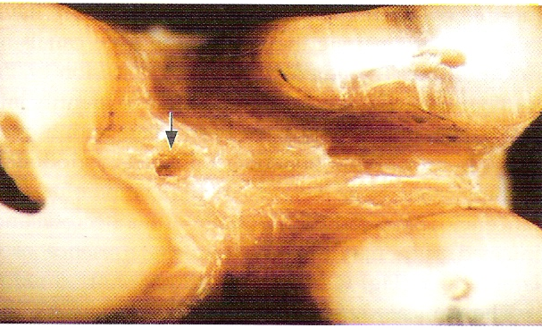
Accesory canals in the furcation of molars may also be a direct pathway of communication between the pulp and periodontium.
Ref- The periodontal – endodontic continuum: A review-J Conserv Dent. 2008 Apr-Jun; 11(2): 54–62

Slide 14
exposed dentinal tubules²
Dentinal tubules can get exposed due to developmental defects in cementum.
Congenital absence of cementum in the CEJ renders about 15,000 dentinal tubules exposed per mm of external root surface and can create a channel of communication.
Exposure of dentinal tubules may occur due to:
Developmental defects
Diseases
Or periodontal procedures

Slide 15
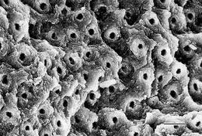
Histological section of Exposed dentinal tubules
Ref- The periodontal – endodontic continuum: A review-J Conserv Dent. 2008 Apr-Jun; 11(2): 54–62

Slide 16
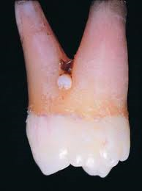
Developmental grooves³
The palatal groove formed as an antomic variant on the crown and root of maxillary incisor could be classified as a combined endo-perio lesion when pathology occurs around these roots.
Enamel projections and pearls
Cervical enamel projections are ectopic extensions of enamel that extend beyond the normal contour of CEJ. These may favour the development of pocket.

Slide 17
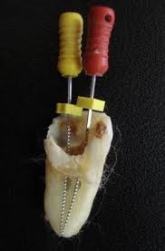
Non physiological pathways³
Iatrogenic root canal perforation
These are serious complications during dental treatment and have a rather poor prognosis

Slide 18
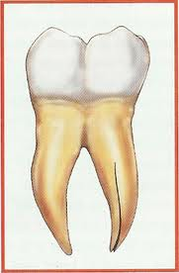
Vertical root fractures³
Vertical root fractures are caused by trauma and have been reported to occur in both vital and non-vital teeth The incidence of vertical root fractures is higher in teeth that:
  filled with lateral condensation techniques.
  Perforations – These mayresult from extensive carious lesions, resorption,

Slide 19
classifications^{3,4}
Simon, Glick and Frank(1972) based on etiology, diagnosis, prognosis and treatment.
Type 1 - Primary endodontic lesions
Type 2 - Primary endodontic lesions with secondary periodontal involvement.
Type 3 – Primary periodontal lesions
Type 4 – Primary periodontal lesions with secondary endodontic involvement.
Type 5 – True combined lesions.

Slide 20
II. Based on treatment plan, Grossman classification (1988^{)4.}
Type 1 – Requiring endodontic treatment only.
Type II – Requiring periodontal treatment only.
Type III – Requiring combined endo-perio treatment

Slide 21
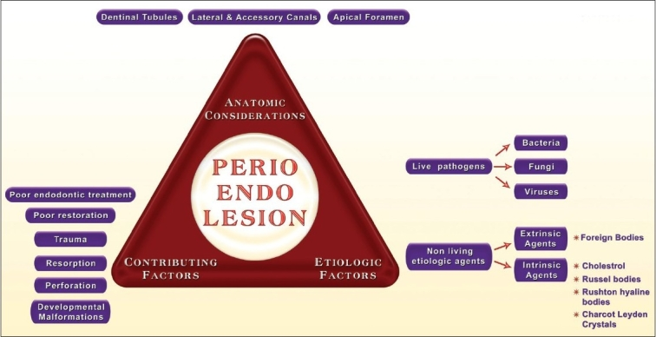
Etio pathOGENESIS of endo-perio lesions^{2,4}

Slide 22
Etiological factors⁵
Among the live pathogens encountered in a diseased pulp and periapical tissue are
1.bacteria
2.fungi
3.viruses

Slide 23
Bacteria associated with pulpitis⁴
Eubacterium ssp.
Fusobacterium ssp.
Porphyromonas spp.
Prevotella spp.
Streptococcus spp.
Lactobacillus spp.
Actinomyces spp.

Slide 24
Bacteria associated with periodontitis⁵
Current classification Previous status
Compylobacter rectus Wolinella recta
Porphyromonas endodontalis Bacteroides endodontalis
Porphyromonas gingivalis Bacteroides gingivalis
Prevotella denticola Bacteroides denticola
Prevotella intermedia Bacteroides intermedia
Prevotella loescheii Bacteroides loescheii
Prevotella melaninogenica Bacteroides melaninogenica
Prevotella nigrescens New species
Treponema lecithinolyticum New species

Slide 25
Differentiation between periodontal and periapical abscess⁵
Periodontal abscesses
- these are not usually severely painful
- they occur in the pocket or sulcus at the level of the connective tissue attachment, so there is little or no elevation of the periosteum to cause significant pain
- any stimulus to the site can be painful.
- formation of fistula is less common than with apical periodontitis

Slide 26
Acute apical abscess ⁵:
- commonly communicate directly with the external soft tissue surface by a sinus tract through the oral mucosa or gingiva
- before the completion of the tract, the patient commonly experiences extreme pain because of the involvement of the periodontal ligament & the elevation of the periosteum
- perforation of the plate is accompanied by swelling, pus formation, and collection under the periosteum

Slide 27
Influence of periodontal disease on pulp⁶
It may be perpetuated that bacterial and the inflammatory products of periodontitis could gain access to the pulp via accessory canals, apical foramina, or dentinal tubules.
This process, the reverse of the effects of a necrotic pulp on the periodontal ligament, has been referred to as retro-grade pulpitis⁵.
Periodontitis rarely produces significant changes in the dental pulp. It has been suggested that the presence of an intact layer of cementum may protect the pulp from injurious elements produced by the plaque microbiota.

Slide 28
Severe breakdown of the pulp apparently does not occur until periodontitis has reached a terminal state- that is, when bacterial plaque has involved the main apical foramina⁵.
The pulp has a good capacity for defense as long as the blood supply via the apical foramina is intact. Therefore retrograde pulpitis, if it occurs, is exceedingly rare.

Slide 29
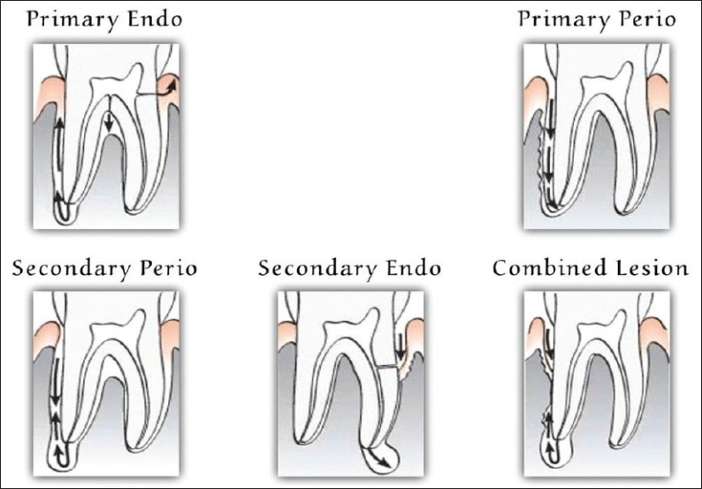
Different types of endo-perio problems²

Slide 30
A. originally an endodontic problem, with fistulization from the apex & along the root to the gingiva.
B. long-standing periapical lesion draining through the periodontal ligament can become secondarily complicated, leading to retrograde periodontitis².

Slide 31
C. Periodontal pocket can deepen to the apex & secondarily involve the pulp.
D. Periodontal pocket can infect the pulp through lateral canal, which in turn can result in a periapical lesion.
E. Two independent lesions, periapical & marginal, can co-exist and eventually fuse with each other².

Slide 32
Therapeutic management of endo-perio lesions!⁴

Slide 33
Primary endodontic lesion⁴
Causes: Deep carious lesion, large restoration approximating the pulp, history of a pulpotomy, pulp capping, poor root canal treatment.
Symptoms: Mobility, Localized bone loss, Narrow pocket, Tenderness to percussion, Sinus tract & Swelling
Diagnosis
Radiographs, Pulpal vitality test, Tracing of sinus tract & periodontal probing
Treatment: Complete resolution is usually anticipated after conventional endodontic therapy.

Slide 34
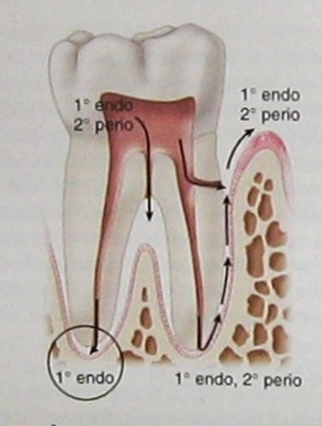
Primary endo secondary perio⁴

Slide 35
Primary endodontic secondary periodontic lesion⁴
Characteristics: Long standing pulpal pathosis leads to destruction of PDL apparatus.
Accumulation of plaque and calculus results in further apical migration of the attachment.
Diagnosis: Radiographs, Pulp is usually nonvital, Periodontal probing (presence of plaque and calculus & pockets)
Treatment: Endodontic and Periodontic treatment.

Slide 36
Primary periodontal lesion⁴
Characteristics: Teeth are vital, presence of generalized bone loss, calculus/plaque & soft tissue inflammation, broad based pockets, mobility, periodontal abscess during acute phase of the disease.
Diagnosis: Visual examination, probing, pulp testing & radiographs.
Treatment: Periodontal therapy, Root amputation, Guided tissue regeneration & Pulp space therapy (advanced cases)

Slide 37
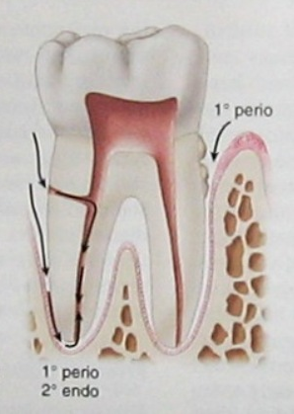
PRIMARY PERIO SECONDARY ENDO⁴

Slide 38
Primary periodontal secondary endodontic lesion⁴
Characteristics: Presence of deep periodontal pockets & history of extensive periodontal procedures
Symptoms: Sensitivity to temperature, tenderness on percussion & presence of mobility and swelling.
Diagnosis: History of disease progression, probing, pulp testing & radiographic changes
Treatment: Pulp space therapy, periodontal therapy, root amputation &Guided tissue regeneration.
Prognosis: Depends on continuing periodontal treatment subsequent to endodontic therapy.

Slide 39
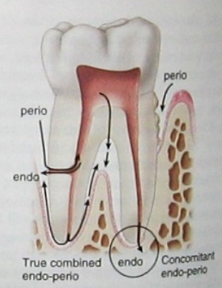
TRUE COMBINED ENDO-PERIO LESION⁴

Slide 40
Combined pulpal periodontal lesion⁴
Characteristics: Once the pulpal and periodontal lesions coalesce, they may be clinically indistinguishable. Necrotic pulp/ failed Endodontic treatment, plaque, calculus and periodontitis will be present in varying degrees.
Diagnosis: Probing, radiographs, pulpal testing & true combined endo-perio disease

Slide 41
Treatment: Endodontic therapy, periodontal therapy, hemisection, bicuspidization & root amputation.
Prognosis: Depends on the each individual factor. Adequate root canal therapy resulted in resolution of the periapical lesion, prognosis of the affected tooth then depends totally on the outcome of periodontal therapy.

Slide 42
REFERENCES
1- FerminA.Carranza,Newmann,Takei;Clinical Periodontology;10thedition
2-The periodontal – endodontic continuum: A review-J Conserv Dent. 2008 Apr-Jun; 11(2): 54–62
3- Endo-Perio Lesions :International Journal of Scientific & Technology Research volume 2, issue 5, may 2013
4-The Periodontol –Endodontic controversy:Perio 2000;(30)2002,123-130.
5-Microbiology and treatment of dental abscesses and periodontal-endodontic lesions:Perio 2000(28)2002,206-239.
6-Treatment ,prognosis and decision- Making in the treatment of combined periodontol-endodontic lesions:Perio 2000(34)2004,165-203.
7- Treatment of periodontol –endodontic lesions-A systematic review:J clin Periodontology vol 41(8) 779-790,August 2014.
8-The chicken or the egg? Periodontal-endodontic lesions. Quintessence International 2007;4(1):15-21

