Slide 1
Periodontal/supportive Maintenance Therapy
(PMT/spt)

Slide 2
:
Periodontal treatment
Eliminate existing disease and
Prevent future disease progression.
Pockets <5mm with no bleeding are less likely to show future disease progression and is considered a satisfactory outcome to periodontal treatment.
Following completion of initial nonsurgical therapy the re-evaluation appointment is crucial to determine the
response to the treatment, at both the tooth level and the patient level and to decide on any further treatment will be required.

Slide 3
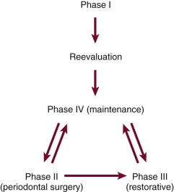

Slide 4
Re-evaluation
“treated site”: < 5 mm and not bleeding.
2. “responding” or “partially treated” site: one that shows improvement (pocket depth reduction) from baseline but that is still 5 mm or greater or still bleeds on probing.
3. A “nonresponding site” one that has shown no improvement from baseline or shows deterioration

Slide 5
Supportive Periodontal Therapy
“Supportive periodontal therapy should be directed towards limiting disease progression, identifying those sites that continue to break down and providing additional treatment when indicated”

Slide 6
Objectives Of Periodontal Maintenance:
To prevent the progression and recurrence of periodontal disease.
To prevent the tooth loss and dental implants after clinical stability has been achieved.
To diagnose and manage, in a timely manner, other diseases or conditions found within the oral cavity.

Slide 7
Rationale for SPT
Poor motivation and plaque control
Incomplete subgingival plaque removal
Healing by weak long Junctional Epithelium
Notes:
slow process compared with that of supragingival plaque. During this period (perhaps months), the subgingival plaque may not induce inflammatory reactions that can be discerned at the gingival margin. The clinical diagnosis may be further confused by the introduction of adequate supragingival plaque control because the inflammatory reactions caused by the plaque in the soft tissue wall of the pocket are not likely to be manifested clinically as gingivitis.
Thus inadequate subgingival plaque control can lead to continued loss of attachment, even without the presence of clinical gingival inflammation.

Slide 8
Clinical significance of SPT

Slide 9
Annual rate of tooth loss after SPT
Authors / year | Mean annual rate of tooth loss | Treatment/SPT provided?
Loe et al. 1986 | 0.1 - 0.3 | Untreated
Becker et al. 1979 | 0.61 0.11 <0.1 | Untreated Treated Treated/SPT
Hirschfeld & Wasserman 1978 | 0.03 | Treated/SPT
Wilson et al. 1987, | 0.06 | Treated/SPT

Slide 10
Frequency of supportive periodontal care
Gingivitis patients but no previous attachment loss – SPT twice a year will suffice.
Patients with previous history of chronic periodontitis - At least 4 times a year.
Microorganisms level after scaling and root planing return to baseline between 9 and 11 weeks.
Compliance with suggested SPT intervals can affect the success of treatment.

Slide 11

Overview
What is Periodontal Maintenance Therapy (PMT)
Rationale and significance
‘Risk analysis’
SPT in daily practice
SPT and Implants
More Free PowerPoint Templates at SmileTemplates.com

Slide 12
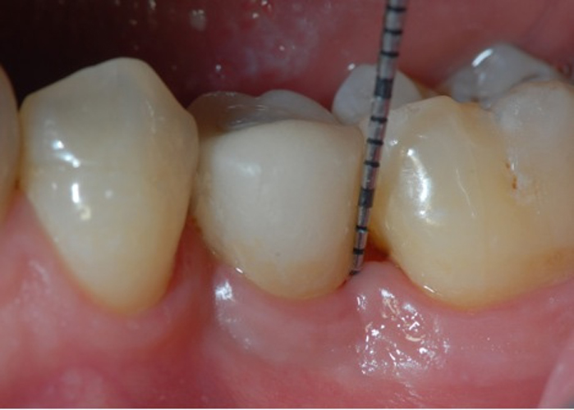
SPT in daily practice
What does it involve?
When does it start?
Who performs it?
How frequently?

Slide 13
Maintenance visit
Update PMH and PDH
Clinical examination
Radiographs if necessary
Assess OH
Treatment including OHI, SRP, restoration, Fluoride
Discussion
Arrange next appointment

Slide 14
Maintenance recall procedures
Lasts around One hour
Part I: Examination
Part II: Treatment
Part III: Discussion, reporting, schedule…

Slide 15
Part I: Examination (~14 min)
Patient greeting
Oral pathologic examination
Oral Hygiene status
Pocket depth changes
mobility/furcation changes
Occlusal changes
Restorative, prosthetic and implant status

Slide 16
Failing case can be recognized by the following:
Recurring inflammation
Increasing depth of sulci
Gradual increases in bone loss
Gradual increases in tooth mobility

Slide 17
Recurrence of periodontal disease
Inadequate or insufficient treatment (local factors, areas of difficult access).
Inadequate restorations placed after the periodontal treatment was completed.
Failure of the patient to return for periodic check-ups .( due to poor compliance or failure if dentist or staff to emphasize the need for periodic examinations).
Presence of some systemic diseases that may affect host resistance to previously acceptable levels of plaque.

Slide 18
Radiographic examination
Must be individualized.
Depends on the initial severity of the case and the findings at the recall visit .
These are compared with findings on previous radiographs to check :
  the bone height
  repair of osseous defects,
  signs of trauma from occlusion,
  periapical pathologic changes,
  caries.

Slide 19
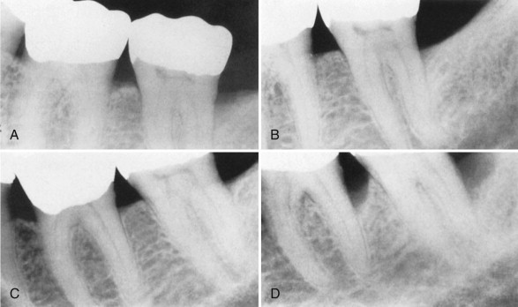
Notes:
This series of radiographs clearly shows the importance of maintenance therapy. A, Original radiograph of a 58-year-old male. Note the deep distal bone loss on tooth #18 and the moderate distal lesion of tooth #19. Surgical treatment included osseous grafting. B, Radiograph 14 months after surgical therapy. The patient had recall maintenance performed every 3 to 4 months. C, Appearance 3 years after surgery, with regular recalls every 3 to 4 months. D, Appearance after 2 years without recalls (7 years after surgery). Note the progression of the disease on the distal surfaces of teeth #18 and #19.

Slide 20
Radiographic Examination of Recall Patients for Supportive Periodontal Treatment
Patient Condition/Situation | Type of Examination
Clinical caries or high-risk factors for caries. | Posterior bite-wing examination at 12- to 18-month intervals.
Clinical caries and no high-risk factors for caries. | Posterior bite-wing examination at 24- to 36-month intervals.
Periodontal disease not under good control. | Periapical and/or vertical bite-wing radiographs of problem areas every 12 to 24 months; full-mouth series every 3 to 5 years.
History of periodontal treatment with disease under good control. | Bite-wing examination every 24 to 36 months; full-mouth series every 5 years.

Slide 21
Part II Treatment (~36 min)
  Oral Hygiene reinforcement
  Scaling
  Polishing
  Root planing
  Chemical irrigation or site-specific antimicrobial placement
  Restorations
  Fluoride application

Slide 22
Part III: Report, Clean-up, and Scheduling (~10 min)
  Write report in chart.
  Discuss report with patient
  Clean and disinfect operatory
  Schedule next recall visit
  Schedule further periodontal treatment
  Schedule or refer for restorative or prosthetic treatment

Slide 23
When?
SPT should start when the initial/corrective phase of therapy has been completed
SPT is ongoing for the life of the patient, while there are teeth or implants present

Slide 24
SPT in daily practice
What does it involve?
When does it start?
Who performs it?
How frequently?

Slide 25
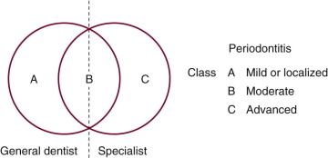
Who should provide SPT?
Notes:
he most important factors in the decision are the extent and location of the periodontal deterioration.

Slide 26
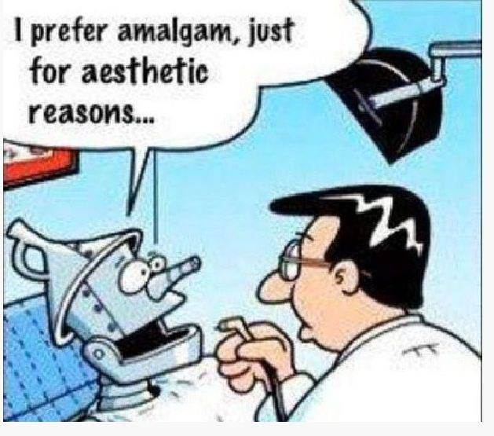
Frequency
The interval between visits is initially set at 3 months .
Tailored to the individual needs of each patient.
Decided by the clinician based on the
  History of disease progression
  Patients medical history
  Compliance with oral hygiene instructions
  Disease extent and severity.

Slide 27
Frequency
The recall interval for first-year patients should not be longer than 3 months.
  educating the patient & reinforcing oral hygiene may take several months
  to evaluate accurately the results of some periodontal surgical procedures
  some areas may have to be re-treated because the results may not be optimal.
  the first-year patient often has etiologic factors that may have been overlooked and may be more amenable to treatment at this early stage.
SPT plan is continuously reviewed and updated

Slide 28
BUT…
Not all patients are at equal risk of developing disease progression

Slide 29
Risk assessment
Risk factors increase probability of disease.
Risk assessment is essential for identifying susceptible individuals and tailor treatment.
Multi-factorial disease

Slide 30
Risk assessment
Subject level
Tooth level
Site level

Slide 31
Subject risk factors
% sites bleeding on probing
Prevalence of sites with PPD>4mm
Loss of teeth (excluding third molars)
Bone loss/age
Systemic and genetic conditions
Environmental factors e.g. smoking

Slide 32
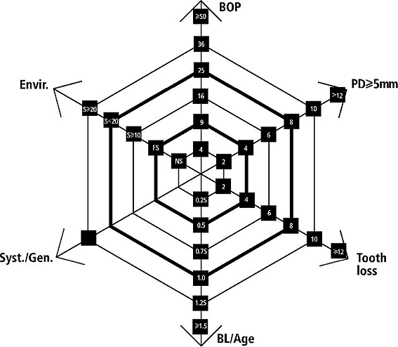
Risk Analysis
Lang & Tonetti, 2008

Slide 33
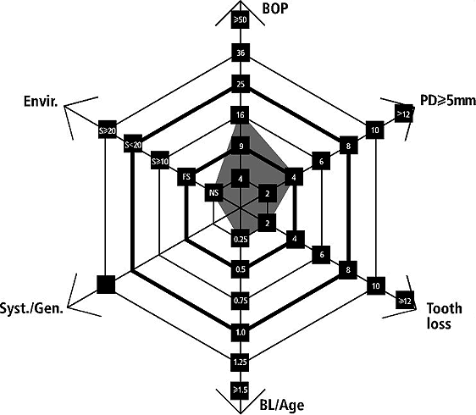

Slide 34
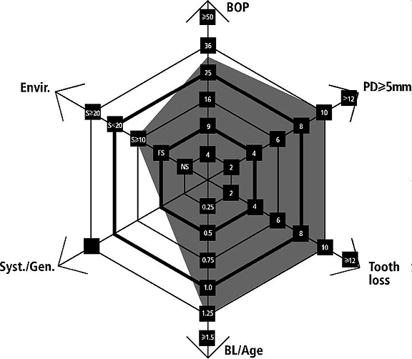

Slide 35
Oral Hygiene
Full-mouth assessment of the bacterial load have a pivotal impact in the determination of the risk for disease recurrence.
In a clinical set-up, a plaque control record of 20–40% might be tolerable by most patients.
Full mouth plaque score has to be related to the host response of the patient, i.e. compared to inflammatory parameters.

Slide 36
Compliance
It is essential that patient is aware prior to initial treatment that they will be required to adhere to maintenance programme long term (cost and time commitment).
28% patients did not attend their first SPT visit.
(Ojima et al. 2001)
59% patients <30years old were non-compliant.
(Novaes & Novaes, 2001)

Slide 37
Compliance
Authors/ yeart | % of compliant patients | Maintenance period
Wilson et al. 1983 | 16% compliant 34% non compliant 49% erratic compliance | 8 years
Demitriou et al. 1995 | 27% | 14 years
Konig et al. 2001 | 25% | 10 years

Slide 38
TOOTH LEVEL
Position within arch
Degree of furcation involvement
Iatrogenic factors – overhanging restorations
Residual periodontal support
Mobility

Slide 39
Site level
Bleeding on probing
PPD/attachment loss
Suppuration

Slide 40
Multi-level Risk Assessment
To schedule patients for supportive periodontal therapy on the basis of an individual risk evaluation for recurrence of disease has been demonstrated to be cost effective.
The determination of such risk level would thus prevent undertreatment, and also excessive overtreatment, during SPT.

Slide 41
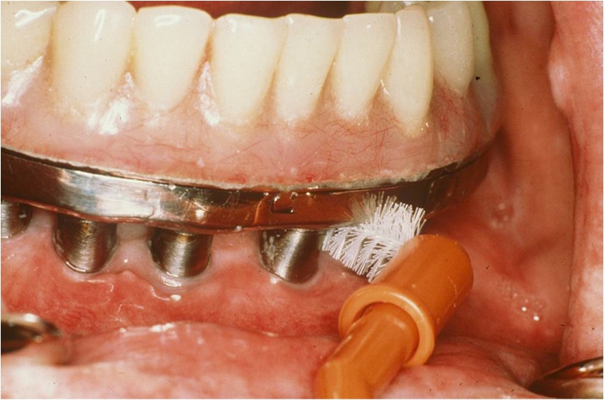
Implant Supportive Care

Slide 42
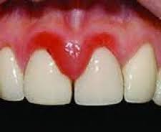
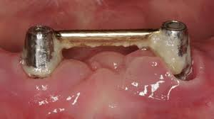
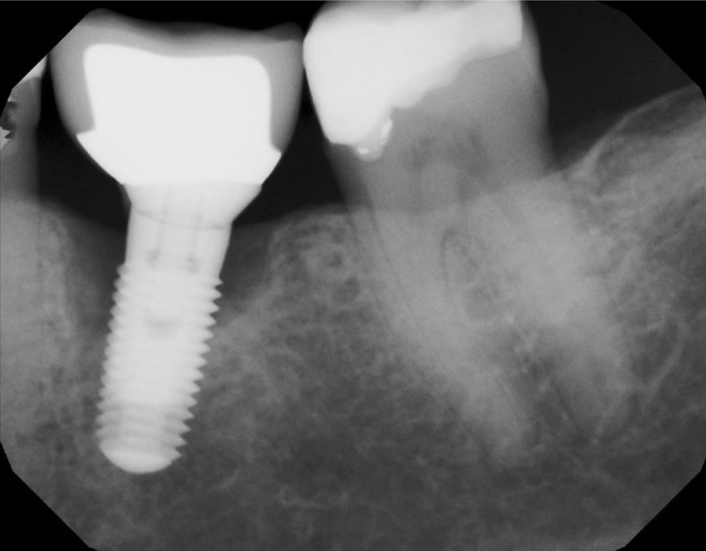
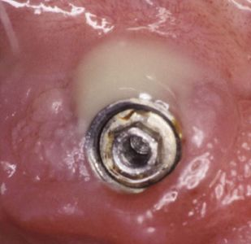

Slide 43
Implant maintenance
Plaque control at implants is as important as at natural teeth.
Hypothesized that routine instrumentation could roughen surface, enhancing potential for plaque accumulation.

Slide 44
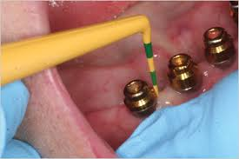
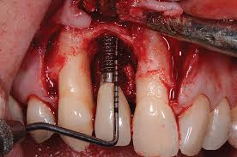

Slide 45
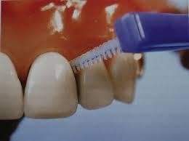

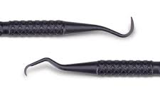
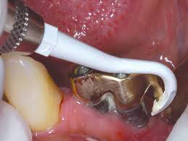
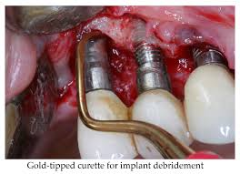

Slide 46
In general, procedures for maintenance of patients with implants are similar to those for patients with natural teeth, with the following three differences:
  Special instrumentation that will not scratch the implants are used for calculus removal on the implants.
  Acidic fluoride prophylactic agents are avoided.
  Nonabrasive prophy pastes are used.

Slide 47
Conclusions
SPT essential part of periodontal treatment
Patient must be made aware of importance and commitment required
Bulk of SPT provided in general practice
Must be tailored to each patient

Slide 48

Thank you

