Slide 1
Anti-HIV drugs
Dr.Gore

Slide 2
-HIV is a single stranded RNA retrovirus→ carries out reverse transcription of proviral DNA from viral RNA (normally RNA is transcripted from DNA) with the help of a viral RNA-dependent DNA polymerase (reverse transcriptase)
-Primary cell type attacked by HIV → CD4+ helper T-lymphocyte, but later macrophages and some other cell types may also be infected
- When population of CD4 cells declines markedly (<200 cells/μL)→CMI is lost and opportunistic infections abound, to which the victim ultimately succumbs, unless treated
-HIV genome integrates with the host DNA, eradication of
the virus from the body of the victim appears impossible at
present

Slide 3
The aim of anti-HIV therapy is to cause maximal suppression of viral replication for the maximal period of time possible
For this ARV drugs are always used in combination of at least 3 drugs and regimens have to be changed over time due to development of resistance
Life long therapy is required
India launched its National AIDS Control Programme (NACP) in 1992
2004 - National AIDS Control Organization (NACO) rolled-out free combination ART to eligible registered patients

Slide 4
The two established targets for anti-HIV attack are:
(a) HIV reverse transcriptase: Which transcripts HIV-RNA into proviral DNA
(b) HIV protease: Which cleaves the large virus directed polyprotein into functional viral proteins
HIV Types:-
HIV – 1 :- More common, more virulent
HIV -2 :- Less common, develops more slowly, less transmitable

Slide 5
Classification:-
Anti-Retrovirus
(a) Nucleoside reverse transcriptase inhibitors(NRTIs): Zidovudine (AZT), Didanosine, Stavudine,Lamivudine, Abacavir, Emtricitabine, Tenofovir (Nt RTI)
(b) Nonnucleoside reverse transcriptase inhibitors (NNRTIs): Nevirapine, Efavirenz, Delavirdine
(c) Protease inhibitors: Ritonavir, Atazanavir, Indinavir, Nelfinavir, Saquinavir, Amprenavir, Lopinavir
(d) Entry (Fusion) inhibitor: Enfuvirtide
(e) CCR5 receptor inhibitor: Maraviroc
(f) Integrase inhibitor: Raltegravir

Slide 6
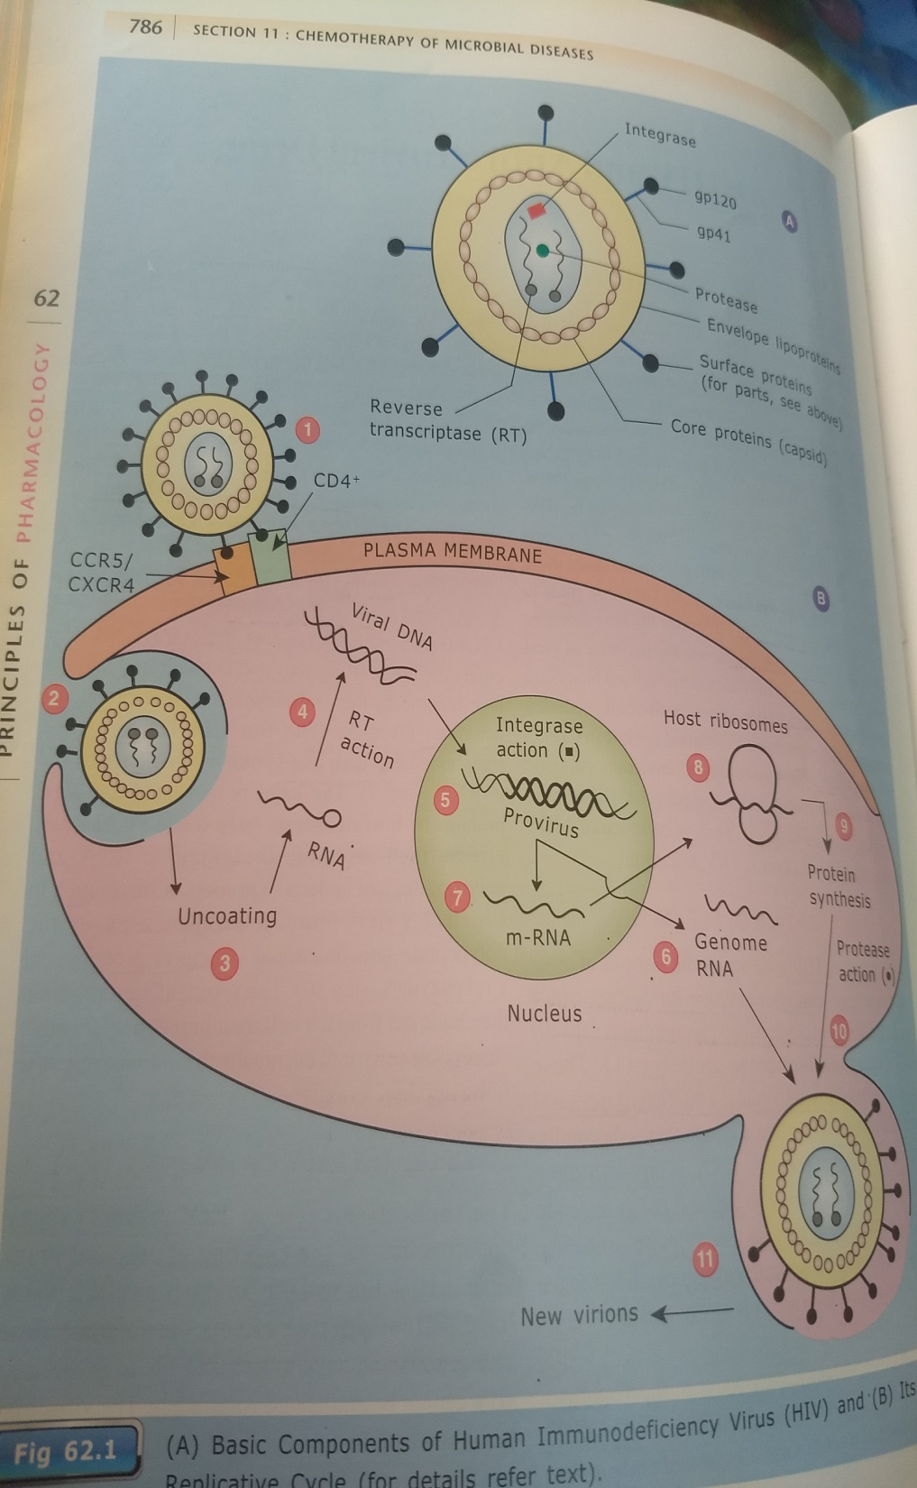
Viral DNA → enters host cells
Nucleus→ integrated into host
genome by viral enzyme
transcriptase producing provirus→
provirus DNA is than transcribed into
both new genomic RNA and m-
RNA→ the latter is translated into
viral protein by host ribosomes
The new virions then assemble the
genomic RNA and polypeptides and
undergo maturation→viral protease
enzyme then cleaves polypeptide in
functional structural proteins and
viral enzymes
The mature virion then buds out from cell membrane to infect other suseptible cells until immune response fails

Slide 7


Slide 8
Drugs

Slide 9
Nucleoside reverse transcriptase inhibitors (NRTIs) :-
Zidovudine:-
After entering the HIV-infected cells→ gets converted to active
triphosphate forms by cellular kinases and competitively inhibit
HIV reverse transcriptase → They get incorporated into the
growing viral DNA and cause termination of chain elongation of
proviral DNA

Slide 10
Zidovudine (AZT)
-1st antiretroviral drug approved for T/t of HIV
It protects the uninfected cells from HIV, but has no effect on HIV-infected cells
Orally effective
Adverse reactions:- Bone marrow suppression, anaemia and neutropaenia, Nausea, vomiting, abdominal discomfort, headache and insomnia (initial stages of therapy)
Long-term:-hepatotoxicity, myopathy with fatigue and lactic acidosis

Slide 11
Interactions:-
1.Zidovudine paracetamol: Both are metabolized by glucuronide
conjugation. Paracetamol competes and interferes with glucuronide conjugation of zidovudine. This leads to a rise in the plasma concentration of zidovudine and its toxicity.
2. Azoles zidovudine: Azole antifungal agents are hepatic microsomal enzyme inhibitors. They inhibit the metabolism of zidovudine and increase its blood level resulting in its toxicity.
3. Zidovudine and stavudine: They should not be combined together because they compete for intracellular phosphorylation (activation).
Zidovudine is used in combination with other antiretroviral drugs for the treatment of AIDS. It is also used for post-exposure prophylaxis (PEP) and to prevent vertical transmission of HIV.

Slide 12
Use :-
a)Used in HIV infected patients only in combination with at least 2 other ARV drugs
It is one of the two optional NRTIs used by NACO for its first line triple drug ARV regimen
Immune status is improved and opportunistic infections become less common
b) Post –exposure prophylaxsis
c)Vertical transfer (mother to child)

Slide 13
Didanosine (ddI), Stavudine, Emtricitabine and Lamivudine→
Transported into cells and activated to respective triphosphate forms → Inhibit HIV reverse transcriptase → DNA chain termination
Stavudine should not be combined with didanosine, because both
cause peripheral neuropathy.
The adverse effects :-
Peripheral neuritis, pancreatitis, gastrointestinal disturbances, lactic acidosis, skin rashes, etc.
Lamivudine is a commonly used agent in antiretroviral therapy because of its efficacy and low toxicity

Slide 14
Non-nucleoside Reverse Transcriptase Inhibitors (NNRTIs):-
Nevirapine (NVP) and Efavirenz (EFV):-nucleoside unrelated
compounds which directly inhibit HIV reverse transcriptase without
the need for intracellular phosphorylation
-Locus of action on the enzyme is also different and they are non-competitive inhibitors
- > potent than AZT on HIV-1, but do not inhibit HIV-2
-If used alone, viral resistance to NNRTIs develops rapidly ; they should always be combined with 2 other effective drugs
-A patient failing any NNRTI regimen should not be treated with
another NNRTI
-Both are enzyme inducers, and cause autoinduction of their own metabolism

Slide 15
Nevirapine (NVP):-hepatotoxic,
Efavirenz (EFV):-headache, rashes, dizziness, insomnia and a variety of neuropsychiatric symptoms.

Slide 16
-Nevirapine 200 mg/day is doubled after 2 weeks when its blood levels go down due to autoinduction
Such dose escalation is not required for EFV
Rifampin induces NVP metabolism and makes it ineffective, but
has little effect on EFV levels
If a patient being treated with NVP develops TB and is put on rifampin, NVP should be replaced by EFV
-Either NVP or EFV is included in the first line triple drug regimen used by NACO

Slide 17
Retroviral protease inhibitors (PIs):- It acts at a late step in HIV replication, i.e. maturation of the new virus particles when the RNA genome acquires the core proteins and enzymes
Eg:-Atazanavir (ATV), Indinavir (IDV), Nelfinavir (NFV), Saquinavir (SQV), Ritonavir (RTV) and Lopinavir
MOA-Bind to the active site of protease molecule → interfere with its cleaving function→ they act at a late step of viral cycle, they are effective in both newly as well as chronically infected cell (more effective viral inhibitors than AZT)
- Under their influence, HIV-infected cells produce immature
noninfectious viral progeny—hence prevent further rounds of infection.

Slide 18
-All PIs (especially ritonavir and lopinavir) are potent inhibitors of CYP3A4, while some other CYP isoenzymes are induced
Combination of NRTIs with PI’s has been found more effective than either drug given alone, and triple therapy is more effective
than double therapy
-Reserve them for failure cases
-Specifically, metabolism of PI’s is induced by rifampin and other enzyme inducers rendering them ineffective. Another problem in
their use is the large tablet load
-In case of different PI’s, 6–18 tablets are to be taken daily,
some on empty stomach, but others with meals; and this has to go on for months and years→ patient acceptability and compliance
are often low.

Slide 19
-One of the strategies adopted to reduce the dose of ATV, IDV, LPV and SQV is to combine them with a low and subtherapeutic dose (100 mg) of ritonavir
- By reducing first pass metabolism, ritonavir increases the bioavailability and by slowing systemic metabolism decreases
clearance of the companion PI
- This ‘boosted PI regimen’ permits reduction in the number/
frequency of tablets to be taken each day
ADR:- gastrointestinal intolerance, asthenia, headache, dizziness, limb and facial tingling, numbness and rashes, lipodystrophy (abdominal obesity, buffalo hump
with wasting of limbs and face), dyslipidaemia (raised triglycerides and cholesterol

Slide 20
Ritonavir (RTV) :- It is a potent PI; also a potent CYP3A4 inhibitor. Drug interactions, nausea, diarrhoea, paresthesias, fatigue and lipid
abnormalities are prominent
- Though RTV (600 mg twice daily) can be used as an antiretroviral
drug, it is more commonly employed in a low dose (100 mg BD) to boost other PIs like LPV, ATV, SQV, IND, but not NFV
Other Drugs
Entry or Fusion Inhibitors: Enfuvirtide and Maraviroc
Enfuvirtide and maraviroc prevent viral entry into the cell. They are used as add on drugs in patients
who are not responding to ongoing antiretroviral therapy (ART).

Slide 21
Integrase inhibitor
Raltegravir:- The HIV-proviral DNA transcripted in the
cytoplasm of host cell translocates to the nucleus along with
an integrase enzyme. The HIV-integrase nicks host chromosomal DNA and integrates the proviral DNA with it.
-----------------------------------------------------------------------------------
Highly active antiretroviral therapy’ (HAART) with combination of 3 or more drugs whenever indicated
Initiating antiretroviral therapy:- Little benefit has been demonstrated in asymptomatic cases with reasonable immune competence (CD4 cell count > 350/μl)
- CD4 cell count is the major determinant of initiating therapy in asymptomatic cases

Slide 22
-Increased mortality occurs when treatment is begun after
CD4 count has fallen below 200/μl, and response to anti-HIV drugs is suboptimal
The US Department of Health and Human Services guidelines (2010) recommend instituting ART to:
(a) All symptomatic HIV disease patients.
(b) Asymptomatic patients when the CD4 cell count falls to 350/μl or less.
(c) All HIV patients coinfected with HBV/HCV requiring treatment.
(d) All pregnant HIV positive women.
(e) All patients with HIV-nephropathy.
In addition to above, the current NACO guidelines give priority in treatment to:
• All HIV-positive persons in WHO-clinical stage 3 and 4.
• All persons who tested HIV positive 6–8 years ago.
• Patients with history of pulmonary TB and/ or Herpes zoster.
• HIV infected partners of AIDS patients.
• All HIV positive children < 15 years of age

Slide 23
Therapeutic regimens:-
-Aggressive (HAART) with at least 3 anti-HIV drugs
-Optimum response to any regimen is reduction of plasma
HIV-RNA to undetectable levels (<50 copies/μl) within 6 months
First line regimens universally include 2 NRTIs + 1 NNRTI
-Preferred NRTIs are lamivudine, abacavir, tenofovir and sometimes emtricitabine
Efavirenz is preferred over nevirapine as the NNRTI
Preferred regimen
1. Lamivudine + Zidovudine + Nevirapine
Alternative regimens
1. Lamivudine + Zidovudine + Efavirenz
2. Lamivudine + Stavudine1 + Efavirenz
3. Lamivudine + Stavudine + Nevirapine
Other options
1. Lamivudine + Tenofovir2 + Nevirapine
2. Lamivudine + Tenofovir2 + Efavirenz
3. Lamivudine3 + Zidovudine + Tenofovir

Slide 24
1. Stavudine is substituted for zidovudine if patient is anaemic
2. Tenofovir is included when there is toxicity or other contraindication to both zidovudine and stavudine
3. 3NRTI regimen is only for patients unable to tolerate both nevirapine and efavirenz.

Slide 25
Prophylaxis of HIV infection
Post-exposure prophylaxis (PEP):- Health care workers and others who get accidentally exposed to the risk of HIV infection by needlestick or other sharp injury or contact with blood/ biological fluid of HIV patients or blood transfusion should be considered
Aim:- To suppress local viral replication prior to dissemination, so that the infection is aborted
PEP is not necessary when the contact is only with intact skin, or with mucous membrane by only a few drops for short duration
It is also not indicated when the source is known to be HIV –ve
-Nevirapine is not recommended for PEP due to its hepatotoxic potential
-When indicated, PEP should be started as soon as possible, preferably within 1–2 hours of exposure

Slide 26
Basic (2 drug) regimen (for low risk)*
Zidovudine 300 mg (BD) + Lamivudine 150 mg for 4 weeks
Expanded (3 drug) regimen (for high risk)$
Zidovudine 300 mg (BD) +Lamivudine 150 mg+ Indinavir 800 mg Thrice daily (or another PI) All for 4 weeks
*Low risk
• When the source is HIV positive, but asymptomatic with low HIV-RNA titre and high CD4 cell count
• Exposure is through mucous membrane, or superficial scratch, or through thin and solid needle.
$High risk
• When the source is symptomatic AIDS patient with high HIV-RNA titre or low CD4 count.
• Exposure is through major splash or large area contact of longer duration with mucous membrane or abraded skin or through large bore hollow needle, deep puncture, visible patient’s blood on the needle

Slide 27
Perinatal HIV prophylaxis :- HIV may be transmitted from the mother to the child either through the placenta, or during delivery, or by breastfeeding
The highest risk (>2/3rd) of transmission is during the birth process
As per current recommendation, all HIV positive women, who are not on ART, should be put on the standard 3 drug ART
This should be continued through delivery and into the postnatal period & prevents vertical transmission of HIV to the neonate, as well as benefit mother’s own health

Slide 28
The first line NACO regimen for pregnant women is:
Zidovudine + Lamivudine + Nevirapine
-Women with CD4 count > 250 cells/μL face a higher risk of hepatotoxicity due to NVP and should be closely watched
-EFV is teratogenic, and not used, particularly in the first trimester
-In HIV-positive women who are not taking ART, Zidovudine (300 mg BD) started during 2nd trimester and continued through delivery to postnatal period, with treatment of the neonate for 6 weeks has been found to reduce mother-to-child transmission by 2/3rd
-Even if not started earlier, AZT administered during
labour and then to the infant is also substantially protective
-Breastfeeding by HIV-positive mother is contraindicated, because it carries substantial risk of transmission to the infant.

