Slide 1
ITS Dental College, Greater Noida
Subject : Pharmacology
Lecture Topic: Anticholinesterases
Lecture Number: L22
Program, Year: BDS, Second Year
Faculty : Dr.Rajeshwari Gore

Slide 2
Lecture Objectives & Learning Outcomes
General Objective : To understand the various routes of absorption
Specific Learning Outcomes:
At the end of the session, the learner should be able to know the following regarding anticholinesterases
1.Classification
2.Mechanism of action
3.Actions
4.Uses
5.Contraindications

Slide 3
Role of AChE…..
Protect ACh from hydrolysis
Prolong action of ACh
Indirectly increase availability of ACh at muscarinic & nicotinic receptors after release from postganglionic parasympathetic neurons
Some have additional direct action on nicotinic cholinoceptors

Slide 4
How are they diff from directly acting parasympathomimetics?
They have no action on denervated organs?
-These drugs act by protecting ACh from its degradation after release while in denervated organs there is no ACh release from cholinergic neuron

Slide 5
Types
Reversible/Competitive inhibitors of AChE:- Produce reversible inhibition of cholinesterase
Carbamates Acridine
Physostigmine (Naturally occuring) Tacrine
Neostigmine
Pyridostigmine
Edrophonium Synthetic
Rivastigmine, Donepezil
Galantamine

Slide 6
B) Irreversible inhibitors of AChE:- Induce irreversible inhibition of cholinesterase :-
Organophosphates Carbamates
Dyflos (DFP) Carbaryl* (SEVIN)
Echothiophate Propoxur* (BAYGON)
Malathion*
Diazinon* (TIK-20)
Tabun£, Sarin£, Soman£

Slide 7
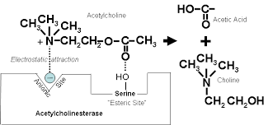
Reversible/Competitive inhibitors of AChE
- Structural resemblance to ACh
Ach is inactivated by combination with 2 sites on the enzyme cholinesterase:-
a)An anionic site:-bearing a –ve charge which attracts the quaternary nitrogen atom (N+) of Ach
b)Esteratic site :- attracts the carboxylic acid group (COOH) of ACh
* Esteratic site is acetylated →splitting off of choline

Slide 8
Acetly group combined with
esteratic site is immediately
removed as a result of
hydrolysis forming acetic acid
This sets the esteratic site of
the enzyme free for further inactivation of ACh

Slide 9
Due to their resemblance, reversible AChE combine to anionic and
esteratic site of cholinesterase like ACh
Complex with esteratic site of anticholinesterase →< readily hydrolysed
than acetyl-esteratic site complex formed with Ach→ Temporary inhibition of the enzyme
*Edrophonium forms reversible complex only with anionic site & hence
has shortest action

Slide 10
Irreversible inhibitors of AChE
Combine & phosphorylate only with esteric site
Hydrolysis of phosphorylated site is slow or does not occur at all
Irreversible inhibition
Echothiophate forms complex with both anionic & esteratic sites and hence is more potent than others
The carbamates and phosphates respectively carbamylate and
phosphorylate the esteratic site of the enzyme

Slide 11
Acetylated enzyme reacts with water extremely rapidly and the esteratic
site is freed in a fraction of a millisecond, the
Carbamylated enzyme (reversible inhibitors) reacts slowly
Phosphorylated enzyme (irreversible inhibitors) reacts extremely slowly
or not at all

Slide 12
Reactivation time of ACh
Acetylated enzyme →esteratic site is freed in a fraction of a millisecond
Carbamylated enzyme →about 30 min, < than synthesis of
fresh enzyme protein
OPs → Phosphorylated enzyme (in days) is more than
the regeneration time

Slide 13
Aging of enzyme
Phosphorylated enzyme may also undergo ‘aging’ by the loss of one of
the alkyl groups and become totally resistant to hydrolysis

Slide 14
PHARMACOLOGICAL ACTIONS
Lipid-soluble agents
-physostigmine ,organophosphates
-Action on skeletal muscles is less prominent
-Marked muscarinic
-Marked CNS effects
-
Lipid-insoluble agents
-Neostigmine , other
quaternary ammonium compounds)
-Marked effect on the skeletal
muscles
-Muscarinic effects less prominent
-Do not penetrate CNS and have
no central effect

Slide 15
Actions
Ganglia:- High doses → persistent depolarization of the ganglionic
Nicotinic receptors and blockade of transmission
2)CVS →complex
Muscarinic action :- bradycardia, hypotension,
Ganglionic stimulation:-to increase heart rate and BP
Medullary:-centres (stimulation followed by depression)
*overall effects are often unpredictable and depend on the agent and
Its dose

Slide 16
3)Skeletal muscles :-After treatment with anti-ChEs,
ACh released by a single nerve impulse
Rebinds to the same receptor
Diffuses to act on neighbouring receptors
Activates prejunctional fibres
Repetitive firing / twitching / fasciculations

Slide 17
CNS :-
Lipophilic anti-ChEs (penetrate brain):- alerting
response,
Cognitive function:-improved in Alzheimer’s disease
Higher doses→ excitement,mental confusion,
disorientation, tremors, convulsions followed by coma
Other effects:- Similar to ACH

Slide 18
PHARMACOKINETICS
Physostigmine :- Rapidly A:- g.i.t., parenteral sites
Eye:-penetrates cornea
- Crosses BBB and is disposed after hydrolysis by ChE
Neostigmine and congeners:- Poorly absorbed orally;
Eye:-Do not penetrate cornea or cross blood-brain barrier
- Partially hydrolysed and excreted unchanged in urine.
Organophosphates:-Absorbed from all sites including intact skin and lungs
* They are hydrolyzed as well as oxidized in the body
and little is excreted unchanged

Slide 19
INDIVIDUAL COMPOUNDS
1)Physostigmine:- eye drops are usually
Prepared freshly by ophthalmology departments
2) Pyridostigmine:- dose to dose less potent and
Longer acting, less frequent dosing is required in
myasthenia gravis

Slide 20
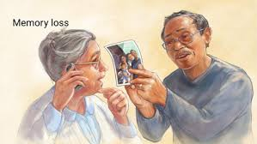
Centrally acting Ach for T/t of AD
Rivastigmine:- Lipophilic,cerebroselective,introduced for AD
Donepezil:- Cognitive, behavioral improvement
in AD, long-acting , OD adminis
Galantamine :-natural alkaloid, weak agonistic action on
nicotinic receptors
Used :-Symptomatic relief in AD

Slide 21
Contraindications
1.Sick sinus
2. A-V conduction defects
3.Hypotensive states
4. Caution :-peptic ulcer, asthma, COPD and seizure patients

Slide 22
USES
As miotic:-
(a) Glaucoma: Increase tone of ciliary muscle (attached to scleral spur) and
sphincter pupillae→ which pull on and improve alignment of the
trabeculae→ outflow facility is increased→ i.o.t. falls in open angle glaucoma
*Pilocarpine preferred, Action:-rapid and short lasting (4–6 hr); 6–8 hourly
instillation is required,i.o.t. may fluctuate in between
S.E.:- Diminution of vision,especially in dim light (due to constricted pupil),
spasm of accommodation and brow pain are
Systemic effects— nausea,diarrhoea, sweating and bronchospasm may occur
with higher concentration eye drops.
Physostigmine (0.1%) :-supplement Pilocarpine

Slide 23
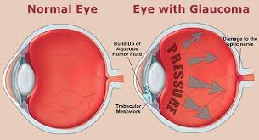

Slide 24
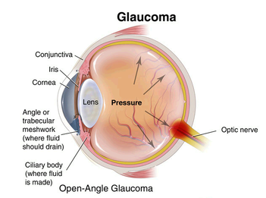

Slide 25
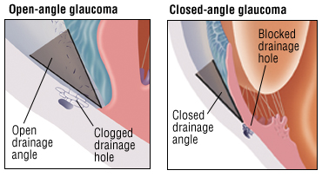

Slide 26
Therapeutic status of Ach in glaucoma
*Miotics -3rd choice drugs, used only as add on
therapy in advanced cases.
Effective in aphakic glaucoma
Pilocarpine (along with other drugs) → angle closure glaucoma as well.

Slide 27
(b) Reverse the effect of mydriatics after refraction testing
(c) Prevent adhesions between iris and lens or iris and
cornea,
d)Break adhesions formed due to iritis, corneal
ulcer, etc.—a miotic is alternated with a mydriatic

Slide 28
Myasthenia gravis
- Autoimmune disorder
Cause:-
1) Development of antibodies against nicotinic receptors (NR) at the muscle endplate
2) Reduction in number of free NM cholinoceptors to 1/3 of
normal or less
3)structural damage to the NMJ

Slide 29
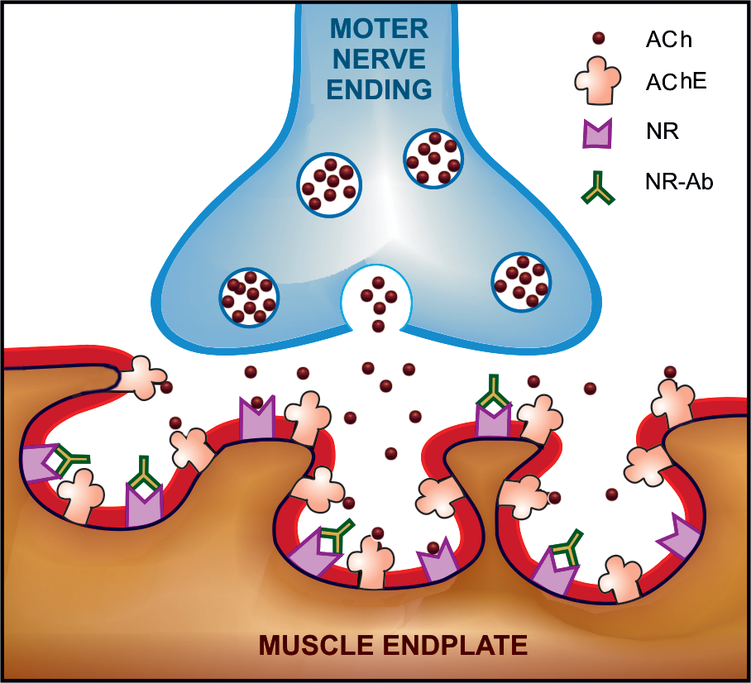

Slide 30
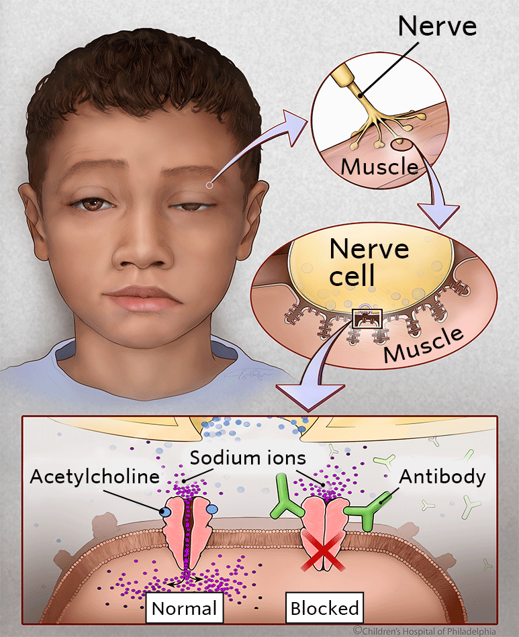
S/S:- weakness. easy fatigability on repeated activity, with recovery after rest.
Muscles 1st affected:- eyelid, external ocular, facial and pharyngeal muscles are generally
Later:- limb and respiratory muscles
T/t:- Neostigmine and its congeners improve muscle contraction by allowing Ach released from
prejunctional endings to accumulate and act on the receptors over a larger area, as
well as by directly depolarizing the endplate.

Slide 31
T/t
1)Start with neostigmine 15 mg orally 6 hourly
* Dose and frequency adjusted
*Dosage requirement may fluctuate
2)Pyridostigmine :-needs < frequent dosing
3) Atropine :-intolerable muscarinic side effects
- Drugs have no effect on the basic disorder →progresses→
may not be possible to restore muscle strength adequately with
anti-ChEs alone

Slide 32
Immunosuppresants in MG
-Afford considerable improvement
Action:- inhibit production of NR-antibodies & increase synthesis of NRs
Long term use has problems
Remission:- Prednisolone 30–60 mg/day induces in 80% of the advanced cases;
Maintenance therapy :-10 mg daily or on alternate days
Azathioprine (slow takes upto 1 year)and cyclosporine (relatively
quick (in 1–2 months).):- inhibit NR-antibody synthesis by
affecting T-cells

Slide 33
Plasmapheresis:- Removal of antibodies(plasma exchange)
*Dramatic but short lived improvement
can often be achieved by it in myasthenic crisis.
Thymectomy :-Effective in majority of the cases,gradual
improvement with complete remission
*Thymus:- May containbe the source of the antigen for
production of anti-NR antibodies in myasthenic patients
becoz it has modified muscle cells with NRs on their
surface

Slide 34
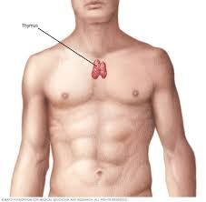

Slide 35
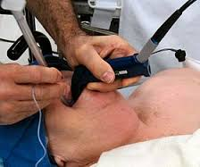
Myasthenic crisis
-Acute weakness of respiratory muscles
T/t:- Tracheal intubation,mechanical ventilation
- i.v. methylprednisolone pulse therapy
is given while anti-ChEs are withheld for 2–3
days followed by their gradual reintroduction

Slide 36
Cholinergic weakness
- If dose of antiChE is not adjusted according to the fluctuating
requirement, relative overdose may occur from time-to-time
Overdose:- produces weakness by causing persistent depolarization of
muscle endplate
Late cases :-often alternately experience myasthenic and cholinergic weaknes
Require opposite T/t :-They can be differentiated by edrophonium
test—
Improvement →myasthenic crisis
Inject
edrophonium
(2 mg. i.v.) no improvement or worsen →cholinergic crisis

Slide 37
Diagnostic tests for myasthenia gravis
Ameliorative test:
Test dose:- Edrophonium 2 mg is inj i.v.
-If nothing untoward happens→remaining 8 mg is
injected after 30–60 sec
*Reversal of weakness and shortlasting improvement in
myasthenia gravis occurs but not in muscular dystrophies
b) Test with 1.5 mg i.v. neostigmine, pretreatment with Atropine →given to block the muscarinic effects of neostigmine

Slide 38
Other Uses
3. Postoperative paralytic ileus/urinary retention :-0.5–1 mg s.c. neostigmine, provided no organic obstruction
4. Postoperative decurarization :-Neostigmine
0.5–2.0 mg (30–50 g/kg) i.v., preceded by atropine /
glycopyrrolate 10 g/kg →blockmuscarinic effects,

Slide 39
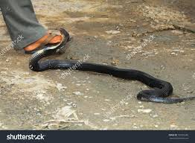
5. Cobra bite:-
Cobra venom has a
curare like neurotoxin
Primary T/t :-specific
antivenom serum
*Neostigmine + atropine
prevent respiratory paralysis

Slide 40
6)Alzheimer’s disease :- neurodegenerative
disorder
-Progressive dementia, primarily affecting
cholinergic neurones in the brain
T/t:- Augment cholinergic transmission in the brain
Relatively cerebroselective anti-ChEs:-
rivastigmine, donepezil and galantamine

Slide 41
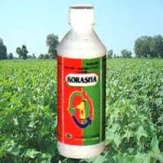
ANTICHOLINESTERASE POISONING
-Easily available
-Extensively used as
agricultural and
household insecticides
-Accidental ,suicidal and
homicidal poisoning is
common

Slide 42
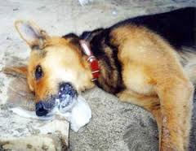
Local muscarinic manifestations:-
Site of exposure (skin, eye, g.i.t.) –
immediate, followed by complex systemic
effects due to muscarinic, nicotinic and central actions
They are—
Irritation of eye, lacrimation,
salivation, sweating,copious tracheo-
bronchial secretions, miosis, blurring
of vision, bronchospasm, br
eathlessness, colic, involuntary defecation and urination

Slide 43
Systemic effects:- Fall in BP, bradycardia or
tachycardia, cardiac arrhythmias, vascular collapse.
Muscular fasciculations, weakness, respiratory paralysis
(central as well as peripheral)
CNS:-Irritability, disorientation, unsteadiness, tremor, ataxia, convulsions, coma and death
Death :-respiratory failure
—

Slide 44
Treatment
Termination of further exposure— fresh air, wash the
skin and mucous membranes with soap and water, gastric
lavage according to need
2. Maintain patent airway, positive pressure respiration if it is
failing
3. Supportive measures—maintain BP, hydration, control of
convulsions with judicious use of diazepam
4. Specific antidotes

Slide 45
Atropine:- 2 mg i.v. repeated every 10 min till atropinization
Highly effective in muscarinic symptoms
higher doses →antagonize the central effects
*Does not reverse peripheral muscular paralysis which is a
nicotinic action
- All cases (carbamate or organophosphate) poisoning –
Max dose:- upto 200 mg in one day
Duration:- Maintenance for 1–2 weeks.

Slide 46
(b) Cholinesterase reactivators:- reactive OH groups in the form of oxime are provided, reactivation occurs faster
a)Pralidoxime (2-PAM) :- +vely charged quaternary nitrogen: attaches
to the anionic site→remains unoccupied in the presence of
OPinhibitors
Oxime end reacts with the phosphorus atom attached to esteratic site:
the oxime-phosphonate so formed diffuses away leaving the reactivated
ChE.

Slide 47
Pralidoxime contraindicated in carbamate poisoning?
-It is ineffective as an antidote to carbamate
anti-ChEs as anionic site of the enzyme is not free
to provide attachment because not only it does not
reactivate carbamylated enzyme, it has weak anti-ChE activity of its own

Slide 48
Dose:-injected i.v. slowly 1–2 g (children 20–40 mg/kg)
OR
Loading dose 30 mg/kg i.v.,→
Continuous infusion :- 8–10 mg/kg/hour
till recovery
Marked reactivation of skeletal muscle ChE than at
autonomic sites and CNS (does not penetrate into brain)

Slide 49
Treatment:- Started ASAP (within few hours),before the
phosphorylated enzyme has undergone ‘aging’
Max doses:- 12 g in first 24 hrs
Maintenance doses:- are continued 1–2 weeks

Slide 50
Status of Pralidoxime:-
Secondary to atropine becoz clinical benefit is
variable -depending on:-
1-compound involved (different organophosphates
‘age’ at different rates)
2.Amount of poison that has entered the body
3.Time lapse before therapy is started and dose of the oxime
Other oximes are obidoxime (more potent than pralidoxime),
diacetyl-monoxime (DAM), which is lipophilic

Slide 51
2nd Last Slide
Commonly Asked Questions
1.Treatment of myasthenia gravis
2.Treatment of Organophosphorus poisoning

Slide 52
Last Slide
Reading List/Reference List
K.D. Tripathi

