Slide 1
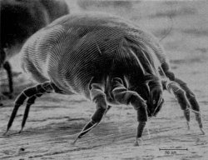
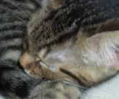
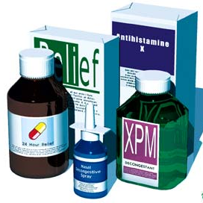
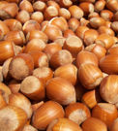
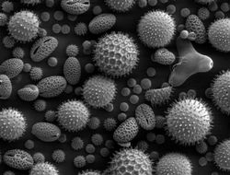
antihistamines
katherine hall
medicinal chemistry
april 10, 2007

Slide 2
Histamine:-tissue amine
Storage:- Mast cells
Present:-skin, gastric and intestinal mucosa,
lungs, liver & placenta
Receptors:-H1,H2,H3,H4

Slide 3
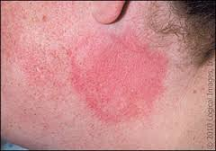
Actions
1.Blood vessels:-
- Dilatation (EDRF mediated)of smaller vessels:-
flushing, heat, HR,CO
Large vessels:- Constricted (H1-mediated constriction of vascular smooth muscles)
Intradermal triple response of Lewis:-
Red spot:- due to intense capillary dilatation
Wheal:- due to exudation of fluid from capillaries and venules
Flare:- i.e. redness in the surrounding area due to arteriolar
dilatation mediated by axon reflex.

Slide 4
2. Visceral smooth muscle:- Bronchoconstriction, abd cramps, colic
3.Glands:- gastric secretions (direct action
exerted on parietal cells through H2 receptors)
4.Sensory nerve endings:- Itching
5.Autonomic ganglia & adrenal medulla:- Stimulatn→Adr release→ BP

Slide 5
Pathophysio roles
1.Gastric secretion:-mediate HCl secretn
2.Allergic phenomenon
3.As transmitter:- initiate itch/pain at nerve endings
Non-mast cell histamine in brain :-involved in maintaining
wakefulness
-suppress appetite, regulate body temp, thrist, CVS functn
4.Inflammation

Slide 6
Histamine analogue
Betahistine:- H1 analogue→vasodilatation in internal ear→control vertigo in pts with Meniere’s dis
Contraidication:- Asthma & ulcer

Slide 7
What are allergies?
Hypersensitivity reaction of the antibody(IgE) located on mast cells in the tissues and basophils in the blood
Allergen binds IgE→activates mast cells/ basophils→ release histamine →inflammatory responses ranging from runny nose to anaphylactic shock
If both parents have allergies, you have a 70% of having them, if only one parent does, you have a 48% chance

Slide 8
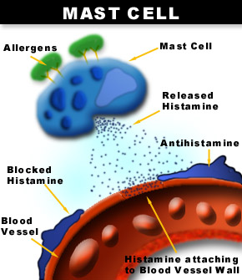
Histamine
Signal involved in local immune response, also a neurotransmitter
synthesized by the decarboxylation of histidine
Either stored or quickly inactivated by histamine-N-methyltransferase and diamine oxidase
Release of histamine from mast cells is stimulated by IgE antibodies which respond to foreign antigens in the body

Slide 9
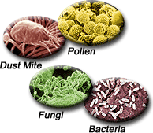
Common Allergens
Tree Pollen and Grass
Pet Danders
Mold
Dust Mites
Foods

Slide 10
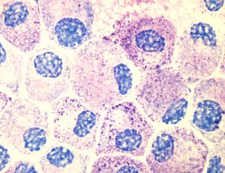
Allergies
Structure of Histamine
When it is released, histamine causes inflammation by increasing vasodilation, capillary permeability, causing smooth muscle contraction, mucus secretion, and parasympathetic nerve stimulation
Mast Cells
Histamine is distributed in Mast Cells in all peripheral tissues of the body and basophils, which circulate in the blood

Slide 12
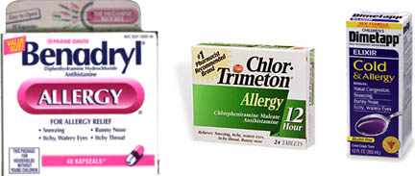
First Generation Antihistamines
Small, lipophilic molecules that could cross the BBB
Not specific to the H1 receptor
HIGHLY SEDATIVE:-
Diphenhydramine, Promethazine
MODERATELY SEDATIVEL:-
Pheniramine, Meclizine, Cinnarizine
MILD SEDATIVE
Chlorpheniramine, Clemastine

Slide 13
Second Generation Antihistamines
Modifications :- Eliminate side effects
More selective for peripheral H1 receptors
Examples:
Terfenadine(banned)
loratadine
cetirizine
mizolastine
Astemizole(banned)
Ebastine
Rupatadine

Slide 14
Terfenadine & Astemizole:- Withdrawn due to
several death due to torsades de pointes with
high doses or with enzyme inhibitors

Slide 15
ADVANTAGE of 2nd generation
1.Absence of CNS depressant property
2.Higher H1 selectivity:- no anticholinergic SE
DISADANTAGE
Poor antipruritic, antiemetic,antitussive

Slide 16
Actions of anti-histaminic drugs
1.Antagonism to histamine
2.Anti-allergic
3.CNS:-older drugs produced CNS depression becoz of their ability to cross the BBB
4.Some are effective in preventing motion sickness
5.Anti-cholinergic:- Anti-muscarinic action of ACH, < with 2nd gen

Slide 17
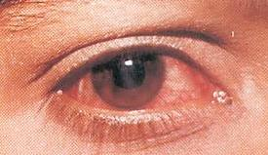
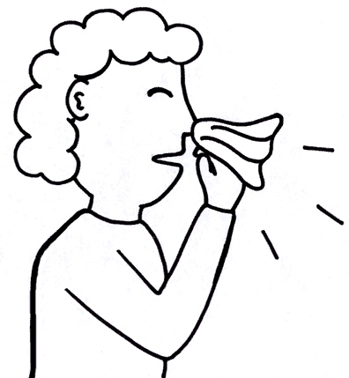
Clinical Uses of Antihistamines
Allergic rhinitis (common cold)
Allergic conjunctivitis (pink eye)
Allergic dermatological conditions
Urticaria (hives)
Angioedema (swelling of the skin)
Puritus (atopic dermatitis, insect bites)
Anaphylactic reactions (severe allergies)
Nausea and vomiting (first generation H₁-antihistamines)
Sedation (first generation H₁-antihistamines)
http://www2.nphs.wales.nhs.uk/icds/documents/conjunctivitis2.jpg

Slide 18
Cough
Vertigo:-Cinnarizine (additional anti-5HT,anti-cholinergic,sedative, vasodilatory)
Inhibits vestibular sensory nuclei in inner ear, suppresses postrotatory labyrinthine reflexes by reducing stimulated influx of Ca from endolymph into vestibular sensory cells

Slide 19
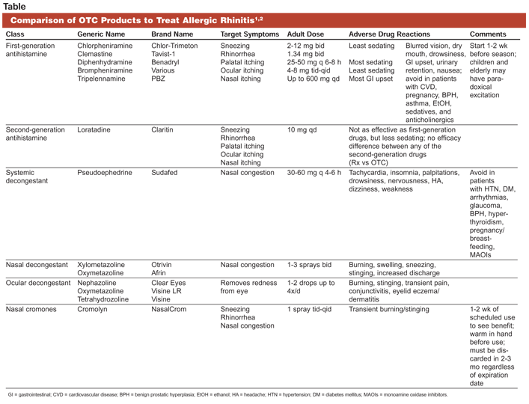
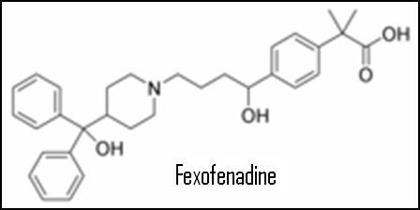
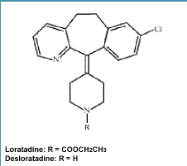
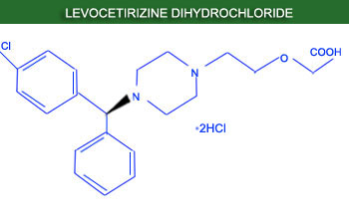
“Next” Generation Antihistamines
Metabolite derivatives or active enantiomers of existing drugs
Safer, faster acting or more potent than Second Generation drugs
Examples:
Fexofenadine
Desloratadine
Levocetirizine

Slide 20
S.E.
CNS:- Sedation, diminished alertness &
concentration, motor incordination, fatigue,
Sleepy
Tests:- Impaired psychomotor function
Caution:- Refrain from driving or machinery
work requiring constant attention
Regular use →avoided in children due to CNS
depression interfering with learning,
academics

Slide 21
Anti-cholinergic:- dry mouth, alteration of bowel movements, urinary hesistancy, blurred vision
Overdose:- Central excitation, tremors, hallucinations, muscular incordination, convulsions,hypotension,fever,respiratory failure

Slide 22
Facts
It well established that leukotrienes (C4 and
D4) and PAF are more important mediators for
human asthma.

Slide 23
Promethazine:-Anticholin+sedative
1.Controls vomiting in pregnancy
2.Reduce tremors,rigidity,sialorrhoea of PD
3.Acute muscle dystonia:- due to antiDA-antipyschotic drugs
4.Motion sickness,radiation sickness
5.Pre-anesthetic medication
Disadv:- Severe resp depression &death in
children in <2yrs

