Slide 1
Antimalarial Drugs
Dr.Gore

Slide 2
-Malaria, caused by 4 species of the protozoal parasite Plasmodium, is endemic in most parts of India and other tropical countries
-malaria comes under ‘National vector borne diseases control programme’ (NVBDCP) with a wider disease coverage
4 species of parasites : P. falciparum, P. vivax, P. ovale and P. malariae

Slide 3
-Malarial parasite undergoes primary development in liver (pre-erythrocytic phase)→ enters RBC’s (erythrocytic phase)→gametes are formed in blood which are taken up by female anapheles mosquito
-Some schizonts remail dormant in liver (exo-erythrocytic phase) & cause relapse
*Exo-erythrocytic phase is absent in P.falciparum therefore no relapse
P. Falciparum – Once cured no relapse as no hypnozoites
P. Vivax - Dormant hypnozoites are present →relapse
P. ovale - Dormant hypnozoites are present →relapse
P. malariae

Slide 4
4 species of parasites : P. falciparum, P. vivax, P. ovale and P. malariae
During a blood meal, a malaria-infected female Anopheles mosquito inoculates sporozoites in humana → infect liver cells and mature→ schizonts (rupture and release merozoites)
P. vivax and P. ovale a dormant stage [hypnozoites/ exo-erythrocytic ] persists in the liver and cause relapses by invading the bloodstream weeks, or even years later
Parasites undergo asexual multiplication in the erythrocytes (erythrocytic schizogony )→ Merozoites infect red blood cells
Some parasites differentiate into sexual erythrocytic stages (gametocytes) . Blood stage parasites are responsible for the clinical manifestations of the disease.

Slide 5
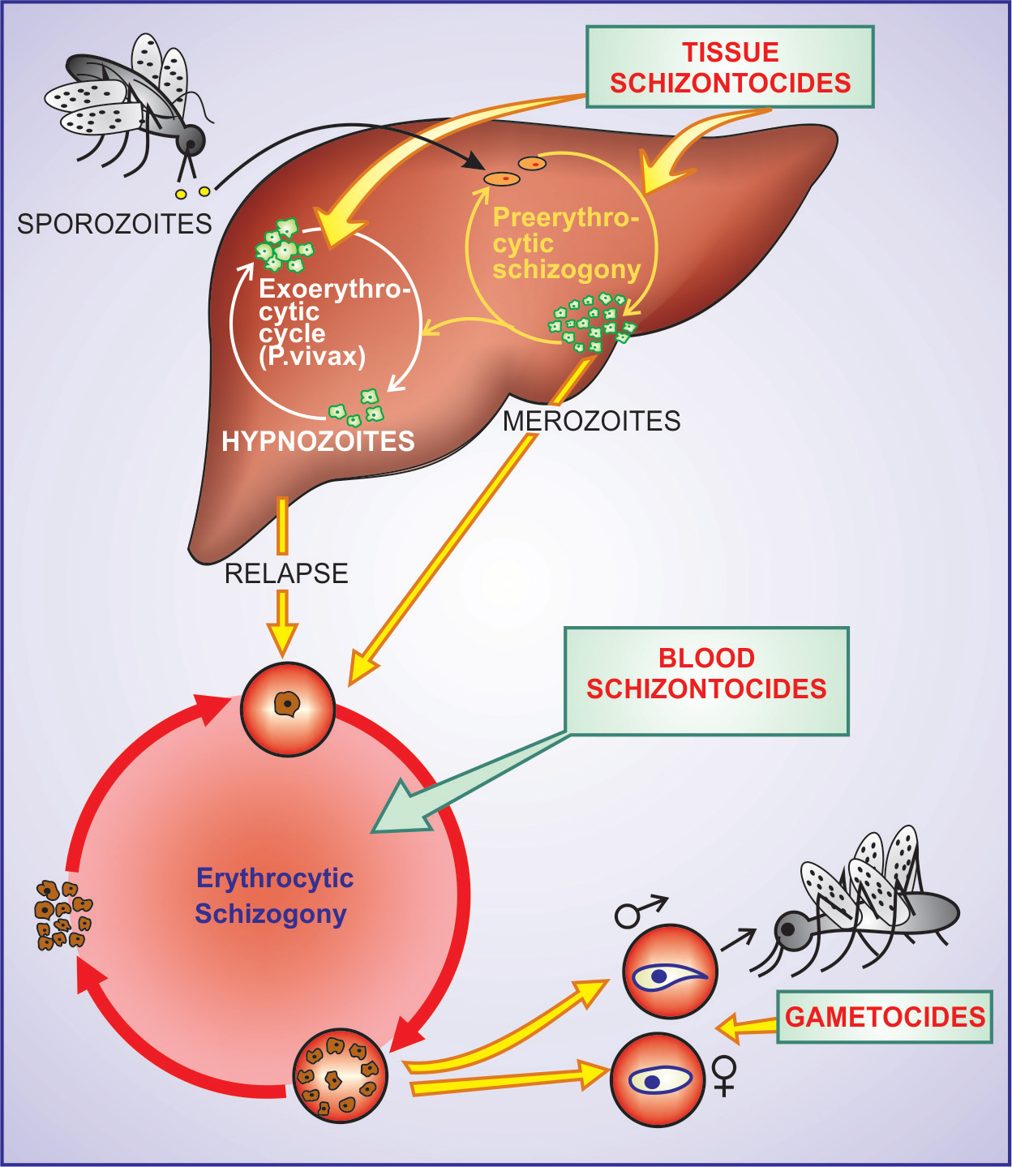

Slide 6
CLASSIFICATION
1. 4-Aminoquinolines Chloroquine (CQ)Amodiaquine (AQ) Piperaquine
2. Quinoline-methanol :- Mefloquine
3. Cinchona alkaloid :- Quinine, Quinidine
4. Biguanide :- Proguanil (Chloroguanide)
5. Diaminopyrimidine Pyrimethamine
6. 8-Aminoquinoline Primaquine Tafenoquine
7. Sulfonamides Sulfadoxine and sulfone Sulfamethopyrazine Dapsone

Slide 7
8.Antibiotics Tetracycline Doxycycline Clindamycin
9. Sesquiterpine Artesunate lactones Artemether Arteether Arterolane
10. Amino alcohols Halofantrine Lumefantrine
11. Naphthyridine Pyronaridine
12. Naphthoquinone Atovaquone

Slide 8
OBJECTIVES AND USE OF ANTIMALARIAL DRUGS
The aims of using drugs in relation to malarial
infection are:
(i) To prevent clinical attack of malaria
(prophylactic)
(ii) To treat clinical attack of malaria (clinical
curative)
(iii) To completely eradicate the parasite from
the patient’s body (radical curative)
(iv) To cutdown human-to-mosquito transmission
(gametocidal)

Slide 9
1)Erythrocytic schizontocides Antimalarials that act on erythrocytic schizogony are called
2) Tissue schizontocides that act on preerythrocytic as well as exoerythrocytic (P. vivax) stages in liver
3) Gametocides:- Those which kill gametocytes in blood

Slide 10
1. Causal prophylaxis The preerythrocytic phase (in liver), which is the cause of malarial infection and clinical attacks, is the target for
this purpose →Primaquine,Proguanil
Suppressive prophylaxis:- The schizontocides which suppress
the erythrocytic phase and thus attacks of malarial fever can be used as prophylaxsis
Though the exoerythrocytic phase in case of vivax and other relapsing
malarias continues, clinical disease does not appear
Chloroquine (CQ) 300 mg or 5 mg/ kg weekly
-In travellers, start one week before with a loading dose of 10 mg/kg and continue till one month after return from endemic area ( only
in areas with CQ-sensitive P.f)

Slide 11
-Due to extensive resistance CQ is no longer employed as prophylactic in India
-Mefloquine 250 mg started 1–2 weeks before and taken weekly till 4 weeks after return from endemic area, has been used for areas where CQ-resistant P.f. is prevalent
- Alternative regimen (short-term max 6 wks) OR unable to take
mefloquine :-
Doxycycline 100 mg/d before travel + till 4 weeks after return
from endemic area for CQ-resistant P.f.
CI:- pregnant women and children < 8 yr.

Slide 12
Radical cure:-In case of vivax and ovale malaria, drugs which attack the exoerythrocytic stage (hypnozoites) + clinical cure for total eradication of the parasite from the patient’s body
Drug of choice for radical cure of vivax and ovale malaria is:
Primaquine 15 mg daily for 14 days
( concurrently with or immediately after chloroquine/other schizontocide only to individuals who test negative for G-6-PD deficiency

Slide 13
P.f. endemicity
+ pregnant women (WHO )
-Intermittent preventive therapy (IPTp) :-
One dose pyrimethamine (75 mg) + sulfadoxine (1500 mg) each is 2nd and 3rd trimester (gap not < 1 month) is recommended

Slide 14
Clinical cure :-
(a) High-efficacy drugs: Artemisinin, CQ,
amodiaquine, quinine, mefloquine, halofantrine,
lumefantrine and atovaquone.
Use singly to terminate attacks
(b) Low-efficacy drugs: Proguanil, pyrimethamine,
sulfonamides, tetracyclines and clindamycin.
These drugs are used only in combination for
clinical cure

Slide 15
-The faster acting drugs are preferred, in falciparum malaria where delay in treatment may result in death even if the parasites are cleared from blood by the drug
-Erythrocytic schizontocides are radical curatives for falciparum, but not for vivax or ovale malaria. However, recrudescences occur in falciparum infection if the blood is not totally cleared of the parasites by the drug
-Relapses of vivax/ovale malaria are treated in the same way as the primary attack because the parasite remains sensitive to the drug.
-Recrudescence in falciparum malaria indicates resistant infection: should be treated with an alternative drug as per local needs

Slide 16
Chloroquine
-It is a rapidly acting erythrocytic schizontocide against all species of plasmodia
-Controls most clinical attacks in 1–2 days with disappearance
of parasites from peripheral blood in 1–3 days
-Largest volume of distribution (>1300)
MOA:- Accumulates in food vacuoles of plasmodium→gets selectively concentrated in parasitized erythrocytes→prevents polymerisation of heme to haemozin→accumulation of heme toxic to parasite
USE:- RED LIP MG
Rhematoid arthritis,
Extraintestinal amoebiasis

Slide 17
Disocid lupus arythematosis
Lepra reaction
Infectious mononucleosis
Photogenic reaction
Malaria
Giardiasis
ADR:-Toxicity of CQ is low, but side effects like nausea, vomiting, anorexia, uncontrollable itching, epigastric pain, uneasiness,peripheral neuropathy,hypotension,myocardial depression,auditory impairment
Prolonged use of high doses:- Blindness due to retinal damage

Slide 18
Mefloquine :- Use:- CQ resistant P.Falciparum infections (T/t+prophylaxis)
ADR:- Cardiac conduction defects, psychosis, seizures
Use:- Single dose T/t
CI used with halofantrine & quinine coz they prolong the QT
Primaquine:- Acts by forming redox compounds which act as cellular antioxidants.
Use:-1)Tissue schizonticide + gametocide+Radical cure
ADR:- haemolysis, methhb in G6PD def
CI:- Pregnancy
*No role for cure in P.falciparum

Slide 19
Antifolate drugs:-
Pyrimethamine,proguanil,sulfadoxine & dapsone
Proguanil :- Prodrug active form is cycloguanil
Pyrimethamine & cycloguanil act by inhibiting DHFRase.
Pyrimethamine + Sulfadoxine act through sequential block
They are slow acting schizointicides active against Cq resistant P.Falciparum infections
Proguanil + Atovaguone can be used in T/t & chemoprophylaxis of CQ resistant malaria

Slide 20
Atovaquone:-
Rapidly acting blood schizointicide that acts by collapsing the parasite’s membrane.
Proguanil potentiates its antimalarial action.
Use:-
P.jiroveci pneumonia
Toxoplasmosis
Artemisin derivatives:- Artemisinin, artesunate ,artemether & arteether
-Obtained from Chinese herb Artemisia annua
-Drugs generate highly effective free radicals that damage parasite membranes.
Artesunate:- Short acting, given i.v.
Use:- MDR malaria, serious cerebral malaria

Slide 21
Halofantrine & lumefanthrine
Halofantrine:- erractic BA + serious cardiotoxicity
Use:- Reserved for MDR malaria
Lumefanthrine:- Similar to halofanthrine,used with artemether

Slide 22
Falciparum malaria during pregnancy
1.Quinine 600 mg TDS × 7 days + clindamycin 300 mg TDS/QID (20 mg/kg) for 7 days; can be used during all trimesters, especially
the 1st
2. Artemisinin-based therapy (ACT; see box) is a better tolerated 3 day regimen, which may be used during the 2nd and 3rd trimester as
an alternative to 7 day quinine + clindamycin therapy

Slide 23
A. Vivax (also ovale, malariae) malaria
1. Chloroquine 600 mg followed by 300 mg after 8 hours and then for next 2 days (total 25 mg/kg over 3 days) + Primaquine 15 mg (0.25 mg/kg) daily × 14 days
In occasional case of chloroquine resistance
2. Quinine 600 mg (10 mg/kg) 8 hourly × 7 days + Doxycycline 100 mg daily × 7 days or + Clindamycin 600 mg 12 hourly × 7 days
+ Primaquine (as above)
or
Artemisinin-based combination therapy + Primaquine

Slide 24
B. Chloroquine-sensitive falciparum malaria£
1. Chloroquine (as above) + Primaquine 45 mg (0.75 mg/kg) single dose (as gametocidal)

Slide 25
C. Chloroquine-resistant falciparum malaria
1. Artesunate 100 mg BD 3 days + Sulfadoxine1500 mg (25 mg/kg) + Pyrimethamine 75 mg (1.25 mg/kg) single dose
or
2. Artesunate 100 mg BD × 3 days +Mefloquine 750 mg on 2nd day and 500 mg (10 mg/kg) on 3rd day.
or
3. Artemether 80 mg + Lumefantrine 480 mg twice daily × 3 days
or
4. Arterolane (as maleate) 150 mg + Piperaquine 750 mg once daily × 3 days
5. Quinine 600 mg (10 mg/kg) 8 hourly × 7 days
+ Doxycycline 100 mg daily × 7 days or + Clindamycin 600 12 hourly × 7 days

Slide 26
-First line ACT under NVBDCP
-Sulfadoxine-pyrimethamine (S/P) alone and mefloquine alone are also used, but should preferably be combined with artesunate.
-£In India (including under NVBDCP) all P.f. cases, irrespective of CQ-resistance status, are treated with artemisinin based
combination therapy (ACT).

Slide 27
Treatment of severe and complicated
falciparum malaria*
1. Artesunate: 2.4 mg/kg i.v. / i.m., followed by 2.4 mg/kg after 12 and 24 hours, and then once daily for 7 days. Switchover to 3 day oral ACT inbetween whenever the patient can take and tolerate oral medication.
or
2. Artemether: 3.2 mg/kg i.m. on the 1st day, followed by 1.6 mg/kg daily for 7 days. Switchover to 3 day oral ACT in between whenever the patient is able to take oral medication.
or
3. $Arteether: 3.2 mg/kg i.m. on the 1st day, followed by 1.6 mg/kg daily for the next 4 days. Switchover to 3 day oral ACT inbetween whenever the patient is able to take oral medication.

Slide 28
4. Quinine diHCl: 20 mg/kg (loading dose) diluted in 10 ml/kg 5% dextrose/dextrose-saline and infused i.v. over 4 hours, followed by 10 mg/kg (maintenance dose) i.v. infusion over 4 hours (in adults) or 2 hours (in children) every 8 hours, untill
patient can swallow. Switchover to oral quinine 10 mg/kg 8 hourly to complete the 7 day course.
————————

