Slide 1
WORLD TUBERCULOSIS DAY MARCH24
TUBERCULOSIS
MARCH24

Slide 2
TUBERCULOSIS
-Chronic granulomatous disease
-Major health problem in developing countries
-In 2012, the Government of India has declared TB to be a
notifiable disease, so that any doctor who treats a TB patient, has to notify it to the Govt !
-In India, control and treatment of TB is covered under a National
Programme which provides free treatment to all TB cases.
-The Revised National Tuberculosis Control Programme (RNTCP) was
launched in 1997, and its treatment guidelines have been further
revised in 2010.

Slide 4
Types of tuberculosis
1.Pulmonary
2.Cervical
3.Uterine/pelvic
4.Intestinal
5.Miliary

Slide 5
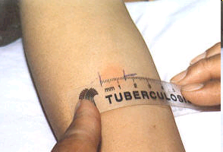
Diagnosis by X-ray:

Slide 6
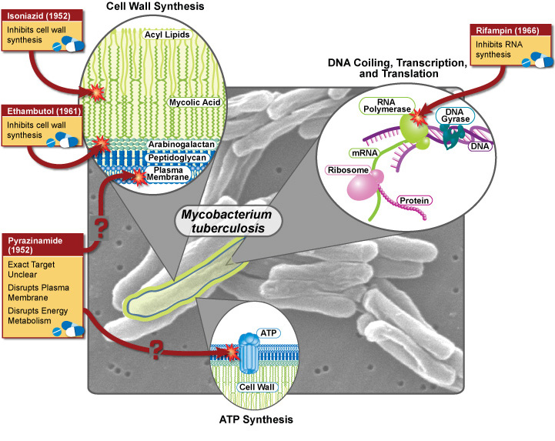

Slide 7
Classification
HIGH EFFICACY,CHEAP AND LOW TOXICITY
First line drugs include:
-ISONIAZIDE (H)
- PYRAZINAMIDE (Z)
- ETHAMBUTOL (E)
-RIFAMPICIN (R)
-STREPTOMYCIN (S)

Slide 8
Second line drugs include:
LOW EFFICACY AND HIGH TOXICITY
-THIACETAZONE
-CAPREOMYCIN
-P-AMINOSALICYLIC ACID
-ETHIONAMIDE
-CYCLOSERINE
-KANAMYCIN
-AMIKACIN

Slide 9
NEWER SECOND LINE DRUGS:
Flouroquinolones are active against M.tuberculosis.
Ciproflaxacin,
Oflaxacin,
Newer macrolides and some rifampin congeners are the recent additions.
Clarithromycin,
Azithromycin,
Rifabutin.

Slide 10
ISONIAZID [H]:
-Highly effective and the most widely used antitubercular agent
-Orally effective, cheapest + tuberculocidal activity
-Bacteriostatic for resting bacilli & cidal for growing bacilli
-Active against both intracellular and extracellular bacilli
-Also used for chemoprophylaxis of tuberculosis
Mechanism of action
Isoniazid inhibits the biosynthesis of mycolic acids, which are essential constituents of the mycobacterial cell wall

Slide 11
MOA
Isoniazid (Prodrug) in mycobacteria →Converted to
active form→Inhibits the synthesis of mycolic acid
(component of mycobacterial cell wall)→Death of bacteria (Tuberculocidal)
PK:-It is metabolized by acetylation and the metabolites
are excreted in urine.
Rate of acetylation of INH is under genetic control resulting in either rapid or slow acetylators
Rapid acetylators:- increase metablism→decreased action
(30–40% of Indians) t½ of INH 1 hr.
Slow acetylators:- (60–70% of Indians) t½ of INH 3 hr.
slow metabolism→Toxicity !!!
Acetylator status does not matter if INH is taken daily, but biweekly regimens are less effective in fast acetylators. Isoniazid induced peripheral neuritis is more common in slow acetylators

Slide 12
ADR:-
1. Hepatotoxicity: More in chronic alcoholics, older people and rapid acetylators (reversible) Patients receiving INH should be monitored for symptoms like anorexia, nausea, vomiting, jaundice, etc.
2. Peripheral neuritis: It is a dose-related toxicity. INH is structurally similar to pyridoxine→ competitively interferes with utilization of pyridoxine & promotes its the excretion.
Peripheral neuritis is more common in slow acetylators.
T/t :- Pyridoxine 10 mg/day is routinely given along with INH to reduce the risk of peripheral neuritis
INH neurotoxicity is treated by pyridoxine 100 mg/day

Slide 13
3. Other side effects are fever, skin rashes, arthralgia, anaemia, GI disturbances, psychosis and rarely
convulsions.
*Isoniazid inhibits the metabolism of phenytoin, carbamazepine, warfarin, etc. increases the plasma levels of these drugs may result in toxicity.

Slide 14
Rifampicin
Rapidly kills intracellular and extracellular bacilli including spurters (those residing in caseous lesion)
-Only agent that can act on all types of bacillary subpopulations; hence rifampin is called sterilizing agent
Bactericidal effect against- mycobacteria, N. meningitidis, H. infl uenzae, S. aureus, E. coli, Pseudomonas, etc
Mechanism of action
Rifampin binds to bacterial DNA-dependent RNA polymerase and inhibits RNA synthesis.

Slide 15
Pharmacokinetics
-Presence of food reduces its absorption;
-The active deacetylated form is excreted in bile and undergoes enterohepatic recycling. The rest of the drug is excreted in urine.
Interactions:- Rifampin is a microsomal enzyme inducer,
-Enhances its own metabolism + warfarin, oral contraceptives, corticosteroids, sulfonylureas, steroids, HIV protease inhibitors
-Contraceptive failures have occurred. It is advisable to switch over to an oral contraceptive containing higher dose (50 μg) of estrogen or use alternative method of contraception.

Slide 16
Uses
1. Tuberculosis
2. Leprosy
3. Prophylaxis of Meningococcal and H. influenzae meningitis and carrier state.
4. Second/third choice drug for MRSA,diphtheroids and Legionella infections.
5. Combination of doxycycline and rifampin is the first line therapy of brucellosis

Slide 17
Adverse effects and drug interactions
1. Hepatitis is the main adverse effect—the risk of hepatotoxicity is more in alcoholics and elderly
patients.
2. Flu-like syndrome with fever, chills, headache, muscle and joint pain.
3. GI disturbances such as nausea, vomiting and abdominal discomfort.
4. Skin rashes, itching and flushing
*Urine and secretions may become orange-red—
but this is harmless.

Slide 18
PYRAZINAMIDE [z]:
-It is active in acidic pH—effective against intracellular bacilli (has sterilizing activity) (tuberculocidal)
-Like INH, pyrazinamide inhibits mycobacterial mycolic acid biosynthesis but by a different mechanism.
ADR:- 1. Hepatotoxicity
2.Impairs the excretion of urates resulting in hyperuricaemia and may also precipitate
acute attacks of gout in susceptible individuals
3. The other side effects are anorexia, nausea, vomiting,
fever and skin rashes

Slide 19
MOA OF PYRAZINAMIDE:
Pyrazinamide
Mycobacterial Pyrazinamidase
Pyrazinoic Acid
Inhibits Mycolic Acid Synthesis
Resistance due to mutation of gene pncA

Slide 20
Ethambutol
-It inhibits arabinosyl transferases that are involved in mycobacterial cell wall synthesis
-Bacteriostatic drug
-Used in combination with other antitubercular drugs
to prevent emergence of resistance and for faster sputum conversion
ADR:-Optic neuritis (decreased visual acuity and colour-vision defects (red–green)
-Avoided in children below 6yrs of age (unable to report the disturbances in the vision +it is also difficult to test visual acuity in children
- Hyperuricaemia is due to the decreased clearance of urates. Other side effects are nausea, vomiting, abdominal pain, skin rashes, itching and joint pain

Slide 21
Streptomycin
-Aminoglycoside antibiotic
It is a bactericidal drug
Active against extracellular bacilli in alkaline pH
Not effective orally; it must be injected intramuscularly
ADR:- ototoxicity, nephrotoxicity and neuromuscular blockade

Slide 22
Para-amino salicylic acid:PAS
-Structurally similar to sulphonamides
-Like sulphonamides, PAS also competitively inhibits folate synthetase enzyme and produces tuberculostatic effect
-At present, PAS is a reserve drug for the management of MDR-tuberculosis
ADR:- GI disturbances—anorexia, nausea,vomiting and abdominal discomfort
ETHIONAMIDE : Bacteriostatic drug
-Structurally similar to INH but is less effi cacious (inhibits synthesis of mycolic acids)
ADRs:- nausea, vomiting and epigastric pain, hepatitis, headache, blurred vision and paraesthesia

Slide 23
Cycloserine
-Second-line antitubercular drug with bacteriostatic activity. It inhibits bacterial cell wall synthesis.
-The common side effects are on CNS and include headache, tremor, psychosis and convulsions.
Other Antitubercular Agents
a) Fluoroquinolones: Ciprofl oxacin, moxifl oxacin and levofl oxacin—bactericidal agents, given orally.
b)Aminoglycosides: Amikacin and kanamycin—bactericidal agents, administered parenterally.
c)Capreomycin (i.m.): May cause nephrotoxicity and ototoxicity.
d)Macrolides: Azithromycin and clarithromycin—given orally.
e)Rifamycins: Rifapentine and rifabutin—bactericidal agents, given orally.

Slide 24
Rifabutin: It is a derivative of rifampin. Rifabutin is preferred to rifampin for the treatment of tuberculosis
in HIV-infected patients on protease inhibitors (PIs) as rifabutin is a less potent enzyme inducer. Rifabutin
is also used for the treatment of MAC infection in combination with clarithromycin and ethambutol.
Rifapentine, analogue of rifampin, is also a potent enzyme inducer.

Slide 25
Treatment of Tuberculosis
WHO recommends the use of multi-drug therapy (MDT) for all cases of tuberculosis. The objectives of MDT are:
1. To make the patient non-infectious as early as possible by rapidly killing the dividing bacilli by using three to four bactericidal drugs.
2. To prevent the development of drug-resistant bacilli
3. To prevent relapse.
4. To reduce the total duration of effective therapy.

Slide 26
DOTS (directly observed treatment short course)
Revised National Tuberculosis Control Programme (RNTCP)
Drug susceptibility testing (DST)

Slide 27
Chemotherapy DOTS:
To control tuberculosis requires:
Effective, inexpensive, simple and standardised technology.
The success of the DOTS strategy depends on:
Government commitment to a national tuberculosis programme.
Case detection –finding by smear microscopy examination of TB susceptible in general health services.
Regular uninterrupted supply of essential anti-TB drugs.
Monitoring system for programme supervised and evaluation.

Slide 28
Multidrug-resistant (MDR) TB
-Defined as resistance to both H and R, and may be any number of other (1st line) drug(s).
-MDR-TB has a more rapid course with worse outcomes.
-Its treatment requires complex multiple 2nd line drug regimens which are longer, more expensive and more toxic
-The regimen should have at least 4 drugs certain to be effective.
-Often 5–6 drugs are included, since efficacy of some may be uncertain

Slide 30
Intensive phase: INH (H) 300 mg
Rifampin (R) 450 mg
Pyrazinamide (Z) 1500 mg
Ethambutol (E) 800 mg/
Streptomycin (S) 1000 mg
Pyridoxine 10 mg daily for 2 months.
Continuation phase: INH 300 mg Pyridoxine 10 mg Rifampin 450 mg daily for 4 months.
Isoniazid, rifampin, pyrazinamide and pyridoxine are administered orally half-an-hour before breakfast.
Streptomycin is given intramuscularly.

Slide 31
Extensively Drug-Resistant (XDR) Tuberculosis
Extensively drug-resistant (XDR) tuberculosis is defi ned as resistance to INH, rifampicin, fl uoroquinolone and one of capreomycin/kanamycin/amikacin.

Slide 32
Chemoprophylaxis of Tuberculosis
It is the prophylactic use of antitubercular drugs to prevent the development of active tuberculosis in patients who are at risk.
INH with rifampin is used for chemoprophylaxis as they are orally effective, less toxic and cheap.
Indications for chemoprophylaxis
1. Newborn of a mother with active tuberculosis.
2. Young children (6 years) with positive tuberculin test.
3. Household contacts of patients with tuberculosis.
4. Patients with positive tuberculin test with additional risk factors such as diabetes mellitus, malignancy, silicosis, AIDS, etc

Slide 33
-The standard drug for chemoprophylaxis of TB
is H 300 mg (10 mg/kg in children) daily for 6
months
-This is as effective in HIV patients as in those with normal immune function.
- Because of spread of INH resistance, a combination of H (5 mg/kg) and R (10 mg/kg, maximum 600 mg) daily
given for 3 months is preferred in some areas

Slide 34
TB Treatment in HIV Patients
Generally, TB treatment is the same for HIV-infected as for non-HIV-infected TB patients. Short-course
chemotherapy must be started, once TB is diagnosed.
Rifabutin is preferred over rifampin in HIV patients on antiretroviral drugs such as protease inhibitors, as it does not interact with them.

Slide 35
Tuberculosis in Pregnancy
All fi rst-line drugs (INH, rifampin, pyrazinamide and ethambutol) except streptomycin can be used
in pregnancy

Slide 36
Glucocorticoids in TB
Tuberculosis is a relative contraindication for the use of glucocorticoids
-But glucocorticoids may be used under the cover of effective antitubercular therapy for tuberculosis of serous membranes (pleura, pericardium, meninges, etc.), tuberculosis of the eye, larynx, genitourinary tract and to treat hypersensitivity reactions to antitubercular drugs.
Prednisolone is the preferred agent, except in meningitis (dexamethasone is preferred in this condition
as it lacks mineralocorticoid activity).

