Slide 1
Beta lactum antibiotics
Dr.Gore

Slide 2
Beta-lactam antibiotics include penicillins, cephalosporins, carbapenems and monobactams
All of them have a -lactam ring in their chemical structure
Penicillin was the fi rst antibiotic developed and used clinically. It was discovered accidentally by Alexander Fleming.
The source of penicillin is the high-yielding Penicillium

Slide 3
-The side chain of natural penicillin can be split off by an amidase to produce 6-aminopenicillanic acid
At the carboxyl group attached to the thiazolidine ring, salt formation occurs with Na+ and K+
-These salts are more stable than the parent acid
-It is stable in the dry state, but solution deteriorates rapidly at room temperature, though it remains stable at 4°C for 3 days
- Therefore, PnG solutions are always prepared freshly. PnG
is also thermolabile and acid labile
Unitage 1 U of crystalline sod. benzyl penicillin = 0.6 μg of the standard preparation. Accordingly,
1 g = 1.6 million units or 1 MU = 0.6 g

Slide 4
Mechanism of action
-All β-lactam antibiotics interfere with the synthesis of bacterial cell wall.
-Bacterial cell wall is composed of peptidoglycan, which has glycan chain cross-linked by peptide chain.
-The glycan chain is composed of alternating amino sugars, NAM (N-acetylmuramic acid) and NAG (N-acetylglucosamine).
-The bacteria synthesize UDP-N-acetylmuramic acid pentapeptide & and UDP-N-acetyl glucosamine
-The peptidoglycan residues are linked together forming long strands and UDP is split off
- The final step is cleavage of the terminal D-alanine of the peptide chains by transpeptidases; the energy so released is utilized for establishment of cross linkages between peptide chains of the
neighbouring strands This cross linking provides stability and rigidity to the cell wall

Slide 5
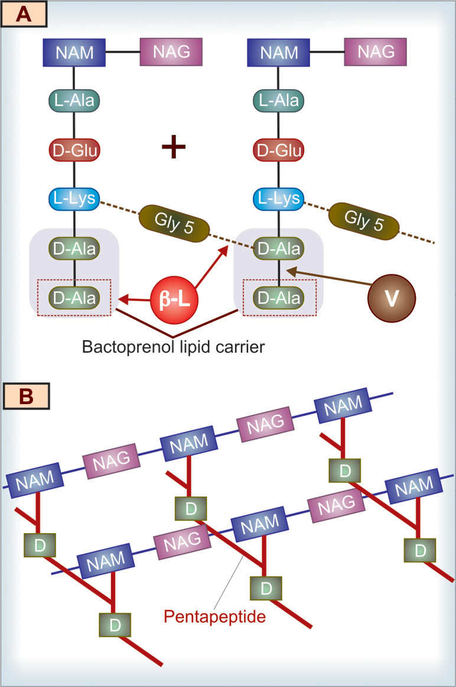
-Transpeptidase (penicillin binding protein) causes cross-linking between the pentaglycine residue of one strand and fourth a.a (D-alanine) of adjacent pentapeptide by cleavage of the terminal D-alanine (fifth a.a residue)
-Lactams, structural analogues of D-alanine, inhibit transpeptidase and thus peptidoglycan synthesis.
-Cell wall-deficient forms are
produced, which undergo lysis (bactericidal action). Beta-lactams exert their cidal effect when the bacteria actively multiply and synthesize cell wall

Slide 6
Gram-positive cell wall of bacteria is composed mainly of highly cross-linked peptidoglycan, which is 50–100-layers thick and is near the cell surface.
In gram-negative bacteria, the peptidoglycan layer is only 1–2 molecules thick.
In addition, there is an outer lipopolysaccharide layer. Hence, gram-negative organisms are less susceptible to penicillins than
gram-positive organisms.
*Blood, pus, and tissue fluids do not interfere with the antibacterial action of β-lactam antibiotics.

Slide 7
Mechanism of bacterial resistance to penicillins
Bacteria develop resistance (i) by producing -lactamases, which destroy the -lactam ring, e.g.S. aureus, E. coli, gonococci, H. infl uenzae, etc. (ii) due to altered PBPs, which have less affi nity for
-lactams, e.g. S. pneumoniae (iii) due to decreased ability of the drug to penetrate to its site of action
Pharmacokinetics:-
Most of the orally administered penicillin G is destroyed by
gastric acid (acid labile); hence penicillin G is usually given by i.v. route.
2.Poor penetration through BBB although during meningitis, adequate amount reaches the CSF.
3. Penicillin G is rapidly excreted in urine mainly by active tubular secretion - The action of penicillins can be augmented and prolonged by giving probenecid simultaneously

Slide 8
Preparations of penicillin G:-The duration of action of penicillin G is increased by combining it with poorly water-soluble compounds, such as procaine (procaine penicillin G) or benzathine (benzathine penicillin G) to yield aqueous suspensions. They are called repository or depot penicillins

Slide 9
Penicillin | Route and Dose | Duration of Action | Special Features
Penicillin G (benzyl penicillin, Crystalline penicillin) | i.v., i.m 20–24 million units (MU) daily | 4–6 h; gram-positive bacteria, few gram negative ones and anaerobes | Rapid onset of action, reaches high plasma concentration; mainly used in severe infections— meningitis, endocarditis, pneumonia, etc.
Repository penicillins (depot penicillins)
Procaine penicillin G | i.m. 6–12 lakh units (0.6–1.2 MU) daily | 12–24 h | Moderate plasma concentration, used in mildto- moderate infections; less painful because of procaine component

Slide 10
Benzathine penicillin G | i.m. 6–24 lakh units (0.6–2.4 MU), once a month | 3–4 weeks | Slow onset but has longest duration of action among penicillins. Used in syphilis, rheumatic fever prophylaxis, etc.
Forti ed procaine penicillin G | 3 lakh U procaine penicillin G + 1 lakh U penicillin G i.m. | 12-24 hrs | Rapid onset with high plasma concentration and longer duration of action; used in mild-to-moderate infections by sensitive organisms
Penicillinase It is a narrow spectrum β-lactamase which opens the β-lactam ring and inactivates PnG and some closely related congeners
The methicillin-resistant Staph. aureus (MRSA) have acquired a PBP which has very low affinity for β-lactam antibiotics.

Slide 11
Adverse effects:- Penicillin G is one of the most nontoxic antibiotics; up to 20 MU has been injected in a day without any organ toxicity.
Local irritancy and direct toxicity:-Pain at i.m. injection site, nausea on oral ingestion and
thrombophlebitis of injected vein are dose related
Non a dose-related adverse drug reaction:-anaphylactic shock are severe hypotension, bronchospasm and laryngeal oedema. It is an immunoglobulin E (IgE) mediated, immediate type of hypersensitivity reaction (Type-I hypersensitivity)
*Cross-reactivity can occur among penicillins and also among -lactams antibiotics
Precautions
1. Before giving penicillin, history of previous administration and allergic manifestations, if any, must
be noted

Slide 12
2. In patients with history of asthma, allergic rhinitis, hay fever, etc. there is an increased risk of penicillin allergy; hence it should be avoided in such cases.
3. Sensitivity test should be performed by an intradermal test on the ventral aspect of forearm. Itching, erythema and wheal formation are watched for. A negative skin test does not ensure absolute safety. Testing with benzylpenicilloyl- polylysine is safer
4. Inj. adrenaline and hydrocortisone should be kept ready before injecting penicillin to treat the
anaphylactic reaction
Jarisch–Herxheimer reaction: It is an acute exacerbation of signs and symptoms of syphilis during penicillin therapy due to release of endotoxins from the dead organisms. The manifestations are fever, chills, myalgia, hypotension, circulatory collapse, etc. It is treated with aspirin and corticosteroids.

Slide 13
Toxicity to the brain may be manifested as mental confusion, muscular twitchings, convulsions and coma, when very large doses (> 20 MU) are injected i.v.; especially in patients with renal insufficiency use has declined very much due to fear of causing anaphylaxis

Slide 14
Therapeutic uses of penicillin G:-n use has declined very much due to fear of causing anaphylaxis
1. In dentistry: Vincent’s angina, necrotizing gingivitis, periodontal infections, etc. either alone or with metronidazole.
2. Pneumococcal infections: In pneumonia, meningitis or other serious infections, third-generation cephalosporins (DOC); i.v. penicillin G can be used as an alternative
3. Streptococcal infections: Streptococcal pharyngitis, otitis media, rheumatic fever, etc. Procaine penicillin G or benzathine penicillin G is used for the treatment of rheumatic fever.
4. Meningococcal meningitis: Third-generation cephalosporins (cefotaxime or ceftriaxone) are preferred. i.v. penicillin G is also effective.Rifampin attains high concentration in nasopharynx and eliminates the meningococcal carrier state. Hence, rifampin but not penicillin G is used for prophylaxis of meningitis.

Slide 15
5. Gonococcal infections: Penicillin was the DOC for gonococcal infections. Because of the emergence of resistant organisms, penicillins are not preferred at present. Third-generation cephalosporins, ceftriaxone or cefixime are the DOC for uncomplicated gonococcal infections.
6. Syphilis: Penicillin G is the drug of choice for syphilis. The alternative drugs are ceftriaxone and azithromycin and doxycycline.
7. Diphtheria: It is an acute infection of upper respiratory tract caused by C. diphtheriae. It is treated mainly with the specifi c antitoxin. Penicillin G helps to eliminate the carrier state. Patients allergic to penicillin are treated with erythromycin.

Slide 16
8. Clostridial infections (tetanus and gas gangrene): The main treatment is the neutralisation of the toxin by using human tetanus immunoglobulin. For gas gangrene, penicillin G is used as an adjunct to antitoxin.
9. Other infections: Anthrax, listeria infections, lyme disease, leptospirosis, actinomycosis, rat-bite fever, etc. are effectively treated with penicillin G.
10. Anaerobic infections: Penicillin G is effective for the treatment of anaerobic infections (periodontal).

Slide 17
SEMISYNTHETIC PENICILLINS:- procaine penicillin and benzathine penicillin are salts of PnG and not semisynthetic penicillins
The aim of producing semisynthetic penicillins has been to overcome the shortcomings
of PnG, which are:
Poor oral efficacy
2. Susceptibility to penicillinase.
3. Narrow spectrum of activity.
4. Hypersensitivity reactions (this has not been overcome in any preparation).
Clavulanic acid Sulbactam, Tazobactam

Slide 18
Limitations/drawbacks of penicillin G
1. Acid labile – orally not very effective.
2. Short duration of action (to overcome this, repository penicillins have been developed).
3. Narrow spectrum of antibacterial activity (mainly against gram-positive organisms).
4. Destroyed by penicillinase enzyme.
5. Possibility of anaphylaxis.

Slide 19
Some β-lactamase inhibitors have been developed which themselves are not antibacterial, but augment the activity of penicillins against β-lactamase producing organisms
CLASSIFICATION
1. Acid-resistant alternative to penicillin G Phenoxymethyl penicillin (Penicillin V).
2. Penicillinase-resistant penicillins Methicillin, Cloxacillin, Dicloxacillin.
3. Extended spectrum penicillins
(a) Aminopenicillins: Ampicillin, Bacampicillin, Amoxicillin.
(b) Carboxypenicillins: Carbenicillin.
(c) Ureidopenicillins: Piperacillin, Mezlocillin.
β-lactamase inhibitors

Slide 20
Penicillins | Route of Administration | Penicillinase Susceptible/ Resistant | Antimicrobial Spectrum/Uses
1. Natural penicillins Penicillin G Procaine penicillin G Benzathine penicillin G | i.v., i.m. i.m. i.m. | Susceptible | Streptococcus species, N. gonorrhoeae, N. meningitidis, B. anthracis, Coryne diphtheriae, Clostr spp., spirochetes (Treponema, Leptospira), Actinomyces and most of the anaerobes (not Bacteroides fragilis)
2. Semisynthetic penicillins a. Acid-resistant penicillin: Phenoxymethyl penicillin (Penicillin V) | Oral | Susceptible | Similar to penicillin G, attains very low plasma concentration, hence used only for mild streptococcal and pneumococcal infections, trench mouth

Slide 21
Penicillinase-resistant Penicillins Methicillin Oxacillin Cloxacillin Dicloxacillin | i.m., i.v. Oral, i.m., i.v. | Resistant | Sensitive strains of Staphylococcus aureus and S. epidermidis infections (abscesses, cellulitis, pneumonia, etc.)
Extended-spectrum penicillins • Aminopenicillins Ampicillin Amoxicillin | Oral, i.m., i.v. | Susceptible | extended to gram-ve E. coli, Proteus, Salmonella, Shigella, Haemophilus in uenzae and Helicobacter pylori.* amoxicillin is the most active against both penicillin-sensitive and penicillin resistant Streptococcus pneumoniae. Ampicillin is highly effective against Listeria monocytogenes

Slide 22
Carboxypenicillins Carbenicillin Carbenicillin indanyl Ticarcillin | i.m., i.v. Oral i.v. | Susceptible | Infections caused by Pseudomonas aeruginosa and Proteus spp.
Ureidopenicillins Mezlocillin Piperacillin | i.m., i.v. i.m., i.v. | Susceptible | Pseudomonas aeruginosa, Klebsiella and Enterobacteriaceae infections (pneumonias, burns and UTIs)
Probenecid competes with -lactams (penicillins and cephalosporins) for active tubular secretion and retards their excretion, thereby increasing the plasma concentration as well as the duration of action of -lactams. The simultaneous administration of probenecid and penicillin increases the therapeutic effi cacy of -lactams—useful in the treatment of bacterial endocarditis and gonococcal infections.

Slide 23
Ampicillin | Amoxicillin
Acid stable; incompletely absorbed from GI tract—alters intestinal ora; hence diarrhoea is more common (superinfection) | Acid stable, completely absorbed from GI tract; hence the incidence of diarrhoea is less
Food decreases the absorption of ampicillin | Food does not decrease the absorption of amoxicillin
Effective against Shigella and Haemophilus in uenzae | Less effective against Shigella and H. in uenzae
Ampicillin reduces the effectiveness of oral contraceptives | Does not reduce the effectiveness of oral contraceptives
Dose: Ampicillin 250–500 mg QID | Dose: Amoxicillin 250–500 mg TID

Slide 24
Antipseudomonal penicillins
They are carbenicillin, carbenicillin indanyl, ticarcillin, mezlocillin and piperacillin
Uses: Serious infections—bacteremias, pneumonias, UTIs, burns, etc. by P. aeruginosa and Proteus are more effectively treated with piperacillin than carbenicillin. Carbenicillin indanyl is used orally for the treatment of UTI caused by P. aeruginosa and Proteus spp.
Ticarcillin with -lactamase inhibitor is used along with an aminoglycoside for the treatment of mixed nosocomial infection.
Adverse effects are similar to penicillin G. Congestive cardiac failure may be precipitated due to sodium
content of carbenicillin sodium. It can also interfere with platelet function and cause bleeding.

Slide 25
Beta -Lactamase Inhibitors:-
They are clavulanic acid, sulbactam and tazobactam. They structurally resemble -lactam molecules.
Beta-lactamase inhibitors bind to lactamases and inactivate them. Coadministration of these drugs with -lactams increases the activity of -lactams by preventing them from enzymatic destruction.
They are clavulanic acid, sulbactam and tazobactam.
Clavulanic acid:
It competitively and irreversibly inhibits -lactamases produced by a wide range of gram-positive and gram-negative bacteria. After binding to the enzyme, clavulanic acid itself gets inactivated; hence it is called a ‘suicide’ inhibitor

Slide 26
Preparation (Brand Name) | Route(s) of Administration | Uses
Clavulanic acid + amoxicillin (Augmentin) | Oral, i.m., i.v. | Skin, soft tissue, otitis media, respiratory and urinary tract infections caused by -lactamase-producing strains of S. aureus, E. coli, H. in uenzae and gonococci
Clavulanic acid + ticarcillin | i.m., i.v. | Mixed nosocomial infections due to aerobic gram-negative bacilli, S. aureus and Bacteroides spp
Sulbactam + ampicillin | Oral, i.m., i.v. | Intra-abdominal and pelvic infections (mixed aerobic and anaerobic infections) due to -lactamase-producing strains of S. aureus, gram negative aerobes and anaerobes

Slide 27
Tazobactam + piperacillin | i.v. | Severe infections caused by -lactamase-producing strains of gram-negative bacilli

