Slide 1
ITS Dental College, Greater Noida
Subject : Pharmacology
Lecture Topic:Coagulents and Anticoagulents
Lecture Number: L37
Program, Year: BDS, Second Year
Faculty : Dr. Shobha

Slide 2
Lecture Objectives & Learning Outcomes
General Objective : To understand the Coagulent and Anticoagulent drugs
Specific Learning Outcomes:
At the end of the session, the learner should be able to know the following
1. Coagulent drugs and their uses
2.Anti Coagulent drugs and their uses

Slide 3
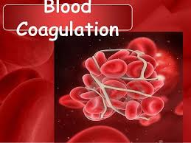
COAGULATION
Coagulation is a complex process by which blood forms clots. It is an important part of hemostasis
wherein a damaged blood vessel wall is covered by a platelet and fibrin-containing clot to stop bleeding and begin repair of the damaged vessel
Disorders of coagulation can lead to:
an increased risk of bleeding (hemorrhage)
or clotting (thrombosis)

Slide 4
Thrombosis:- When coagulation of blood occurs in blood vessels without injury to the vessel wall
-Serious consequence of blockage of vessel can occur
Types:-
a)Venous (Fibrin thrombi)
b)Arterial (platelet thrombi)

Slide 5
Venous thrombus:-
Causes:-
1.Immobility
- stagnation of blood in veins after operation
-pregnancy
-severe illness
2.Obese
3.Malignancy
4.Oral contraceptives containing Estrogen(stopped 6 wks before surgery)
Danger is, part of clot can break off, forming an embolus,
which is swept off along the blood flow and may block
major arteries in heart, brain

Slide 6
THE COAGULATION CASCADE

Slide 7
COAGULANTS
These are substances which promote coagulation, and are indicated in haemorrhagic states
Fresh whole blood or plasma provide all the factors needed for coagulation and are best therapy for deficiency of any clotting factor
Other coagulants
-Tranexamic acid
Aprotinin
Ethamsylate

Slide 8
VITAMIN K
Used in
In neonates to prevent haemorrhagic disease of newborn
Counteract overdosing of oral anticoagulants
Prophylaxis & T/t of def. of clotting factors d/t def. of vit K
Deficiency of vit K occurs due to
Liver disease- Cirrhosis or hepatitis
Obstructive jaundice
Malabsorption
Long-term antimicrobial therapy ,Deficient diet
Fat soluble ;required for synthesis of clotting factors
Dietary sources -green leafy vegetables-cabbage, spinach & liver, cheese, etc
Acts as a cofactor in the synthesis of coagulation proteins-prothrombin, factors VII, IX and X
The vit K dependent change confers on them the capacity to bind Calcium and to get bound to phospholipid surfaces

Slide 9
Haemostatic Agents They arrest bleeding either by vasoconstriction or by promoting coagulation of blood
Local agents (styptics)
Astringents
Adrenaline Fibrin glue Adrenochrome monosemicarbazone
Gelatin Collagen Calcium alginate Oxidized cellulose
Tranexamic acid Haemocoagulase
Haemocoagulase
Systemic agents
Vitamin K
Fibrinogen
Thrombin
Antihaemophilic factor
Ethamsylate
Desmopressin
Tranexamic acid
Epsilon amino-caproic acid

Slide 10
Local Haemostatics (Styptics)
Control bleeding from capillaries and minute vessels, e.g. bleeding
following tooth extraction, abrasions, epistaxis, etc.
Astringents: They ppt proteins locally in the bleeding site and control capillary oozing, e.g. tannic acid, ferric chloride, ferric sulfate, aluminum chloride, aluminum sulfate, etc.
Adrenaline: Vasoconstriction→ arrests bleeding. Cotton pad soaked in 0.1% adrenaline applied on bleeding site e.g., epistaxis, bleeding after tooth extraction
Adrenaline should be avoided in patients with hypertension, congestive cardiac failure, arrhythmias, ischaemic heart disease and uncontrolled hyperthyroidism as it may precipitate myocardial infarction (MI) or aggravate the existing condition

Slide 11
Thrombin:facilitating the last step in the coagulation; recombinant thrombin are available
*Human plasma-derived thrombin carries the risk of virus transmission. Thrombin is placed in the tooth socket to arrest bleeding
Fibrin glue:-Control bleeding during surgical procedures or as a spray on the bleeding surface
Haemophilic patients:- Fibrin sealant+tranexamic acid mouthwash helps to reduce bleeding during dental extraction
Sealants made from human plasma carry the risk of transmitting viral infections
Collagen: Controls bleeding by promoting aggregation of platelets and accelerating coagulation.
*Collagen sponges are placed in tooth socket following extraction to arrest bleeding.

Slide 12
Gelatin: Protein used as a haemostatic in surgical procedures; Absorbable haemostatic available as a sponge or a film
-Produces haemostasis by providing a physical meshwork on
which clotting can occur. Adverse effects are infection, granuloma formation and fi brosis
Haemocoagulase:Isolated from the venom of Bothrops atrox (viper)
-Powerful haemostatic,promotes coagulation by two enzymes: a) thrombinlike action (converts fi brinogen to fi brin) b)thromboplastin-like action
Shorten bleeding &clotting time→controls capillary bleeding.
- Topical, i.v., i.m & sc:onset within 5–10 min of i.v.; 20–30 min after i.m. administration and within a minute of topical application (spray/soaked swab).

Slide 13
Indications
a)To control bleeding following tooth extraction or any other dental procedure.
b)For prevention and treatment of haemorrhagic conditions of different etiology.
Adverse effects are rare; they may cause anaphylactic reaction on intravenous administration

Slide 14
Classification:-
A. Parenteral anticoagulants
(i) Indirect thrombin inhibitors: Heparin, Low molecular weight heparins, Fondaparinux, Danaparoid
(ii) Direct thrombin inhibitors: Lepirudin, Bivalirudin, Argatroban
B. Oral anticoagulants
(i) Coumarin derivatives: Bishydroxycoumarin (dicumarol), Warfarin sod, Acenocoumarol (Nicoumalone), Ethylbiscoumacetate
(ii) Indandione derivative: Phenindione.
(iii) Direct factor Xa inhibitors: Rivaroxaban
(iv) Oral direct thrombin inhibitor: Dabigatran
etexilate

Slide 15
HEPARIN
McLean, a medical student ,discovered in 1916 that liver contains a powerful anticoagulant
Howell and Holt in 1918 named it ‘HEPARIN’
because it was obtained from liver
Heparin is a heterogenous mixture of sulfated mucopolysaccharides with MW 10,000 to 20,000
It carries strong electronegative charges and is the strongest organic acid present in the body
Heparin is found in the secretory granules of mast cells richest sources : lung, liver and intestinal mucosa
Commercially it is produced from ox lung and pig intestinal mucosa
Notes:
It contains polymers of two disaccharide units:
D-glucosamine-L-iduronic acid
D-glucosamine-D-glucuronic acid

Slide 16
PHARMACOLOGICAL ACTIONS
1.ANTICOAGULANT:-Heparin is a powerful and instantaneously
acting anticoagulant, effective both in vivo and in vitro
2.Heparin produces its anticoagulant effect by activating plasma
antithrombin III(AT III a serine proteinase inhibitor)
3.The heparin-AT III complex then binds to clotting factors of the
intrinsic and common pathways and inactivates them but not factor VIIa operative in the extrinsic pathway
4.The anticoagulant action is exerted:- by inhibition of factor
Xa & thrombin (IIa) mediated conversion of fibrinogen to fibrin

Slide 17
ACTIONS
2 ANTIPLATELET:-
Heparin in higher doses inhibits platelet aggregation and prolongs bleeding time
3 LIPAEMIA CLEARING:-
clears turbid post-prandial lipaemia by releasing a lipoprotein lipase from the vessel wall and tissues
Notes:
, which hydrolyses triglycerides of chylomicra and very low density lipoproteins to free fatty acids; these then pass into tissues and the plasma looks clear

Slide 18
PHARMACOKINETICS
Heparin is a large, highly ionized molecule-not absorbed orally
i/v acts instantaneously, but s/c inj effect develops after 60 min
Heparin does not cross blood-brain barrier or placenta, Not secreted in breast milk (safe in pregnancy)
*It should not be mixed with penicillin, tetracyclines,
hydrocortisone or NA in the same syringe or infusion bottle
-Heparinized blood is not suitable for blood counts
(alters the shape of RBCs and WBCs), fragility testing
and complement fixation tests

Slide 19
Dosing
- i.v. bolus 5,000–10,000 U (children 50–100 U/kg), f/b
continuous infusion of 750–1000 U/hr.
Rate of infusion is controlled by aPTT(activated partial
thromboplastin time)which is kept at 50–80 sec. or 1.5–2.5
times the patient’s pretreatment value
-If this test is not available, whole blood clotting time should
be measured and kept at ~2 times the normal value
-Low dose (s.c.) regimen :-5000 U is injected s.c. every 8–12
hours, started before surgery and continued for 7– 10 days or till
the patient starts moving about (prevents postop DVT
without increasing surgical bleeding. It also does not prolong aPTT or clotting time)

Slide 20
ADVERSE EFFECTS
Bleeding due to overdose Haematuria is generally the first sign!
Thrombocytopenia
Transient and reversible alopecia
Osteoporosis on long-term use of relatively high doses
Hypersensitivity reactions are rare
CONTRAINDICATIONS
Bleeding disorders, Heparin induced thrombocytopenia
Severe hypertension, threatened abortion, piles, GI ulcers
Subacute bacterial endocarditis
Large malignancies
Tuberculosis
Chronic alcoholics, cirrhosis
Renal failure
Aspirin and other antiplatelet drugs should be used very cautiously during heparin therapy

Slide 21
Low molecular weight (LMW) heparins
1.Selectively inhibit factor Xa with little effect on IIa
2.Smaller effect on aPTT and clotting time
3. Lesser antiplatelet action—less interference with
Haemostasis
4. Thrombocytopenia is less frequent
5.They are eliminated primarily by renal excretion; are not to be used in patients with renal failure

Slide 22
Advantages of LMW heparins
1.Better s.c B.A. (70–90%) compared to UFH (20–30%)
2.Longer and more consistent monoexponential t½: (4–
6 hours); making possible once daily s.c. administration.
3. Since aPTT/clotting times are not prolonged,
laboratory monitoring is not needed; dose is calculated
on body weight basis.
4. Risk of osteoporosis after long term use is much less
*Can be used in pregnancy
Fondaparinux:The bioavailability of fondaparinux
injected s.c. is 100% and it is longer acting (t½ 17 hours)

Slide 23
Indications
1.Prophylaxis of deep vein thrombosis and pulmonary
embolism in high-risk patients undergoing surgery;
stroke or other immobilized patients.
2. Treatment of established deep vein thrombosis.
3. Unstable angina and MI: they have largely replaced
continuous infusion of UFH.
4. To maintain patency of cannulae and shunts in
dialysis patients.

Slide 24
HEPARIN ANTAGONIST Protamine sulfate
It is a strongly basic, LMW protein obtained from the sperm of certain fish
Given i/v → neutralises heparin w/w i.e. 1 mg neutralises 80-100 U of heparin
Used in:
Severe bleeding
Heparin action needs to be terminated rapidly eg: after cardiac or vascular surgery
Hirudin:- originally obtained from leeches, now produced recombinantly
-Specific inhibitor for thrombosis

Slide 25
ORAL ANTICOAGULANTS
Act by interfering with synthesis of vitamin K dependent clotting
factors in liver & regeneration of active form of vit K
Indicated in pt’s at risk of abnormal blood clotting/thrombosis
Abnormal blood clotting can occur in arteries, veins or heart
Clotting
Brain vessels → stroke ; heart vessels → cardiac arrest & limb vessels → gangrene
Clots can dislodge and go to the lungs, known as pulmonary embolism

Slide 26
WARFARIN
-A synthetic derivative of coumarin ( chemical found naturally in many plants, like, woodruff (Galium odoratum, Rubiaceae), and at lower levels in licorice, lavender, species
-Most common oral anticoagulant used for long-term therapy
Inhibits the synthesis of vitamin K-dependent biologically active
forms of the calcium-dependent clotting factors i.e of II, VII, IX and X, as well as the regulatory factors protein C
They apparently behave as competitive antagonists of
vit K and lower the plasma levels of functional clotting
factors in a dose-dependent manner
-
Notes:
Warfarin is prescribed to people with an increased tendency for thrombosis or in those individuals that have already formed a blood clot (thrombus)

Slide 27
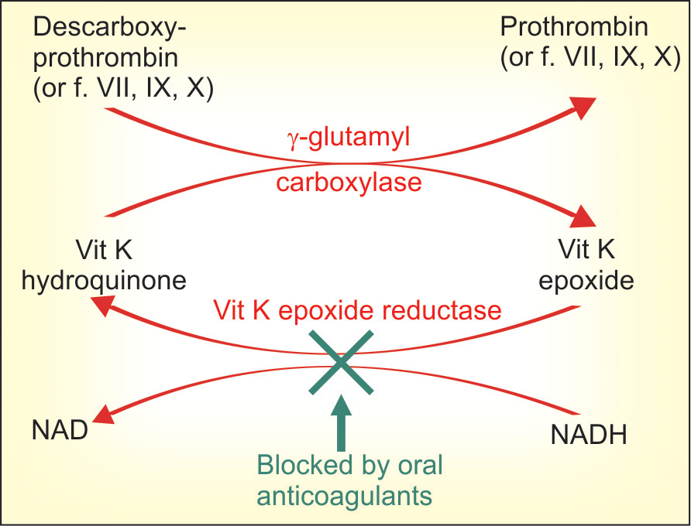
MECHANISM OF ACTION

Slide 28
-They inhibit the enzyme vit K epoxide reductase (VKOR) and
interfere with regeneration of the active form of vit K (cofactor for
the enzyme γ-glutamyl Carboxylase)→ carries out the final step of γ
carboxylating glutamate residues of prothrombin & factors VII, IX and X
-This carboxylation is essential for the ability of theclotting factors
to bind Ca2+ and to get boundto phospholipid surfaces, necessary for the coagulation sequence to proceed
Therapeutic effect occurs when synthesis of clotting factors is reduced by 40–50%

Slide 29
ADVERSE EFFECTS
Hemorrhage:- Bleeding is more likely if therapy
is not properly monitored,
or when INR exceeds
4, or interacting
drugs/contraindications are
present
Warfarin necrosis
Osteoporosis
Purple toe syndrome
Toxicity
TREATMENT: give fresh blood transfusion, supplies clotting factors & replenishes lost blood
Give vit K1-specific antidote but it takes 6-24 hours for clotting factors to be resynthesised & released in blood after vit K administration

Slide 30
Factors decreasing effect of oral anticoagulants
Pregnancy: plasma level of
clotting factors is higher
• Nephrotic syndrome: drug
bound to plasma protein is lost
in urine
Genetic warfarin resistance:
affinity of warfarin to bind
to the reductase (VKOR)
enzyme is low
Dose of oral anticoagulant is 4–5 times higher.
Factors enhancing effect
-Debility, malnutrition, malabsorption ,prolonged antibiotic therapy: the supply of vit K to liver is reduced in these conditions.
• Liver disease, chronic alcoholism: synthesis of clotting factors may be deficient.
• Hyperthyroidism: the clotting factors are degraded faster.
• Newborns: have low levels of vit K and clotting factors (there should be no need of these drugs in neonates anyway).

Slide 31
Contraindications
All contraindications to heparin
Pregnancy:-
Early pregnancy increases birth defects, especially
Skeletal abnormalities
Foetal warfarin syndrome—hypoplasia of nose, eye
socket, hand bones, and growth retardation
Later in pregnancy:-CNS defects, foetal haemorrhage,
foetal death and accentuates neonatal hypoprothrombinemia

Slide 32
Drug interactions
1.Broad-spectrum antibiotics: inhibit gut flora & reduce vit K
production
2. Newer cephalosporins (ceftriaxone, cefoperazone) cause
hypoprothrombinaemia by the same mechanism as warfarin —
additive action
3. Aspirin: inhibits platelet aggregation and causes g.i.
bleeding—this may be hazardous in anticoagulated patients. High
doses of salicylates have synergistic hypoprothrombinemic action
and also displace warfarin from protein binding site.
4.Long acting sulfonamides, indomethacin, phenytoin and
probenecid: displace warfarin from plasma protein binding
5. Chloramphenicol, erythromycin, celecoxib, cimetidine, allopurinol, amiodarone and metronidazole: inhibit warfarin metabolism

Slide 33
Reduced anticoagulant action
1.Barbiturates (but not benzodiazepines),
carbamazepine, rifampin and griseofulvin induce the
metabolism of oral anticoagulants.
*Dose should be higher.
2. Oral contraceptives: increase blood levels of
clotting factors.

Slide 34
USES:-
Deep vein thrombosis and pulmonary embolism
Myocardial infarction
Unstable angina
Rheumatic heart disease (RHD)
Atrial fibrillation
Cerebrovascular disease
Vascular surgery, prosthetic heart valves,
Retinal vessel thrombosis,
Extracorporeal circulation, haemodialysis
Defibrination syndrome/‘disseminated intravascular coagulation’

Slide 35
PLASMA EXPANDERS
-High molecular weight substances which exert colloidal
osmotic (oncotic) pressure, and when infused i.v. retain
fluid in the vascular compartment
They are used to correct hypovolemia due to loss of plasma/blood
-Human plasma or reconstituted human albumin would
be best
However, they carry risk of transmitting serum
hepatitis, AIDS, etc.therefore synthetic are used

Slide 36
Desirable properties of plasma expander
1. Should exert oncotic pressure comparable to
plasma
2. Should remain in circulation and not leak out in
tissues, or be too rapidly disposed.
3. Should be pharmacodynamically inert
4. Should not be pyrogenic or antigenic
5. Should not interfere with grouping and crossmatching
of blood
6. Should be stable, easily sterilizable and cheap

Slide 37
Substances employed are:
Human Albumin
Dextran
Polygeline
Hetastarch

Slide 38
USE OF PLASMA EXPANDERS
Used primarily as substitutes for plasma in conditions
where plasma has been lost or has moved to
Extravascular compartment, e.g. in burns (acute phase
only), hypovolemic and endotoxin shock, severe
Trauma and extensive tissue damage
Contraindications to plasma expanders are—
severe anaemia, cardiac failure, pulmonary edema,
liver disease, renal insufficiency

Slide 39
2nd Last Slide
Uses of Heparin
Heparin antidote
Warfarin uses and contraindication
LMW heparin
Thrombolytics
Reading List/Reference List
K.D. Tripathi

