Slide 1
ITS Dental College, Greater Noida
Subject : Pharmacology
Lecture Topic: General Anesthesia
Lecture Number: L28
Program, Year: BDS, Second Year
Faculty : Dr.Rajeshwari

Slide 2
Lecture Objectives & Learning Outcomes
General Objective : To understand the various drugs used to produce general anaesthesia
Specific Learning Outcomes:
At the end of the session, the learner should be able to know the following regarding General Anesthetics
1.Stages of anesthesia
2.Classification of general anesthetics
3.Uses
4.Adverse effects

Slide 3
Surgery Before Anesthesia
Notes:
50

Slide 4
Background
General anesthesia was absent until the mid-1800’s
William Morton administered ether to a patient having a neck tumor removed at the Massachusetts General Hospital, Boston, in October 1846.
The discovery of the diethyl ether as general anesthesia was the result of a search for means of eliminating a patient’s pain perception and responses to painful stimuli.
(CH₃CH₂)₂O
Notes:
Yet, the most famous contribution by the United States to medical progress at this period was undoubtedly the introduction of general anesthesia. Drugs of various kinds have been used for many centuries to reduce the distress of surgical operations. It was a procedure that not only liberated the patient form the fearful pain of surgery, but also enabled the surgeon to perform more extensive operations.
Now, known as one of the most important discoveries in medical science, Morton’s technique quickly reached Europe, and establishing the practice of anesthesiology. Safely has improved greatly, less than one death per 200,000 procedures occurs currently.

Slide 5
Desirable features of a GA
Analgesia
Amnesia
Unconsciousness
Muscle relaxation
Suppression of undesirable reflexes
*But practically no single anesthetic can satisfy the desired goals:- several different categories of drugs are used to provide optimal anesthesia

Slide 6
-Principal locus of :-
Unconsciousness - Thalamus or reticular activating system (RAS)
-Amnesia - Cerebral cortex and hippocampus
Recent findings show that ligand gated ion
channels (but not voltage sensitive ion channels) are the major targets of anaesthetic action
-Many inhalational anaesthetics, barbiturates,
benzodiazepines and propofol potentiate the
action of inhibitory transmitter GABA to open Cl¯ channels

Slide 7
-Each of the above anesthetics appears to
interact with its own specific binding site on the GABA A receptor- Cl¯ channel complex
N2O and ketamine do not
affect GABA or glycine gated Cl¯ channels
Rather they selectively inhibit the excitatory
NMDA type of glutamate receptor
-Unlike LA’s which act primarily by blocking axonal conduction, the GAs appear
to act by depressing synaptic transmission

Slide 8
MAC (Minimal alveolar concentration)
-The lowest conc of the anaesthetic in pulmonary alveoli needed to produce immobility in response to a painful stimulus (surgical incision) in 50% individuals
-Accepted as a valid measure of potency of inhalational gas
*MAC - shows correlation with their oil/gas partition coefficient - reflects capacity of the anaesthetic to enter into CNS and attain sufficient concentration in the neuronal membrane

Slide 9
Stages of Anesthesia:- 4
-Correlate with increasing depth of CNS depression
-Best appreciated with diethyl ether only (slow onset of action)
Ether is obsolete now becoz ->highly inflammable & explosive
*Brain :-Higher functions are lost 1st & progressively than lower ones
*Spinal cord lower segments are affected somewhat earlier than the higher segments
*Vital centres located in the medulla are paralysed the last as the depth of anaesthesia increases

Slide 10
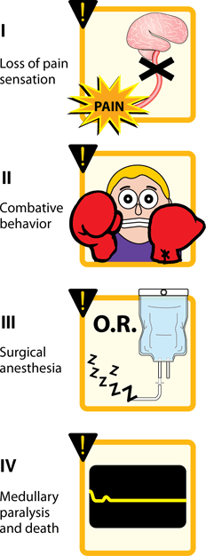
Stages
I:- Analgesia but no amnesia
II:-Excitement & delirium
III:-Surgical anesthesia
Plane I:- Eye balls show
roving movements
Plane 2:-Progressive loss of
light, corneal & laryngeal
reflexes, respiration slow
but regular
*Most surgical procedures
are carried out in this stage

Slide 11
Plane 3:- Pupil is dilated, eye ball movement, light,
corneal & laryngeal reflexes are absent, respiration
abdominal
Plane 4:- Complete muscle relaxation, pupil
dilated, complete loss of light, corneal, laryngeal
reflexes , respiration abdominal
IV:-Medullary pararlysis, fatal

Slide 12
Classification
Inhalational Gas
Volatile liquids Nitrous oxide
Ether
Halothane
Isoflurane
Desflurane
Sevoflurane

Slide 13
Classification
Intravenous
Fast acting drugs Slower acting drugs
Thiopentone sod. Benzodiazepines
Methohexitone sod. Diazepam
Propofol Lorazepam
Etomidate Midazolam
Dissociative anaesthesia
Ketamine
Opioid analgesia
Fentanyl

Slide 14
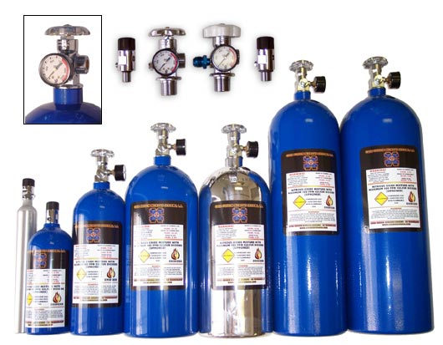
Inhalational
A)Gaseous:-
Nitrous oxide:-Non-irritating, non-inflammable,
gaseous anesthetic of low potency
Adv:-
Rapid induction/recovery
Good analgesic
Induction:-Time between administration of
anesthetic and development of Stage III plane
2

Slide 15
4) No ADR on CVS,RS, kidney & liver
5)Does not sensitize heart to CAs, no arrythmogenic potential
Disadv:- Devoid of muscle relaxation &
bronchodilatation
ADR:-prolonged exposure- megaloblastic
anemia, abortion & birth defects

Slide 16
Pharmacokinetics of Inhaled Anesthetics
Amount that reaches the brain
Indicated by oil:gas ratio (lipid solubility)
Solubility of gas into blood
The lower the blood:gas ratio, the more anesthetics will arrive at the brain
Notes:
Factors influencing the effects of inhaled anesthetics included:

Slide 17
Diffusion hypoxia / pneumothorax
NO has < soluble in blood
quickly moves out & passes into
alveoli & closed body compartment (during recovery phase)
Significantly lower conc of O2 in alveoli
**Presence of gas in different body compartments (sinuses)→ Pneumothorax→ Continued O2 administratn during recovery

Slide 18
2nd gas effect
The MAC of halothane/isoflurane required to produce anesthesia is reduced when given with NO→ Becoz conc of halothane/isoflurane required is reduced → S.E. are also reduced.
NO diffuses rapidly whereas halothane/isoflurane diffuse poorly into blood→when administered simultaneously halothane/isoflurane enter blood rapidly along with NO
Adv:- Faster recovery,dose is reduced.
Halothane/isoflurane is a potent anesthetic and poor analgesic whereeas NO is a good analgesic and poor anesthetic

Slide 19
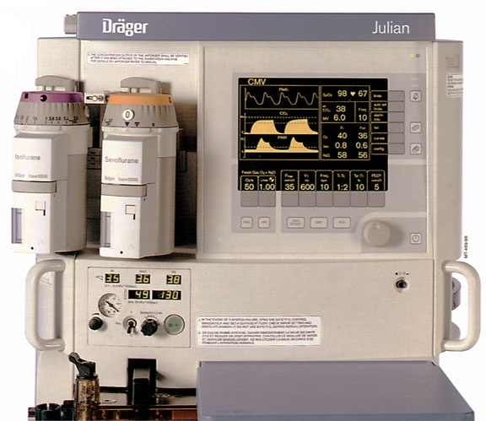
Volatile liquids
Halothane:- Widely
used , < expensive,
non-irritating, non-
inflammable,potent
anesthetic
Adv:-
1.Intermediate
onset/recovery
2.Good bronchodilator
→suitable for asthamatics
3.Non hepatotoxic for
children→ suitable for
paediatric use

Slide 20
Disadv:- poor analgesic & muscle relaxant
1.Hypotension
2. myocardial sensitivity to CA’s
3.Repeated use:- hepatic necrosis (interval of 2-3wks needed)
4.Postpartum hemorrhage
5.Malignant hyperthermia in genetically predisposed

Slide 21
Enflurane:- Non-irritating, non-inflammable
Adv:- Moderate bronchodilator & muscle
relaxant
Safer than halothane
Disadv:- Seizures (CNS excitation),
nephrotoxic (metabolized to fluoride
ions→polyuric renal failure)

Slide 22
Isoflurane:- Non-inflammable, pungent
Adv:- Widely used, safer than above mentioned drugs
Disadv:-Bronchial irritation, ppt MI, hypotension, reflex tachycardia

Slide 23
Desflurane:- non-inflammable, pungent
Adv:- Rapid induction/recovery hence
suitable for OPD surgery’s use
-Safer , good muscle relaxant
Disadv:- Bronchial irritant, post op N & V
Sevoflurane:- Non-pungent (suitable for
children), non-inflammable , potent
anaesthetic
Disadv:-Not a bronchodilator, N & V after
recovery

Slide 24
I.V. anesthetics
Fast inducers :- Used for induction,
maintained by inhalational+ NO
-2 groups - Barbituarates
-Non-barbituarates
Barbiturates:- eg-thiopental
-Rapid induction (<1min) & faster recovery
(due to redistribution)
-Can be used in cerebral oedema ( ICP)
Disadv:- No analgesia, no muscle
relaxation, causes laryngospasm, respiration

Slide 25
Non-barbiturates:-Propofol
-Very rapid induction & faster recovery (both redistribution+metabolism)
-Non-irritant to airway, least N & V after recovery
-Mild anti-convulsant, < laryngospasm
-MOST SUITED FOR OPD SURGERY
Disadv:- Low analgesic & muscle relaxant
property, hypotension, bradycardia, pain at
site of injection

Slide 26
Slow inducers:-Midazolam,Lorazepam
Slower action than barbituarates
I.V. adm→sedation, muscle relaxant, amnesia
No post op N & V
Midazolam:-Widely used:- better amnesia,
non-irritant to veins
Lorazepam:- Delayed awakening:-
>>sedative

Slide 27
Dissociative anesthesia:-ketamine
IV→ feeling of dissociation from
surrounding, profound analgesia,
immobility, bronchodilatation, amnesia with
light sleep
MOA:- Blocks action of glutamate (an
excitatatory NT at NMDA)
HR, BP , CO (CI in HT & angina)
ICP (CI:- epilepsy, cerebral odema)
*Recovery:-Emergence delirium (not suitable for psychiatric pts → frightening dreams)

Slide 28
Neurolept Analgesia
It is a combination of a highly potent (but
very short acting) opiod analgesic
FENTANYL+ DROPERIDOL D2 blocker
(with antiemetic action)
Use:- Short procedures→ endoscopies, burn
dressings, angiographies
ADR:-serious:-QT prolongation, chest
rigidity
Substituted:- Fentanyl/Sufentanyl/Remifentanyl+DZP

Slide 29
Ideally neurolept anaesthesia
Fentanyl+droperidol+NO+O2

Slide 30
Induction
intravenous
Faster onset
avoiding the excitatory phase of anaesthesia
inhalational
where IV access is difficult
Anticipated difficult intubation
patient preference (children)

Slide 31
Maintenance
Inhaled agents are supplemented by intravenous anaesthetics, such as opioids (usually fentanyl or morphine)

Slide 32
Balanced anesthesia
Aim is to achieve surgical stage III (plane2) anaesthesia with fewer SE
Fast inducer (thiopental) + opioid analgesic (pethidine/fentanyl) +SMR(pancuronium)+ NO+O2+inhalational anesthetic (sevoflurane)

Slide 33
Pre-anesthetic medication
It is the medication done before
anaestheisa to provide comfort to the
patient + minimize ADRs of GA:-
1.To reduce anxiety+produce amnesia:-BDPs
2.Sedation:-Promethazine :-antiemetic+sedative+anticholinergic→suitable for children
3.Analgesia:-Opioid analgesics:-morphine,pethidine

Slide 34
4.Reduce salivary & bronchial secretions:-glycopyrolate, hyoscine
5.Emesis:-Gastrokinetics-Metoclopromide,domperidone,ondansetron(5HT3 antagonist)
6.Acidity:-Ranitidine,omez

Slide 35
Complication of GA
Hypoxia
N,V
Dislocation of TM joint
Persisting sedation
Cardiac arrythmia esp with halothane
Hyperthermia
Subcutaneous emphysema of face

Slide 36
Conscious Sedation
Technique which produces a state of
depression of the CNS enabling treatment to
be carried out with verbal contact with the
patient throughout the period of sedation
The drugs should carry a margin of safety wide
enough to render loss of consciousness unlikely

Slide 37
Indications
1. Dental anxiety and phobia;
2. Prolonged or traumatic dental procedures;
3.Medical conditions potentially aggravated by
stress
4.Medical conditions affecting the patient’s
ability to cooperate
5.A special needs

Slide 38
Contraindications
1.COPD
2.Pregnancy
3.Prolonged surgery
4.Psychoses

Slide 39
Drugs Used
1.BZP’s:-
Diazepam 1-2mg i.v. or oral is the most commonly used drug
Midazolam is short acting,given i.v.
Temazepam orally , safe & better compliance
2.Nitrous oxide inhalational +100%O2
3.Chloral hydrate (orally), propofol (i.v.),fentanyl (i.v)

Slide 40
Precautions
1.Written informed consent from the patient prior to the procedure
2.S/b administered by a trained personnel
3.Constant monitoring of vital function during & after the procedure
4.Procedure s/b documented, post-op instructions s/b written
5.Emergency drugs & equipments s/b kept handy
6.Patient s/b escorted by a attendant

Slide 41
Key points for dentists
Ketamine s/b avoided in epileptics ( ppt seizures) & in patients with H/O psychiatric diseases
Thiopentone can cause RS depression
Sevoflurane/halothane along with NO & O2 can be used for induction & maintenance of anesthesia in children & adults
Isoflurane along with NO & O2 can be used for maintenance of anesthesia

Slide 42
2nd Last Slide
Commonly Asked Question
1.Diffusional hypoxia
2.Non-barbiturate anesthetics
3.Neurolept anesthesia
Preanaesthetic medication
Ketamine
Second gas effect

Slide 43
Last Slide
Reading List/Reference List
K.D. Tripathi

