Slide 1
ITS Dental College, Greater Noida
Subject : Pharmacology
Lecture Topic: Haematinics
Lecture Number: L37
Program, Year: BDS, Second Year
Faculty : Dr. Gore

Slide 2
Lecture Objectives & Learning Outcomes
General Objective : To understand Haematinics
Specific Learning Outcomes:
At the end of the session, the learner should be able to know the following
Iron preparations
Iron uses
T/t of Fe poisoning

Slide 3
Hematinics
Agents that help in formation of blood & treatment of anaemia
It includes:
Iron
Folic acid
& Vit. B12
Others: copper, pyridoxine etc (in small amt.)

Slide 4
Iron
Sources
Good amount in dry beans, dry fruit, wheat, yeast, amla, spinach, banana & apple
Meat, liver, egg yolk, chicken & fish
Poor in milk & root vegetables

Slide 5
Normal Hb levels: Male – 13.5-2-16 gm% Female – 12.5-13 gm% To raise Hb level by 1gm% ~200 mg elemental iron required Daily requirement of iron:
Males | 0.5-1 mg
Females (Menstruating) | 1-2 mg as they loose 30 mg in each cycle
Females (pregnant) | 3-5 mg
Infants | 0.06 mg/kg
Children | 0.025 mg/kg

Slide 6
Absorption occurs majority in the upper part of the intestine
-Dietary iron is present either as haeme(absorptn is better & direct)or as inorganic ferric form(major part of dietary iron)
-Needs to be reduced to the ferrous form before absorption
Transporters:-in the intestinal mucosal cells function to effect iron absorption
a) Luminal membrane the divalent metal transporter 1 (DMT1) carrys ferrous iron into the mucosal cellThis along with the iron released from haeme is transported across the basolateral membrane by another iron transporter ferroportin (FP)

Slide 7
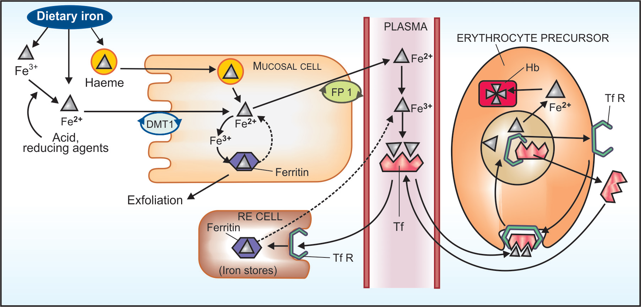

Slide 8
Factors affecting absorption
Absorption facilitated | Absorption decreased
Gastric acid (Favor dissolution & Fe ³⁺ → Fe ²⁺ ) | Antacids Calcium (milk & milk products)
Reducing substances ascorbic acid & SH containing amino acid (Fe ³⁺ → Fe ²⁺ ) | Phosphates (egg yolk) Phytates (maize, wheat) Tetracyclines,
Meat (heme iron): ↑ HCl secretion | Presence of other food in stomach
Notes:
There is no special mech. for iron excretion. Excreted by mucosal cell exfoliation. So excreted into the stools, traces in bile, urine & sweat.
Adult females loose iron during menstruation & child birth

Slide 10
Iron distribution in normal adult
 | Iron | Hemopoisis
Blood (hemoglobin) | 70% | Recycled
Stores (liver, spleen & BM) as ferritin | 13-18% | Available
Muscles (myoglobin) | 10-15% | No
Transport (transferrin) | 0.2% | Available
Enzymes (cyt oxidase) | 0.3% | No

Slide 11
Pharmacokinetics
diet iron
3+
erythropoiesis
Fe
Heme
Heme
RBC
2+
2+
3+
transferrin
Fe
Fe
+
Fe
ferritin
Duodenum &
upper Jejunum
mucosal cell
store
plasma
excreted
Mucosal block or “ferritin curtain”
Liver, spleen

Slide 12
-Gut has a mechanism to prevent entry of excess iron in the body
-Iron reaching inside mucosal cell is either a)Transported to plasma
b)Oxidised to ferric form + Complexed with apoferritin to form ferritin [stored in the mucosal cells and is lost when they are shed (lifespan 2–4 days):-‘Ferritin curtain
*Iron status of the body and erythropoietic
activity govern the balance between these two
processes, probably through a ‘haematopoietic
transcription factor

Slide 13
Transport:-Free iron is highly toxic
-On entering plasma it is immediately converted enzymatically to ferric form and complexed with a
glycoprotein transferrin (Tf)
Iron circulates in plasma bound to Tf
Iron is stored in RE cells (in liver, spleen, bone
marrow), as well as in hepatocytes and myocytes
as ferritin and haemosiderin

Slide 14
Apoferritin synthesis is regulated by iron status of the body
Low—>the ‘iron regulating element’ (IRE) on
mRNA is blocked—transcription of apoferritin
does not occur, while more Tf is produced.
-While more apoferritin is synthesized
to trap iron when iron stores are rich. Plasma
iron derived from destruction of old RBCs
(lifespan ~120 days), from stores and from
intestinal absorption forms a common pool that
is available for erythropoiesis, to all other cells
and for restorage

Slide 15
Absorbed in duodenum
Stored as: Fe ⁺³ + Apoferritin
Ferritin
Hemosiderin
available for hemoglobin synthesis
(Reticuloendothelial cells of liver, spleen, BM, Hepatocytes)
Notes:
Total body iron - adult males 50 mg/kg
- adult females 38 mg/kg

Slide 16
Introduction of iron therapy
Anemia – imbalance between production & destruction of RBC
Increased demand -Infancy & Childhood
-Pregnancy & Lactation
Acute/Chronic blood loss
Malabsorption – (small bowel disease) coeliac disease or post gastrectomy
Impaired red cell formation
Def. Of essential factors – Fe, B12, folic acid
BM depression – hypoplastic anemia

Slide 17
Calculation of iron requirement
Calculated amount of iron (mg) given for correction of anemia & replenishment of stores
4.4 x body wt (kg) x Hb deficit (g/dL)
0.66 x body wt (kg) x Hb % deficit
( Normal 100%)
Test dose – rule out hypersensitivity

Slide 18
Oral iron Therapy Ferrous sulfate, -gluconate, -succinate, -fumarate
As effective as parenteral if absorption from GIT is normal
Ferrous salts should be used
In Iron deficiency 50-100 mg elemental iron can be absorbed & utilized everyday
SR preps – Irrational – more expensive….
Liquid preps – stain teeth

Slide 19
Recommended dose: 200 mg /day by giving in 3 divided doses with meals (30% elemental iron)
* Prophylactic dose is 30 mg iron daily
In pregnancy, start iron therapy in 2nd trimester
Therapy continued for 3-6 months to replenish the iron stores
Anemia recovers in 1-3 months
Adequate response: ↑ in Hb by 0.5-1g/dl per week

Slide 20
Adverse effects of oral therapy
NV, Epigastric pain , Heart burn
Metallic taste
Staining of teeth
Constipation(astringent action of Fe)
Diarrhea – Local irritant action of Fe
Black colored stools
To avoid these….. Iron is given with food….
Failures of oral iron therapy
Incorrect diagnosis of primary cause
Continued iron loss due to bleeding
Malabsorption
Bone marrow suppression due to chronic diseases

Slide 21
Indications of parenteral therapy
Failure to absorb oral Fe – Malabsorption, Inflammatory bowel ds.
Severe deficiency with chronic bleeding
Non-compliance
ADRs to oral iron therapy
Patient is unable to tolerate oral iron therapy
*The ionized salts of iron used orally cannot
be injected because they have strong protein
precipitating action and free iron in plasma is
highly toxic
Notes:
No normal route of excretion of excess iron

Slide 22
Parenteral preparation
Iron dextran 100mg in 2 ml (i.v/ i.m)
-HMW-50mg elememtal Fe/ml
-I.M.-Absorbed thr’ lymphatics
-Injected muscle- 10–30% of the dose remains locally bound (unavailable for utilization for several wks)
-25% extra needs to be added to the calculated dose
Antigenic -anaphylactic reactions are more common than the newer preprations
I.M: Inj deeply in gluteal region using Z track technique (to avoid staining of the skin)
Can be injected 2 ml daily, or on alternate days, or 5 ml each side on the same day (local pain lasting weeks
may occur with the higher dose
Notes:
Iron sorbitol should not be given i/v b’coz it will cause rapid saturation of transferrin receptors, which can cause more iron toxicity due to more free iron.

Slide 23
I.V: After a test dose of 0.5 ml inj i.v. over 5–10 min, 2 ml can be injected per day taking 10 min for the injection
Alternatively, the total calculated dose is diluted
in 500 ml of glucose/saline solution and infused
i.v. over 6–8 hours under constant observation.
Injection should be terminated if the patient
complains of giddiness, paresthesias or tightness
in the chest
Adverse effects
Local Pain i.m. injection, pigmentation of skin, sterile abscess—especially in old and debilitated patient.
Systemic Fever, headache, joint pains, flushing,
palpitation, chest pain, dyspnoea, lymph node
enlargement
An anaphylactoid reaction resulting in vascular
collapse and death occurs rarely.

Slide 24
Ferrous-sucrose :- Newer , HMW complex of iron hydroxide with sucrose
- Safer and a dose of 100 mg (max 200 mg) can be injected i.v. taking 5 min, once daily to once weekly till the total calculated dose (including that to replenish stores) is administered. However, total dose i.v. infusion is not possible. The solution is highly alkaline ruling out i.m./s.c. injection.
The incidence of hypersensitivity reaction is very low. Though, some consider a test dose to be unnecessary, the British guidelines recommend it before the first dose
Indicated :-Anaemia in kidney disease ( reports of kidney damage are on record. Oral iron should not be given concurrently and till 5 days after the last injection.

Slide 25
Ferric carboxymaltose It is the latest formulation of iron in which a ferric hydroxide core is stabilized by a carbohydrate shell
It is administered either as daily 100 mg i.v. injection, or upto 1000 mg is diluted with 100 ml saline (not glucose solution) and infused i.v. taking 15 min or more. Infusion may be repeated after a week
*Not be injected i.m.
-Due to lack of safety data, it is not recommended for children <14 years

Slide 26
Use
1.Iron deficiency anaemia:-Iron should be normally administered orally; parenteral therapy is to be reserved for special circumstances
2. Megaloblastic anaemia When brisk
haemopoiesis is induced by vit B12 or folate
therapy, iron deficiency may be unmasked. The
iron status of these patients should be evaluated
and iron given accordingly

Slide 27
Iron poisoning
Acute: In children accidental intake of many iron tablets
Antidote: Desferrioxamine (i/m inj)
Dimercaprol(BAL) in C/I as it’s complex with iron is itself toxic
Chronic iron overload: in thalassemia pt
Chelating agent DEFERIPONE (Oral )

Slide 28
Treatment of iron poisoning
ABCD of resuscitation
Gastric lavage with 1% sod bicarbonate
Admn of milk or egg yolk
Specific iron chelating agents:
Desferrioxamine mesylate (5-10g in 100ml isotonic saline)
Calcium diethylene triamine pentacetate (DTPA)
Calcium disodium acetate
Electrolytes / other fluids – correc of metabolic acidosis, hypotension
Other supportive measures eg anticonvulsants for convulsions

Slide 29
Folic acid
-Consists of:
Pteridine
PABA
Glutamic acid/ polyglutamates

Slide 30
Role in:
1.Conversion of homocysteine to methionine →1-C transfer reac
2. Generation of thymidylate, an essential
constituent of DNA
3. Purine synthesis

Slide 31
Daily requirement
Adults ≤ 0.1 mg/day
Pregnancy and lactation 0.8mg/day
Absorbed from intestine by passive diffusion
Part of it by specific carrier mediated transport
Stored in liver
Undergoes enterohepatic circulation

Slide 32
Deficiency
due to
leads to
Inadequate intake
Malabsorption
Biliary fistula
Increased demand
Chronic alcoholism
Drug induced i.e prolonged therapy with
a) Anticonvulsants: phenytoin
b) Oral contraceptives
Megaloblastic anemia (indistinguishable from vit B₁₂ def)
Glossitis
Enteritis
Diarrhea
Steatorrhoea
Weight loss
Sterility
General debility

Slide 33
Therapy
Orally: given as 2-5 mg/day in deficiency states
Prophylactic dose: 0.5 mg/day
Injectable preparations: used only in malabsorption

Slide 34
Uses
Megaloblastic anemia due to nutritional deficiency
Methotrexate toxicity (Folinic acid / Leucovorin / citrovorum factor / formyl THFA is used)
Antiepileptic therapy
Pernecious anemia
Pregnancy & lactation (to prevent neural tube defects)
Malabsorption syndrome
Prophylaxis of folate deficiency

Slide 35
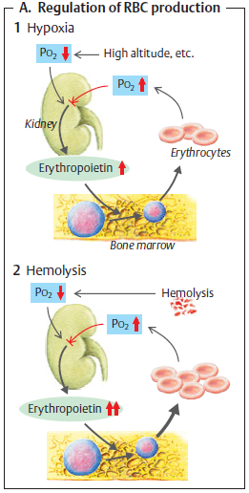
Hormone produced by kidney (peritubular cells)
Erythropoetin (Epoeitin):
Dose-dependent erythropoesis No effect on RBC life-span
Adm by i.v or s.c route
Erythropoetin

Slide 36
Uses:
Anaemia of chronic renal failure
Anaemia in AIDS pt treated with zidovudine
Cancer chemotherapy induced anaemia
Preoperative to autologous transfusion during surgery

Slide 37
Adverse Effects: d/t sudden ↑ in hematocrit, blood viscosity, peripheral vascular resistance
↑d clot form^{n} in AV shunts in dialysis pt’s
Hypertensive episodes, seizures
Flu-like symptoms lasting for 2-4 hrs

Slide 38
2nd Last Slide
Iron prepartions and uses
T/t of Fe poisioning
Reading List/Reference List
K.D. Tripathi

