Slide 1
ITS Dental College, Greater Noida
Subject : Pharmacology
Lecture Topic: Introduction to Autonomic system
Lecture Number: L15
Program, Year: BDS, Second Year
Faculty : Dr. Shobha

Slide 2
Lecture Objectives & Learning Outcomes
General Objective : To understand the various routes of absorption
Specific Learning Outcomes:
At the end of the session, the learner should be able to know the following regarding autonomic system
1.Parts of ANS
2.Neurotransmission in ANS
3.Regulation of catecholamine's
4.Metabolism of catecholamine's
5.Types of receptors in ANS

Slide 3
Autonomic nervous system (ANS) functions
largely below the level of consciousness and
controls visceral functions
-HR
-BP
-Blood flow

Slide 4
Autonomic Nervous System
Central Nervous System (CNS) - Brain and spinal cord
Peripheral Nervous System (PNS) - Located outside the brain & spinal cord
* Autonomic Nervous System (ANS) & the somatic
The PNS receives stimuli from the CNS & initiates responses to the stimuli after it’s interpreted by the brain
Central Nervous System (CNS) - Brain and spinal cord
Peripheral Nervous System (PNS) - Located outside the brain & spinal cord
* Autonomic Nervous System (ANS) & the somatic
The PNS receives stimuli from the CNS & initiates responses to the stimuli after it’s interpreted by the brain
Central Nervous System (CNS) - Brain and spinal cord
Peripheral Nervous System (PNS) - Located outside the brain & spinal cord is divided into:-
- Autonomic Nervous System (ANS) & Somatic Nervous System
The PNS receives stimuli from the CNS & initiates responses to the stimuli after it’s interpreted by the brain

Slide 5
Autonomic Nervous System
ANS acts on smooth muscles & glands
- Controls & regulation of the heart, respiratory. system, GI tract, bladder, eyes & glands
- Involuntary - person has little or no control
Somatic - voluntary - person has control (skeletal muscle)

Slide 6
 | Somatic | Autonomic
Organ supplied | Skeletal muscles | All other organs
Nerve fibres | Myelinated | Pregang.—myelinated Postgang.—non-myelinated
Primary efferent transmitter | Acetylcholine | Acetylcholine, Noradrenaline
Effect of nerve section on | Paralysis and atrophy | Activity maintained

Slide 7
NT’s
NT of all preganglionic autonomic fibers & most postganglionic parasympathetic fibers are ACh
Majority of postganglionic sympathetic fibers are adrenergic & NT is NA
Terms cholinergic & adrenergic describe neurons that liberate Ach & NE respectively

Slide 9
NEUROHUMORAL TRANSMISSION
Neurohumoral transmission implies that nerves
transmit their message across synapses and
neuroeffector junctions by the release of
humoral (chemical) messengers

Slide 10
Cotransmission
In the ANS, besides the primary transmitters
Ach & NA, neurones have been found to elaborate purines (ATP, adenosine), peptides (vasoactive intestinal peptide or VIP, neuropeptide-Y or NPY, substance P, enkephalins, somatostatin, etc.), nitric oxide (NO) and prostaglandins as
cotransmitters

Slide 11
Functions of ANS
Maintain internal environment of the organism
Sympathetic :- Not essential for life; but it is very essential in stress
Eg:-
a) Maintenance of body temperature when
environmental temp varies
b)Conc of glucose will not rise as per need in crisis
c)Compensatory vascular response to haemorrhage, O2 deprivation & excitement are lost

Slide 12
Effects of sympathetic discharge are:-
1.HR rises
2.BP rises
3.Blood flow is shifted from skin to skeletal muscles
4.Blood glucose rises
5.Bronchioles & pupils dilate
**Organism better prepared for “flight or fight”

Slide 13
Parasympathetic system
1.Conservation of energy & maintenance of
organ function during periods of minimal activity
2.Important for survival
Effects:-
Slows the heart rate, decreases BP, stimulated GI
movements & secretions, aids absorption of
nutrients, protects retina from excessive
light, empties urinary bladder & rectum

Slide 14
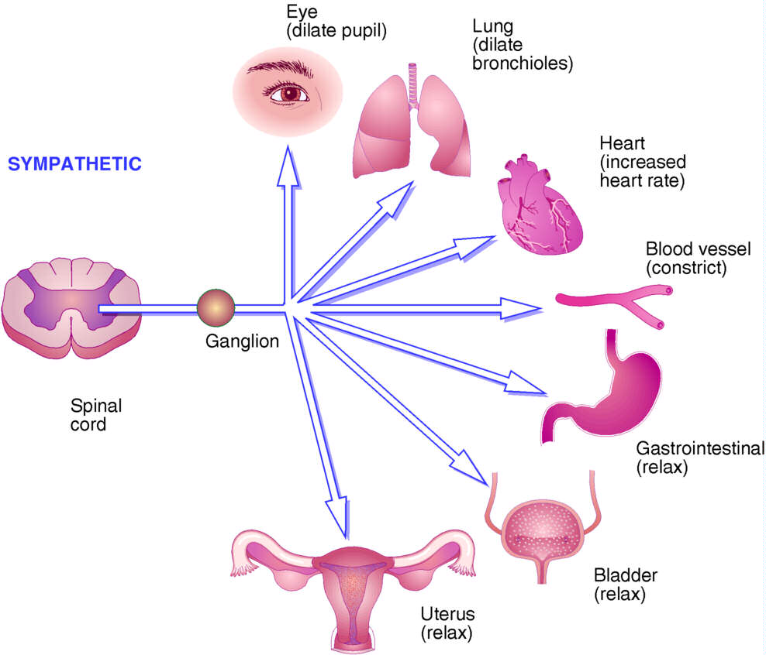
SYMPATHETIC RESPONSES

Slide 15
Catecholamines (CAs)
Three closely related endogenous catecholamines (CAs)
a)Noradrenaline (NA) Transmitter at postganglionic
sympathetic sites (except sweat glands, hair follicles and some
vasodilator fibres) and in certain areas of brain
b)Adrenaline (Adr) It is secreted by adrenal medulla and may
have a transmitter role in the brain
c)Dopamine (DA) It is a major transmitter in basal ganglia,
limbic system, CTZ, anterior pituitary, etc. and in a limited
manner in the periphery

Slide 16
Synthesis of NA occurs in all adrenergic
neurones, while that of Adr occurs only in the
adrenal medullary cells
* It requires high concentration of glucocorticoids
reaching through the intraadrenal portal
circulation for induction of the methylating
enzyme

Slide 17
Synthesis of CAs
-CA are synthesized from the
a.a. phenylalanine
-Tyrosine hydroxylase
is a specific and the rate limiting
enzyme. Its inhibition by α-
methyl-p-tyrosine results in
depletion of CAs
This inhibitor can be used in
pheochromocytoma before
surgery and in inoperable cases

Slide 18
Storage of CAs
NA stored :-synaptic vesicles or
‘granules’ (within adrenergic nerve
terminal)
The vesicular membrane actively
takes up DA from the cytoplasm
Final step of synthesis of NA takes
place inside the vesicle which
contains dopamine β-Hydroxylase
.

Slide 19
NA is then stored as a complex
with ATP
In adrenal medulla NA formed
within chromaffin granules
diffuses into the cytoplasm→
methylated →Adr so formed
is again taken up by a separate
set of granules
Cytoplasmic pool of CAs kept low
by monoamine oxidase (MAO)
present on the outer surface of
mitochondria

Slide 20
Release of CAs
The nerve impulse coupled
release of CA takes place by
exocytosis and all the
vesicular contents (NA or Adr,
ATP, dopamine β hydroxylase,
chromogranin) are poured
out

Slide 21
Uptake occurs in 2 steps—
Axonal uptake:- An active amine
pump (NET) present at the
neuronal membrane which
transports NA by a Na+ coupled
mechanism
It takes up NA at a higher rate
than Adr and had been labelled
uptake-1
The indirectly acting
sympathomimetic amines like
tyramine, but not isoprenaline,
also utilize this pump for entering
the neurone.

Slide 22
This uptake is the most important mechanism
for terminating the postjunctionalaction of NA
From 75% to 90% of released NA is retaken back
into the neurone
This pump is inhibited by cocaine, desipramine
and few other drugs

Slide 23
Vesicular uptake:-
Membrane of intracellular
vesicles has another amine pump
the‘vesicular monoamine
transporter’ (VMAT-2)→
transports CA from the cytoplasm
to the interior of the storage
vesicle
Vesicular NA is constantly leaking
out into the axoplasm and is
recaptured by this mechanism

Slide 24
This carrier also takes up DA formed in the
axoplasm for further synthesis to NA
Thus,it is very important in maintaining the NA
content of the neurone. This uptake is inhibited
by reserpine, resulting in depletion of CAs

Slide 25
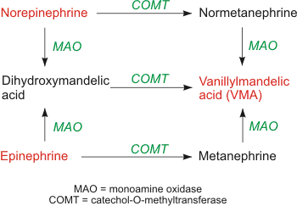
Metabolism of CAs

Slide 26
Part of the NA leaking out from vesicles into cytoplasm is taken up
by axonal transport is first attacked by MAO
While that which diffuses into circulation is first acted upon by
catecholo-methyl transferase (COMT) in liver and other tissues
In both cases, the alternative enzyme can subsequently act to produce
vanillylmandelic acid (VMA)
The major metabolites excreted in urine are VMA and 3-methoxy-4-
hydroxy phenyl glycol (a reduced product) along with some
metanephrine, normetanephrine and 3,4 dihydroxy mandelic
acid

Slide 27
Adrenergic receptors
Adrenergic receptors are membrane bound G-protein coupled
receptors which function primarily by increasing or decreasing
the intracellular production of second messengers cAMP or
IP3/DAG
Ahlquist (1948) classified adrenergic receptors in:-
Αlpha & Beta receptors

Slide 28
Types of Adrenergic Receptors
Agonist affinity of alpha (α):
noradrenaline > adrenaline > isoprenaline
Antagonist :-Phenoxybenzamine
Effector pathway :-IP3/DAG, cAMP and K+ channel opening
A gonist affinity of beta(β):
isoprenaline > adrenaline > noradrenaline
Antagonist :- Propranolol
Effector pathway :-cAMP and Ca+ channel opening

Slide 29
functions of sympathetic nervous system receptors
Alpha 1—smooth muscle contraction
Alpha 2(autoreceptor)-negative feedback causes less NE to be released so BP is reduced
Alpha 1a,1b,1d.& alpha 2 a,2b,2c
Beta 1—increased heart rate
Beta 2—bronchodilation
Beta 3—actual site for lipolysis

Slide 30
Differences between α1 and α2
 | Alpha-1 | Alpha-2
Location | Post junctional | Prejunctional/Post--
Function | Stimulatory – GU, Vasoconstriction, gland secretion, Gut relaxation, Glycogenolysis | Inhibition of transmitter release, vasoconstriction, decreased central symp. Outflow, platelet aggregation
Agonist | Phenylephrine, Methoxamine | Clonidine
Antagonist | Prazosin | Yohimbine

Slide 31
Differences between β1, β2 and β3
 | Beta-1 | Beta-2 | Beta-3
Location | Heart and JG cells | Bronchi, uterus, Blood vessels, urinary tract, eye | Adipose tissue
Agonist | Dobutamine | Salbutamol | -
Antagonist | Metoprolol, Atenolol | Alpha-methyl propranolol | -
Relative potency | NA < Adr | NA << Adr | Strong

Slide 32
β2 Adrenoceptor – Clinical Effects
Bronchi -- Relaxation
Arterioles -- Dilatation
Uterus – Relaxation
Skeletal Muscle - Tremor
Hypokalaemia
Hepatic Glycogenolysis

Slide 33
Dopamine receptors
D1-receptors are post synaptic receptors located in blood vessels and CNS
D2-receptors are presynaptic present in CNS, ganglia, renal cortex

Slide 34
2nd Last Slide
Commonly Asked Questions
Types of receptors in ANS

Slide 35
Last Slide
Reading List/Reference List
K.D. Tripathi

