Slide 1
-Routes of drug administration -Pharmacokinetics -Pharmacodynamics

Slide 2
Routes
Local Systemic
Enteral Parenteral Others
Topical Deeper tissue ↓
IM IV SC ID
Skin MM
Oral SL Rectal
Local Interarterial
Inhalational Nasal TD

Slide 3
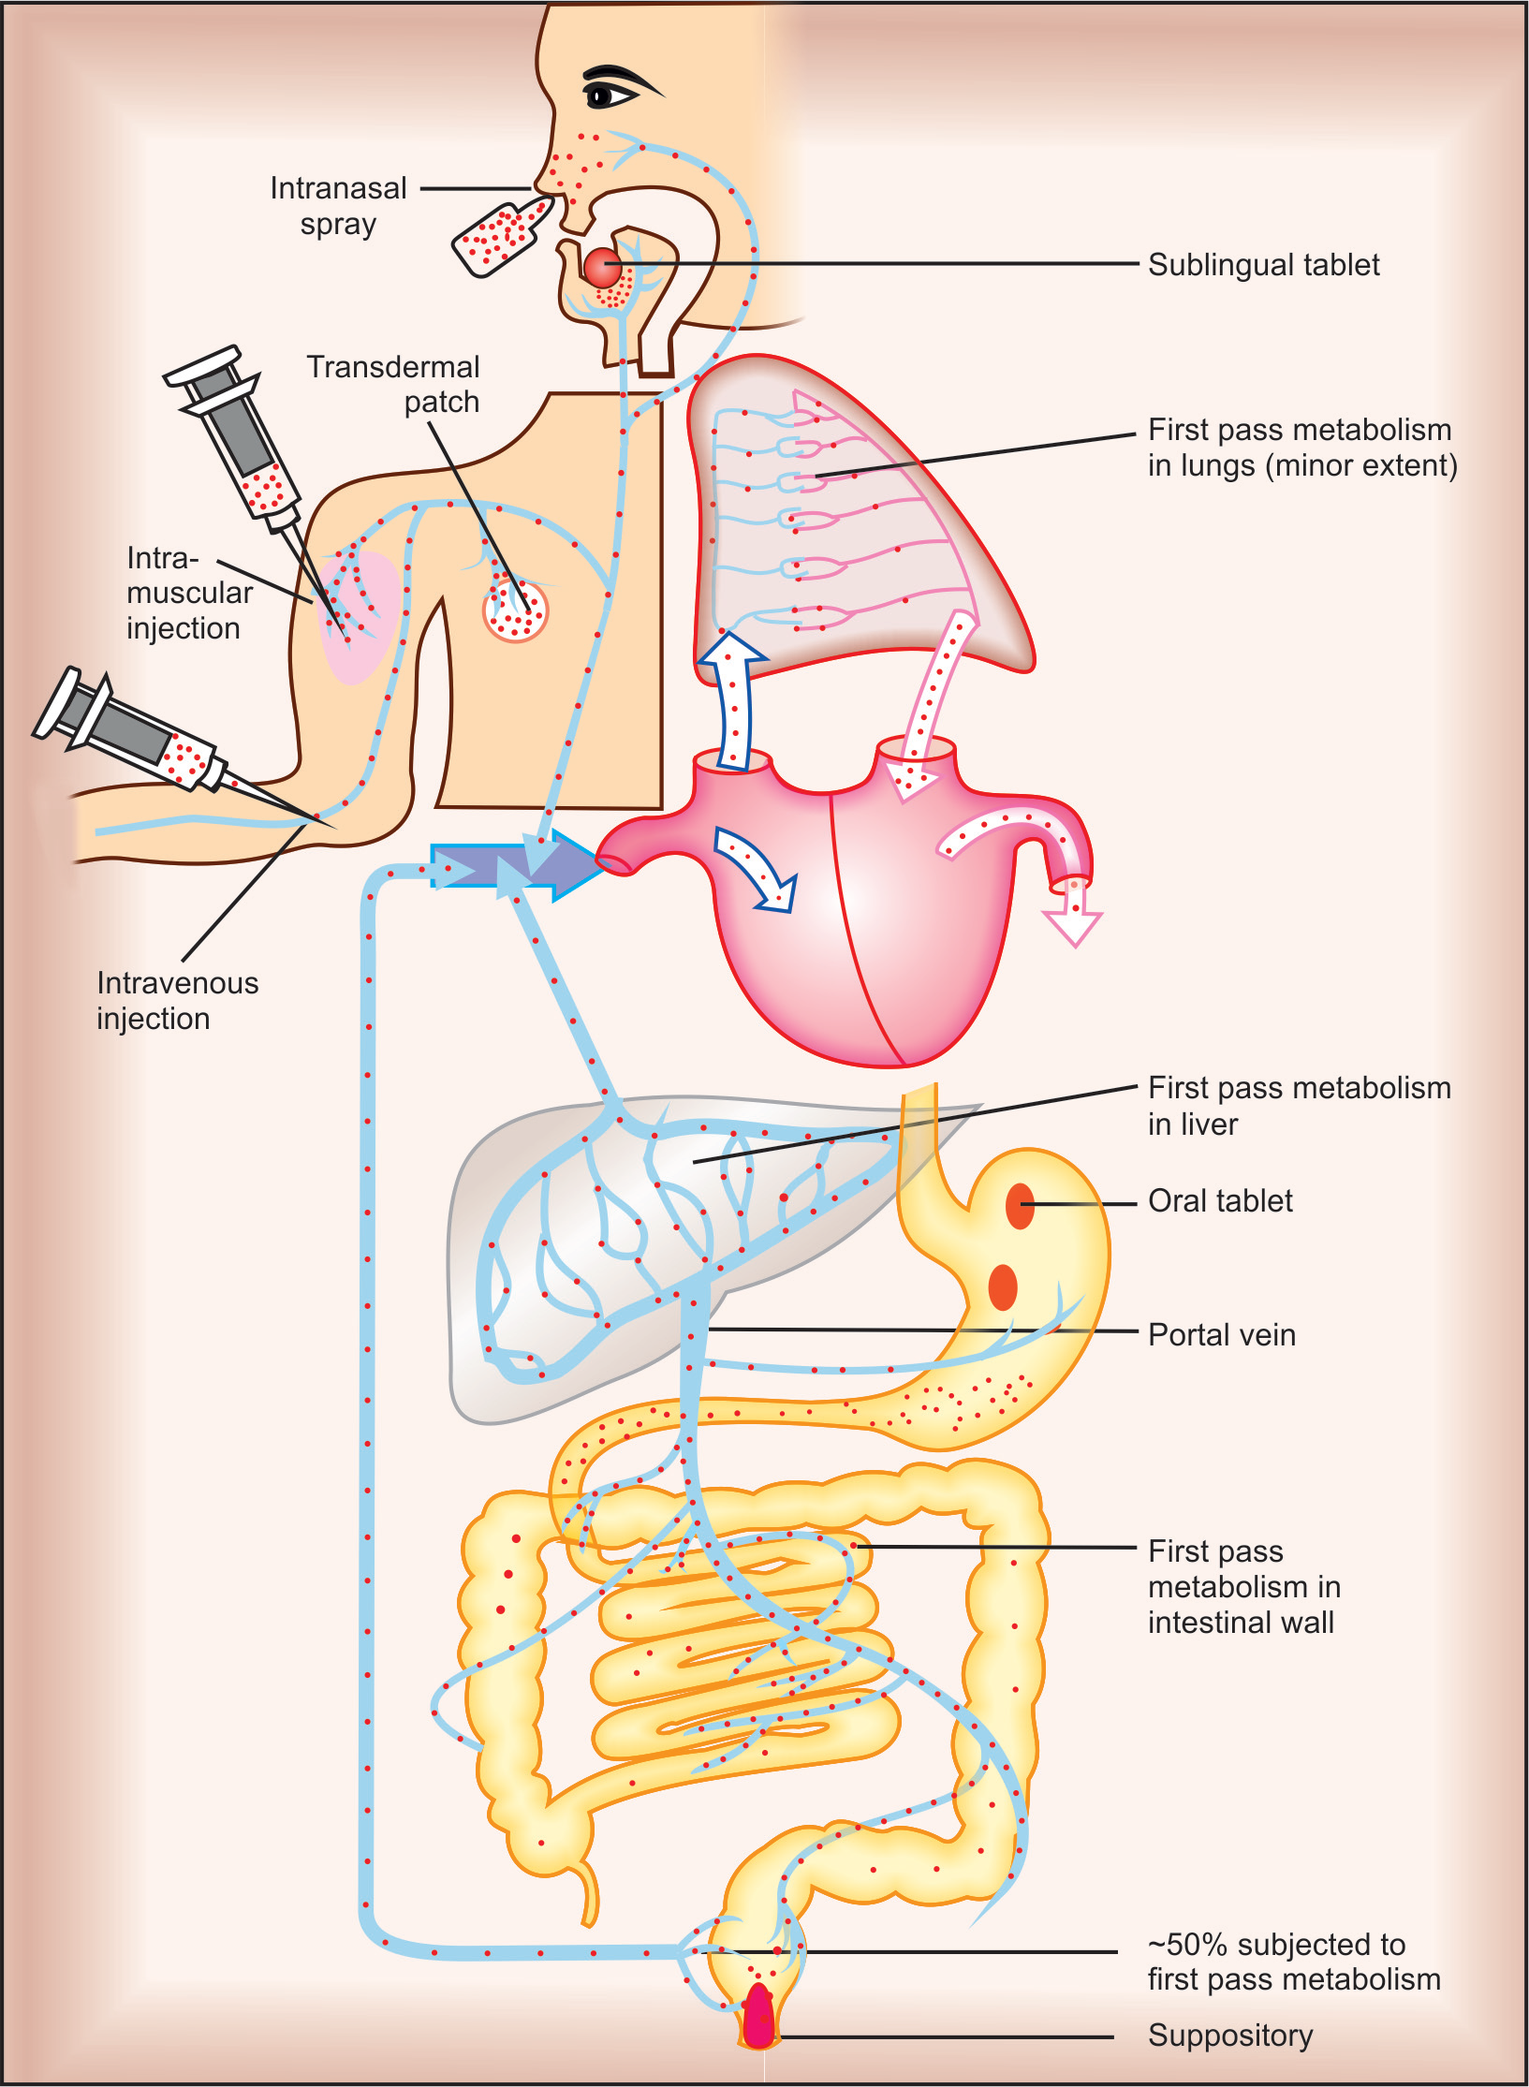
Routes of administration

Slide 4
Topical
Skin
Mucous membranes-
Mouth & pharynx
Eyes, nose & ear
GIT - Neomycin, sucralfate
Bronchi - salbutamol, steroids
Genitourinary tract
Anal canal

Slide 5
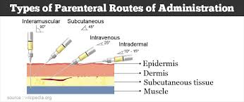

Slide 6
Absorption
The first stage for the drugs to reach to their target organs is known as “absorption”.
In fact, the absorption is the transportation of the drug across the biological membranes
There are different mechanisms for a drug to be transported across a biological membrane:
Passive (simple) diffusion
Active transport
Pinocytosis
Facilitated diffusion

Slide 7
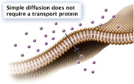
SIMPLE (PASSIVE) DIFFUSION
The major role for the transportation of the drugs across the cell membrane is simple (passive) diffusion.
The substances move across a membrane according to a concentration gradient.
The concentration gradient is the factor that determines the route and rate of the diffusion.
No energy is required.
There is no special transport (carrier) protein.
No saturation.

Slide 8
ACTIVE TRANSPORT
The transportation of the drug molecules across the cell membrane against a concentration or an electrochemical gradient.
It requires energy (ATP) and a special transporter (carrier) protein.
There is «transport maximum» for the substances (the rate of active transport depends on the drug concentration in the enviroment).

Slide 9
FACILITATED DIFFUSION
Occurs by the carrier proteins.
Net flux of drug molecules is from the high concentration to low concentration.
No energy is required.
Saturable.

Slide 10
Distribution
Apparent volume of distribution (Vd) =
Amt of drug in body/plasma drug conc
VOLUME OF DISTRIBUTION FOR SOME DRUGS
DRUG Vd (L)
cocaine 140
clonazepam 210
amitriptyline 1050
amiodarone ~5000

Slide 11
TOTAL BODY WATER
Vascular
3 L
4% BW
Extravascular
9 L
13% BW
Intracellular
28 L
41% BW

Slide 12
Plasma Protein Binding
Many drugs bind to plasma proteins in the blood steam
Plasma protein binding limits distribution.
A drug that binds plasma protein diffuses less efficiently, than a drug that doesn’t.

Slide 13
BIOTRANSFORMATION (Metabolism)
-It is the chemical alteration of the drug in the body
-Renders nonpolar (lipid-soluble) compounds to polar (lipid
insoluble) so that they are not reabsorbed in the renal tubules and
are excreted
-Most hydrophilic drugs need little biotransformed and are largely
excreted unchanged !!!
Site :-liver, kidney, intestine, lungs and plasma

Slide 14
Biotransformation lead to :-
(i) Inactivation
(ii) Active metabolite from an active drug
(iii) Activation of inactive drug :-Few drugs are inactive as such
and need conversion in the body to one or more active
metabolites. Such a drug is called a prodrug eg:-Levodopa
Biotransformation reactions classified
Nonsynthetic/Phase I/Functionalization reactions: a functional
group is generated or exposed— metabolite may be active or
Inactive
(b) Synthetic/Conjugation/ Phase II reactions: an endogenous radical
is conjugated to the drug—metabolite is mostly inactive

Slide 15
Nonsynthetic reactions
Oxidation :- Involves addition of O2/ -vely charged radical or
removal of hydrogen/+vely charged radical
**Most important drug metabolizing reactions
(ii) Reduction :-Converse of oxidation and involves cytochrome P-450
enzymes working in the opposite direction
iii) Hydrolysis :-This is cleavage of drug molecule by taking up a
molecule of water
(iv) Cyclization:-This is formation of ring structure from a straight
chain compound, e.g. proguanil
(v) Decyclization :-This is opening up of ring structure of the cyclic
drug molecule, e.g. barbiturates,phenytoin

Slide 16
Synthetic reactions
Conjugation of the drug or its phase I metabolite with
an endogenous substrate,usually derived from carbohydrate or
amino acid, to form a polar highly ionized organic acid→ easily
excreted in urine or bile
-Conjugation reactions have high energy requirement
Glucuronide conjugation:-most important synthetic reaction
Carried out by a group of DP-glucuronosyl transferases (UGTs).
-Not only drugs but endogenous substrates like bilirubin,
steroidal hormones and thyroxine utilize this pathway
-Glucuronidation increases the molecular weight of the drug which
favours its excretion in bile.

Slide 17
Enzyme inducers
Drugs which increase the M of other drugs
Decreased response
**Dose of the affected drugs should be increased
G - Griseofulvin
P - Phenytoin
R - Rifampicin
S - Smoking
Cell - Carbamazepine
Phone - Phenobarbitone

Slide 18
Enzyme inhibitors
Vitamin - Valproate
K - Ketoconazole
Cannot - Cimetidine
Cause - Ciprofloxacin
Enzyme - Erythromycin
Inhibition - INH

Slide 19
FIRST PASS (PRESYSTEMIC) METABOLISM
This refers to metabolism of a drug during its passage from the
site of absorption into the systemic circulation
-All orally administered drugs are exposed to drug
metabolizing enzymes in the intestinal wall and liver (where
they first reach through the portal vein)
-Presystemic metabolism in the gut and liver can be avoided by
administering the drug through sublingual, transdermal
or parenteral routes

Slide 20
RENAL EXCRETION
-Excreting all water soluble substances
-Amount of drug or its metabolites ultimately
present in urine =
Glomerular Filtration+ tubular reabsorption
+tubular secretion

Slide 21
Tubular reabsorption
-By passive diffusion
-Depends on:- lipid solubility & ionization of the drug at the existing
urinary pH
-99% of glomerular filtrate is reabsorbed:-
Except :-Nonlipid-soluble & highly ionized drugs i.e.lipid soluble
drugs are reabsorbed

Slide 22
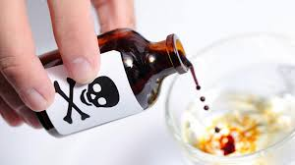
Acidic/basic poisoning
1.Weak bases ionize more and are less reabsorbed in acidic
urine
2. Weak acids ionize more and are less reabsorbed in alkaline
Urine
Hence, urine is alkalinized in barbiturate and salicylate
Poisoning
*Though elimination of weak bases (morphine,amphetamine)
can be enhanced by acidifying urine, this is not practiced
clinically, because acidosis can induce rhabdomyolysis,
Cardiotoxicity and actually worsen outcome

Slide 23
KINETICS OF ELIMINATION
Important for :-
a)Devising rational dosage regimens
b) Modify them according to individual needs
Drug elimination = Metabolic inactivation + excretion
Clearance (CL) The clearance of a drug is the theoretical volume of
plasma from which the drug is completely removed in unit time
CL = Rate of elimination/C
where C is the plasma concentration

Slide 24
First order kinetics
The rate of elimination is directly proportional to the drug
Concentration
CL remains constant
OR
a constant fraction of the drug present in the body is
eliminated in unit time;
**Majority of drugs which do not saturate the elimination processes

Slide 25
Zero order kinetics
The rate of elimination remains constant irrespective of drug
Conc
-CL decreases with increase in concentration
or
a constant amount of the drug is eliminated in unit time, e.g.
ethyl alcohol
**Also known as capacity limited elimination or Michaelis-
Menten elimination
-Plasma concentration increases disproportionately with
increase in dose, as occurs in case of phenytoin, tolbutamide,
theophylline, warfarin

Slide 26
Zero : -Zero order kinetics is shown by:-
W -Warfarin
A - Alcohol , Aspirin
T - Theophyline
T - Tolbutamide
Power - Phenytoin

Slide 27
Thank You

