Slide 1
ITS Dental College, Greater Noida
Subject : Pharmacology
Lecture Topic: Sedative Hypnotics
Lecture Number: L30
Program, Year: BDS, Second Year
Faculty : Dr. Rajeshwari

Slide 2
Lecture Objectives & Learning Outcomes
General Objective : To understand the various routes of absorption
Specific Learning Outcomes:
At the end of the session, the learner should be able to know the following regarding sedatives and hypnotics
1.What are sedatives and hypnotics
2.Classification
3.Barbiturates
4.Benzodiazepines
5.Newer non-benzodiapezines

Slide 3
Hypnotics & Sedatives
Hypnotic – Produce drowsiness and encourage onset and maintenance of sleep
Sedative/Anxiolytic - Agents which reduce anxiety and exert calming effect with little or no effect on motor or mental functions.

Slide 4
Difference between sedative and hypnotic
Sedatives and hypnotics depress the CNS & inhibit transmission of nerve impulses
Sedatives produce less response to stimuli without producing sleep.
Reduce anxiety and nervousness
Hypnotics have a more depressant effect on CNS and usually produce sleep

Slide 5
Sedative/Hypnotics
I. Barbiturates
II. Benzodiazepines
III. Newer nonbenzodiazepines

Slide 6
Classification
Barbiturates:
Phenobarbitone
Pentobarbitone
II.Benzodiazepines:
Diazepam
Nitrazepam
Midazolam
Lorazepam

Slide 7
_{Respiratory}
_{Depression}
_{BARBS}
_{BDZs}
_{Coma/}
_{Anesthesia}
_{Ataxia}
_{RESPONSE}
_{Sedation}
_{Anticonvulsant}
_{Anxiolytic}
_{DOSE}

Slide 8
Normal
➔
ANXIOLYTIC
_________ ➔ _________________
Drowsiness / increase reaction time
➔
HYPNOSIS
➔
Confusion, Delirium, Ataxia
➔
Surgical Anesthesia
➔ Coma
➔
DEATH

Slide 9
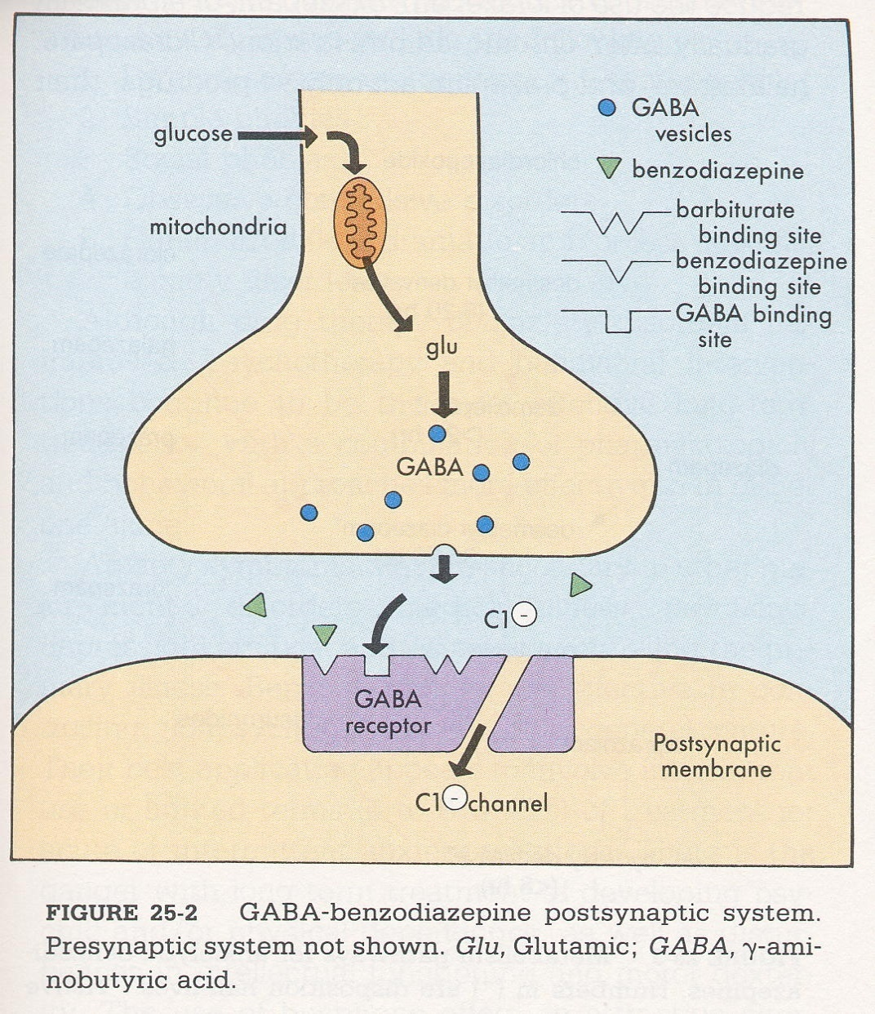
Mechanism of Action
The GABA receptor has a Cl⁻ channel , distinct binding sites for BZPs, barbiturates and GABA-like substances
GABA transmission exerts an inhibitory effect on NE, DA,5-HT), and ACh pathways

Slide 10
Sedative/Hypnotics
Barbiturates increase duration of channel opening
BZDs increase frequency of opening
_{BARBs}
_{BDZs}
GABA AGONISTS
_{γ}
_{α}
_{β}
_{β}
_{α}

Slide 11
Barbiturates:
Used clinically as anticonvulsant, preanesthetics and anti-anxiety drugs
Long acting Short acting Ultrashort
Phenobarbitone Secobarbitone Thiopentone
Mephobarbitone Pentobarbitone Methohexitone

Slide 12
Barbiturates
Can produce varying degrees of depression of the CNS, ranging from mild sedation to general anesthesia
In low doses - Calming effect ; phenobarbital →selective anticonvulsant properties
In moderate doses- Produce a drunken euphoric state, similar to alcohol
Sedation & sleep result from increasing doses
Higher doses produce surgical anesthesia
Ability to produce sedation & decrease sleep latency

Slide 13
Mechanism of action:
Act primarily at GABA:BZD receptor –Cl channel complex and potentiate GABA nergic inhibition by increasing life time of Cl channel opening
They do not bind to BZD receptor but bind to another site on the same complex to exert GABA facilitatory action

Slide 14
USES
1.Phenobarbitone in epilepsy
2. Thiopentone in anaesthesia
*As hypnotic and anxiolytic they have been
superseded by BZDs.
*Occasionally employed as adjuvants in
psychosomatic disorders.

Slide 15
Adverse effects
Listlessness & “hangover" effect
S/S: nausea, vomiting, dizziness
& emotional disturbance
May cause physical dependence with long use
Abrupt withdrawal can lead to seizures & death
Tolerance

Slide 16
Barbiturate poisoning
Respiratory depression ,circulatory shock
Asphyxia→ Pupil constriction f/b dilatation
Hypothermia
Renal failure
Pulmonary edema

Slide 17
Treatment
Gastric lavage
Maintenance of ABC
Oxygen inhalation
I.V.fluids
Forced diuresis
Alkalinization

Slide 18
Benzodiazepines
Antianxiety
Sedative-hypnotic
Amnesia
Anticonvulsant
Skeletal muscle relaxant

Slide 19
Benzodiazepines:
Long acting Short acting
Flurazepam Temazepam
Diazepam Midazolam
Nitrazepam Triazolam
Flunitrazepam

Slide 20
MOA
They enhance pre and post synaptic inhibition through a spc BZD receptor on GABA A receptor-Cl channel complex
This receptor increases frequency of Cl channel opening induced by submaximal GABA conc
They enhance GABA binding to GABA A receptor
They have GABA facilitatory not mimetic action

Slide 21
Actions
1. Sedation and hypnosis:
-They decrease time required to fall asleep (sleep latency)
The total sleep time is increased.
They shorten all stages of NREM sleep except stage 2, which is prolonged.
The duration of REM sleep is usually decreased.
BZDs reduce night awakenings and produce refreshing sleep.

Slide 22
At present, BZDs are the preferred drugs for treatment of short-term insomnia because: a)They have a wide therapeutic index.
b) They cause near-normal sleep; less rebound phenomena on withdrawal.
c) They produce minimal hangover effects (headache and residual drowsiness on waking).
d) They cause minimal respiratory depression. e)They are less likely to cause tolerance and dependence when used for short period.

Slide 23
f) They have no enzyme-inducing property; hence drug interactions are less.
g) They have a specific BZD receptor antagonist, flumazenil, for the treatment of overdosage.
* Long-term use of BZDs for insomnia is not recommended because of tolerance, dependence and hangover effects; but for occasional use by air travellers, shift workers, etc. these drugs are ideal.

Slide 24
2. Anticonvulsant: i.v.diazepam/lorazepam is used to control life-threatening seizures in status epilepticus, tetanus, drug-induced convulsions, febrile convulsions, etc. Clonazepam is used in the treatment of absence seizures.
3. Diagnostic (endoscopies) and minor operative procedures: I.V BZDs are used because of their sedative–amnesic–analgesic and muscle-relaxant properties.

Slide 25
4. Preanaesthetic medication: These drugs are used as preanaesthetic medication because of their sedative–amnesic and anxiolytic effects. Hence, the patient cannot recall the perioperative events later.
BZDs do not cause true general anaesthesia (GA). Intravenous diazepam, lorazepam, midazolam, etc. are combined with other central nervous system (CNS) depressants to produce GA.

Slide 26
5. Antianxiety (anxiolytic) effect: Selective antianxiety action at low doses due to their action on limbic system.
6. Muscle relaxant (centrally acting): They reduce skeletal muscle tone by inhibiting polysynaptic reflexes in the spinal cord. The relaxant effect of BZDs is useful in spinal injuries, tetanus, cerebral palsy and to reduce spasm due to joint injury or sprain.
7. To treat alcohol-withdrawal symptoms.
8. Conscious sedation:

Slide 27
Drug | Actions
Diazepam (prototype drug) | control convulsions but not for long-term therapy of epilepsy because of its sedative effect and rapid development of tolerance to anticonvulsant effect. • It can be used rectally to control convulsions
Flurazepam & Nitrazepam | Long duration,T/t of insomnia
Ozazepam | Antianxiety drug, can be used in liver dis pts
Lorazepam | Anticonvulsant, antianxiety and preanaesthetic medication
Alprazolam | antianxiety and antidepressant effects
Temazepam | Is short acting • Mainly used for insomnia
Triazolam | Has rapid onset of action; short acting • Mainly used for insomnia —reduces sleep latency
Midazolam | Rapid onset of action; short acting • Used as preanaesthetic medication, i.v. GA with other drug; status epilepticus not responding to other drugs
Chlordiazepoxide | Is long acting • Used in alcohol withdrawal and anxiety

Slide 28
Pk
-Large volume of distribution
Short duration of action on occasional use because of rapid redistribution, hence are free of residual (hangover) effects, even though elimination half-life is long.
Metabolized :- in liver (Some produce active metabolites that have long half-life; hence cumulative effects may be seen

Slide 29
ADRs
Wide margin of safety (well tolerated)
Side effects:- drowsiness, confusion, blurred vision, amnesia, disorientation, tolerance and drug dependence.
-Withdrawal after chronic use causes symptoms like tremor, insomnia, restlessness, nervousness and loss of appetite.
-Use of BZDs during labour may cause respiratory depression and hypotonia in the newborn (Floppy baby syndrome).

Slide 30
In some patients, these drugs may produce paradoxical effects, i.e. convulsions and anxiety.

Slide 31
Sedative Hypnotics
Tolerance
- Pharmacodynamic tolerance exists to most CNS depressants
-Tolerance of modest degree to sedative effects but not to respiratory depressant effects
- Cross-tolerance with alcohol, anesthetics and volatile intoxicants

Slide 32
Sedative Hypnotics
Acute Intoxication
Pupils are normal;
BP & respiration are depressed;
nystagmus on lateral gaze;
tendon reflexes depressed;
ataxia; slurred speech; confusion; coma;
shock => Risk of Death, particularly with BARBs.

Slide 33
Toxicity/Overdose with Benzodiazepines
Treatment of overdose:
Drug overdose is treated with flumazenil (BDZ receptor blocker, short half-life), but respiratory function should be adequately supported and carefully monitored
Seizures and cardiac arrhythmias may occur following flumazenil administration when BDZ are taken with TCAs
Flumazenil is not effective against BARBs overdose
No pharmacological treatment available for overdose with Barbiturates

Slide 34
Benzodiazepine Antagonist :-Flumazenil
Competitively reverses the effects of both BZD agonists (CNS depression) and BZD-inverse agonists (CNS stimulation)
It is not used orally because of its high ﬁ rst-pass metabolism. It is given by i.v. route and has a rapid onset of action.
Use:- treatment of BZD overdosage and to reverse the sedative effects of BZDs during general anaesthesia.

Slide 35
Adverse effects include confusion, dizziness and nausea. It may precipitate withdrawal symptoms (anxiety and convulsions) in dependent subjects

Slide 36
Diazepam
It is the oldest and all purpose
BZD, used as anxiolytic, hypnotic, muscle relaxant, premedicant, anaesthetic and for
emergency control of seizures due to its broad
spectrum activity

Slide 37
Benefits of BDZ over Barbiturates
High therapeutic index
Hypnotic doses does not affect respiration or CVS functions
No action on other body systems
Less distortion of sleep architecture, less rebound phenomenon
No microsomal enzyme induction
Lower abuse liability
BZD antagonist flumazenil has been developed

Slide 38
Drug-Drug Interactions with BDZs
BDZ's have additive effects with other CNS depressants (narcotics, alcohol) => have a greatly reduced margin of safety
BDZs reduce the effect of antiepileptic drugs
Combination of anxiolytic drugs should be avoided
Concurrent use with OTC antihistaminic and anticholinergic drugs as well as the consumption of alcohol should be avoided
SSRI’s & oral contraceptives decrease metabolism of BDZs

Slide 39
USES
As hypnotic
As anxiolytic and for day-time sedation
3.As anticonvulsant, especially emergency
control of status epilepticus, febrile
convulsions,tetanus, etc.
4. As centrally acting muscle relaxant
5. For preanaesthetic medication
6. Before ECT,

Slide 40
Newer nonbenzodiazepine hypnotics
Zopiclone
Zolpidem
Zaleplon

Slide 41
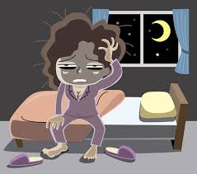
Zopiclone
Action on sleep similar but does not alter REM sleep & tends to prolong stage 3 & 4
No hangover or withdrawal phenomenon
Used for short term treatment of insomnia
Side effects: Metallic taste, impaired judgment, dry mouth

Slide 42
Zolpidem
Hypnotic effect is pronounced
No evidence of anticonvulsant, muscle relaxant & antianxiety effects
Use: in short term treatment of insomnia
Advantages:
Relative lack of effect on sleep stages
Minimal day time sedation
No rebound insomnia
Absence of tolerance and physical dependence

Slide 43
Sedative/Hypnotics
Flunitrazepam (Rohypnol; forget-me pill, Valium, R2,–
visual & gastrointestinal disturbances, urinary retention, memory loss for the time under the drug's effects
GHB (gamma-hydroxybutyrate; G, Georgia home boy, grievous bodily harm)-
drowsiness, nausea/vomiting, headache, loss of consciousness, loss of reflexes, seizures, coma, death

Slide 44
Antihistamine drugs
As benadryl that has side effect of sedation
Should not use with alcohol or other CNS depressant drugs. These may cause adverse interaction
Should seek medical help if insomnia continues for 2 weeks
Should not take unless can allow for full night sleep

Slide 45
2nd Last Slide
Commonly Asked Question
1.Diffrences between barbiturates and benzodiazepines
2.Mechanism of action of bariturates and benzodiazepines
3.Treatment of BZP overdose?
4.Treatment of insomnia

Slide 46
Last Slide
Reading List/Reference List
K.D. Tripathi

