Slide 1
Tetracycline

Slide 2
Classification on the basis of source
Natural:
Oxytetracycline, Demeclocycline
Semi-synthetic:
Tetracycline, Doxycycline and Minocycline

Slide 3
Spectrum of activity
Antimicrobial activity
Broad-spectrum bacteriostatic antibiotics
Gram +ve & gram -ve bacteria including anaerobes
Rickettsiae, chlamydiae and mycoplasm
Most gram-positive bacilli

Slide 4
Mechanism of action:- Bacteriostatic

Slide 5
Bacterial ribosomes consist of 50S & 30S subunit which combine to form 70S subunit
Mammalian ribosomes consist of 60S & 40S subunit to form 80S subunit
This difference provides basis for selective antimicrobial action
mRNA transcribed from DNA becomes attached to 30S→50S binds to 30S forming 70S→moves along the m-RNA so that successive codon of mRNA pass along ribosome from acceptor(A) site to peptidyl (P) site :- Initiation complex
*Codon:- triplet of 3 nucleotides carrying codes for a.a. needed for protein synthesis

Slide 6
t-RNA with its existing a.a. chain (A1-A3) is already attached at
the P-site of complex by complementary codon: anticodon pairing.
Incoming t-RNA carries a.a. residue (A4) to be added to growing
peptide chain
A4 will then bind to A site , A1-A3chain on the P site is
transferred to A site - transpeptidation
-Now A site has A1-A4 →t-RNA which has lost its peptide site is ejected out from P site, while t-RNA at A site is translocated to P site
-Freed A site is ready to receive next a.a
-During this process of translocation the ribosome moves on one codon relative to the messenger

Slide 7
Mechanism of action
Tetracyclines bind reversibly to the 30s subunit of bacterial ribosome
Block the binding of aminoacyl-tRNA to the acceptor site
Prevent the elongation of peptide

Slide 8
Pharmacokinetics
Oral absorption of most tetracyclines is incomplete & greater in the fasting state
High for doxycycline (95%) & minocycline (100%)
P.S.- not to be given with food
Have chelating property – Form insoluble and & unabsorbable complexes with Calcium, milk, Iron preparations, Sucralfate.

Slide 9
…Contd.
Excreted in urine- dose reduced in renal failure, except doxycycline
Cross placental barrier and excrete in milk
M.C Dosage form- oral capsules

Slide 10
Clinical uses(first choice)
Rickettsiae infections First choice
Chlamydial urethritis First choice
Plague , Cholera
Relapsing fever: Most effective
Atypical pneumonia, brucellosis
Gastric ulcer & duodenal ulcer caused by H. pylori in combination regimens

Slide 11
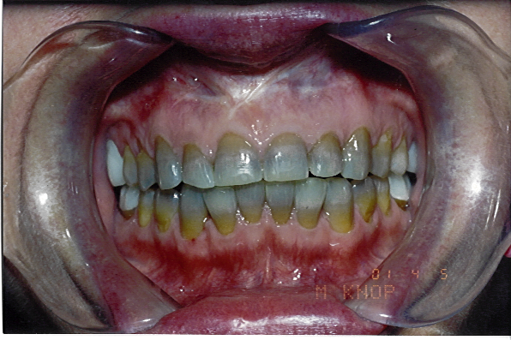
Adverse reactions
Gastrointestinal adverse effects
Superinfection
Most common antibiotics responsible
Intestinal superinfection - most prominent
Effects on bony structure and teeth
Teeth: fluorescence, discoloration and enamel dysplasia
Bone: deformity or growth inhibition

Slide 12
…Contd.
Liver and kidney toxicity
Fancony syndrome- due to usage after expiry- Proximal tubular damage
Hypersensitivity reactions: Rash, hives with itching, itching
Anaphylactic reactions
Phototoxicity: darkening of skin & sunburn when patient exposed to sunlight

Slide 13
Remember
Not to be used in pregnancy, lactation, and in children.
Used cautiously in hepatic & renal failure.
Never use after expiry date
Avoid with Diuretics, Ca++ suplements, Milk, and Iron.

Slide 14
CHLORAMPHENICOL
Mechanism of action
Inhibits protein synthesis ( 50 s subunit )
Antibacterial activity
H. Influenzae S. typhi
N. Meningitidis E. coli
S. Pneumoniae V.cholera
Ricketsiae Anaerobes- clostridium &
B. fragilis

Slide 15
Chloramphenicol ( cont. )
Pharmacokinetics
Rapidly & completely absorbed from GIT
30 % protein bound
Metabolized by liver – glucuronidation
Well distributed, including CNS and CSF
Excreted in urine

Slide 16
Chloramphenicol Cont. )
Clinical uses
Limited because of potential toxicities
(a plastic anaemia &circulatory collapse in neonates)
1. Typhoid fever- s. typhi ( quinolones are preffered)
2. Meningitis – H.influenzae,N.meningitidis,S.pneumoniae
( Ceftriaxone is preffered )
3. Anaerobic infections- B. fragilis
(Metronidazole is the drug of choice)
4. Rickettsial infections – Doxycycline is preffered
5. Bacterial conjunctivitis ( topical )

Slide 17
Chloramphenicol ( cont. )
Side effects
1.Hypersensitivity- low incidence
May ppt hemolysis in G6PD deficient pts
2. A plastic anaemia ( fatal )
3.Grey baby syndrome
4.Suprainfections
5. Interaction with other drugs :
Inhibits liver microsomal enzymes
Phenytoin
Tolbutamide
Chlorpropamide
Anticoagulants

